Slide 1
Creating Effective PowerPoints (For Teaching)
Prepared and Presented by
Dr. Dana Lynn Driscoll
CETL Faculty Fellow
Assistant Professor, Department of Writing and Rhetoric
driscoll@oakland.edu

Slide 2
Presentation Overview
Teaching vs. research presentations
Interactivity and engagement
Learning principles for using PPT
Basic principles of rhetoric and design
Discussion

Slide 3
Introductions
Please let us know:
  Your Name
  Your Department
  Courses you typically teach
  The size of your classes

Slide 4
Freewrite
The title of this talk is “Creating ‘Effective’ PowerPoints.” In a short freewrite, please consider:
How do you intend your students to use your PowerPoints?
How do your students actually use your PowerPoints?
How have you used PowerPoint in your past courses?
Do you feel this use was effective?

Slide 5
Teaching Students vs. Research Presentations
Research PowerPoints – present results of research or scholarship, aid for attendees, no quizzes/tests.
  Audience: high motivation/interest of attendees; attendees there of their own free will; no long-term learning/retaining of information necessary
Teaching PowerPoints –Goal is to facilitate student learning of content/knowledge/skill area. Can be used with lecture, discussion, groupwork, etc.
  Audience: Captive audience; retaining/long-term learning necessary
How does this change how we think about PowerPoint in the classroom?

Slide 6
PowerPoints for Teaching
Using PowerPoint a both teaching tools and study guides changes the nature and amount of information presented.
  Use “notes” to keep PowerPoints clean and uncluttered
PowerPoints as teaching aids to facilitate discussion, class time management, and groupwork
PowerPoints have a psychological component—students feel that PowerPoint's are important and are more likely to take notes
Notes:
Here is an example of the note feature in PPT. It allows for additional details without “cluttering” up slides.

Slide 7
Student Engagement
One of the challenges of PowerPoint as an instructional delivery system is that it can be a very passive learning environment.
What strategies have you used to make your PowerPoints more engaging and encourage active learning?
  How does this differ for small vs. large classes?

Slide 8
Student Engagement
Small Classes
Large Classes
Class discussions with questions embedded in PowerPoint material
Group work (even short, 5 minute discussions in pairs) breaks up lecture portions
The “think → pair → share” strategy works (demonstrate a point, have them freewrite, have them pair, and discuss)
Use of clickers, twitter feed, or other technology can aid in engagement
Short discussions among students with 3-4 groups reporting back (or all groups reporting to forum/twitter feed)
Good delivery helps (more later on this)!

Slide 9
Writing and Design: Which slide do you prefer?

Slide 10
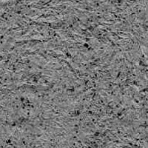
#1 Writing a Literature Review for a Scientific/IMRAD Article
When you are writing a scientific article, there are a number of sections to consider. First is the LITERATURE REVIEW (or Lit Review, Background and Significance, etc.)
The Literature Review allows you to do the following things:
  You need to establish your credibility as a researcher by demonstrating that you know the important literature (don’t cite all of the literature, just the most relevant and/or noteworthy)
  You can demonstrate how your research fills a gap in the existing body of research
Rhetorical Strategies for writing a literature review include:
  You can discuss approaches to studying the topic before, and why your approach is appropriate and builds upon previous research (or novel and new)
  You need to lead the reader through your arguments, so by the time they finish reading your lit review, your study seems like a natural next step
  Keep your writing focused only on the most important works—otherwise, your literature review will get out of control and be unfocused and lengthy
  A lit review is, in many ways, like a “story of research” on your topic
Notes:
Example of a particularly bad slide.

Slide 11
#2 Writing a Literature Review for a Scientific/IMRAD Article
When you are writing a scientific article, there are a number of sections to consider. First is the LITERATURE REVIEW (or Lit Review, Background and Significance, etc.)
The Literature Review allows you to do the following things:
  You need to establish your credibility as a researcher by demonstrating that you know the important literature (don’t cite all of the literature, just the most relevant and/or noteworthy)
  You can demonstrate how your research fills a gap in the existing body of research
Rhetorical Strategies for writing a literature review include:
  You can discuss approaches to studying the topic before, and why your approach is appropriate and builds upon previous research (or novel and new)
  You need to lead the reader through your arguments, so by the time they finish reading your lit review, your study seems like a natural next step
  Keep your writing focused only on the most important works—otherwise, your literature review will get out of control and be unfocused and lengthy
  A lit review is, in many ways, like a “story of research” on your topic
Notes:
Example of a cluttered slide.

Slide 12
#3 Writing Literature Reviews
Literature Reviews should:
  Building the author’s credibility through citation
  Demonstrating a “gap” in the existing research that your work fills
Rhetorical strategies for writing include:
  Justifying of method/approach using previous literature
  Building the argument that your work leads from existing literature and fills a gap
  Keeping focused on the “story” of the research
Lit Review
Methods
Results
Discussion
Notes:
Notice the use of parallel language and concise bullet points.

Slide 13
Writing a Good PowerPoint
Use Bullet points to increase scannability and readability
Avoid too large blocks of text; create concise language (my favorite method for learning concise language is here: https://owl.english.purdue.edu/owl/resource/635/01/)
Keep one idea to one slide rather than trying to cram (or add more slides for dense information)
Use parallel language (using the same verb tense at the beginning of each point, like in this slide)
Provide clear references for source material used (this helps students see the connections)

Slide 14
Designing a Good Powerpoint
Keep information straightforward
Include graphics and visuals, like “smart art” graphics, but don’t go overboard
Consider other multimedia elements, such as embedded short video clips, audio, etc.
Break up large portions of lecture with activities, freewrites, checks for understanding, short group work, discussions, etc.

Slide 15
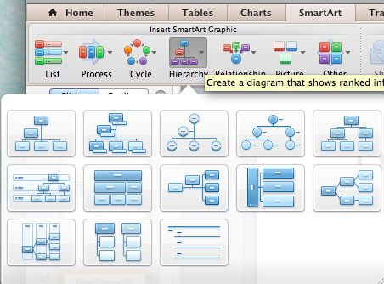
Tricks and Tips:
Smart Art in PPT
“Smart Art” allows for visualization of lists, relationships, cycles, and more.
Found under “Smart Art.” Very useful displaying information and relationships

Slide 16
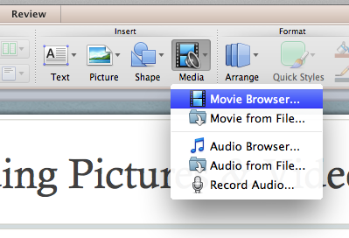
Tricks and Tips:
Embedding Pictures & Video
Microsoft’s Instructions for Embedding Photos/Clip Art:
  http://office.microsoft.com/en-us/powerpoint-help/insert-a-picture-or-clip-art-HA010079409.aspx
Microsoft’s Instructions for Embedding Video:
  http://office.microsoft.com/en-us/powerpoint-help/insert-video-into-your-presentation-RZ102673174.aspx
If you want to embed a Youtube video, the easiest way to do so is to either link to it or download it and embed directly. I prefer to link to the videos.
Note that some versions of PPT (such as Office 2011 for Mac, the version I’m running, do not allow you to insert videos from the web.) You just have to link to them.

Slide 17

Tricks and Tips:
Basic Design Principles
Think about what is most effective in terms of conveying information to your student audience.
  Limit the use of flashy colors and silly clip art (unless it serves an educational purpose)
  Keep fonts readable, consistent, and effective
  Limit the use of large blocks of text on a single slide
  Consider the design principles of contrast, alignment, repetition, and proximity
Pointless clip art?
Or, does this Rooster serve an
educational purpose?

Slide 18
Tricks and Tips:
Basic Design Principles, cont.
Alignment = Everything should look well placed, everything is connected with an “invisible line” (e.g. bullet points on top of each other)
Contrast = Difference, make elements that need to be different different (through font choice, formatting, offsetting text, etc.)

Slide 19
Tips and Tricks: Basic Design Principles, cont.
Repetition = Repetition is about unity, consistency, and creating cohesiveness (three slides with the same design and similar content)
Proximity = where things are placed in relationship to one another; where does your eye move? What is the path it takes?
*Information taken from Williams (2008) Non-Designer’s Design Book

Slide 20
Organizing PowerPoints
Find a partner or small group and consider the following questions:
How do you organize the content of Powerpoint presentations for your courses?
  What typically comes first, second, third, etc?
  What kinds of content is included in your Powerpoint?
  How do you break up long presentations of information/lectures?

Slide 21
Organization of a PowerPoint
Slide 1: Title
Slide 2: Overview - Provide students with a roadmap of where you are gong
For longer PowerPoints, provide SIGNPOSTS (slides that say, this is where we’ve been and here’s where we are going next)
Use notes area to supplement material-dense slides
Use text formatting and graphics to draw attention

Slide 22
Organization with Emphasis on Student Engagement (5o min class)
Introduction/Overview of what we will cover (1-2 min)
Short freewrite + class discussion on what students already know/prior experience (5-10 min)
Presentation of material (10-20 min). Includes 2-3 open-ended questions for students to break up presentation.
Groupwork on material to help solidify concepts (15 min) and final discussion or freewrite (5 min)

Slide 23
Delivery of a PowerPoint
Part of an effective PowerPoint is how its delivered/presented in a classroom
Students prefer faculty who are engaged and interested in the material (through enthusiasm in voice, engagement with subject, interesting stories)
Students also want to see clear connections to future careers and real life (this is a good activity to do with students at the beginning or end of a class session)
I find it helpful to talk about my own experiences, successes, and struggles in relationship to material and ask students to share theirs (if applicable)
I also find it helpful to include humor to keep students interested and engaged.
Question: What are your best tips for keeping things interesting in presenting a PowerPoint presentation in a class?

Slide 24
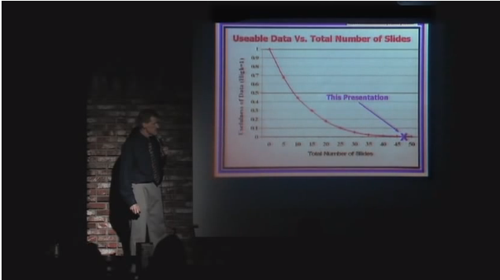
Example of Poor Delivery and Poor PPT Design
http://www.youtube.com/watch?v=lpvgfmEU2Ck

Slide 25

Online Delivery of PPT
Powerpoint does allow you to record a slide show, which can be useful for flipped classes, online courses, or polar vortex snow days.
  You need a microphone (or use your computer’s built in mic) for recording.
You can find the tools to record under Slide Show→ Presenter Tools

Slide 26
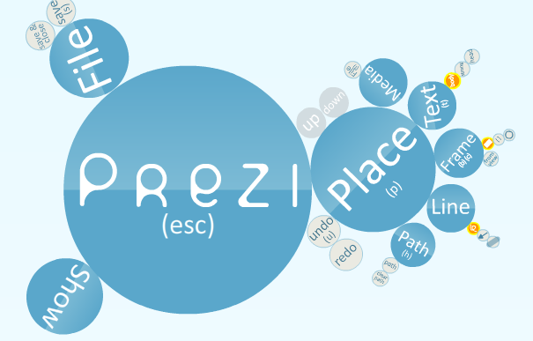

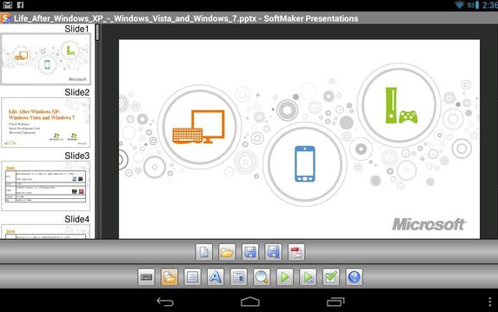
Alternatives to PowerPoint
Prezi (www.prezi.com)
Haiku Deck (iPad/web app) -
Softmaker Presentations (Android App) – Allows you to edit and open PPTS on Android.

Slide 27
Discussion Questions
What other ideas do you have for effective use of PowerPoints in class?
How do you use PowerPoint for online / flipped classes?
What challenges have you had with PowerPoint?
What is PowerPoint “good at” doing in classes? What is it “poor at” doing in classes?
What other questions do you have?

