Slide 1


A Disappearing Sun
Dr. Kapila Clara Castoldi
Physics Department
Oakland University

Slide 2
Solar Eclipses in Ancient Cultures
In India, the demon Rahu is beheaded when it tries to steal the nectar of immortality from the gods. As its head flies around the heavens, it swallows the Sun or the Moon...
Similarly, in China, Mongolia, and Siberia, beheaded mythical characters chase and consume the Sun and Moon…
In Indonesia and Polynesia, Rahu consumes the Sun, but the Sun burns its tongue, so it spits it out…

Slide 3
We will explore:
Solar and Lunar Eclipses
What does a Solar Eclipse look like
What will we see in Michigan
Tools for viewing Eclipses
Viewing the Eclipse Online
Solar Observatories – simulating the Eclipses

Slide 4
Solar and Lunar Eclipses
  Why do they happen
  Partial, annular and total eclipses
  Why do they fall on such a small area of our planet
  Why are solar eclipses so rare
  Why are solar eclipses so short

Slide 5
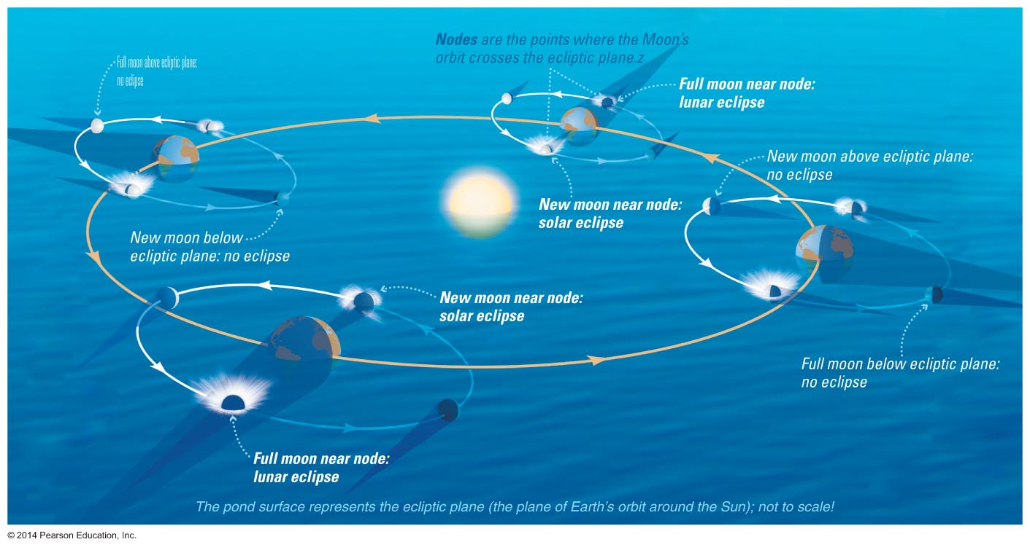
Every Month a New Moon and a Full Moon

Slide 6
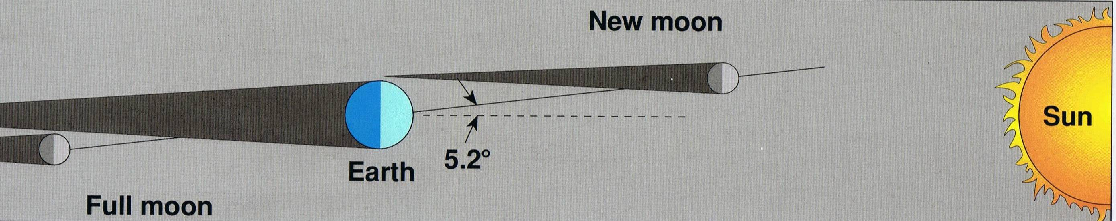
Why don’t we have an eclipse every month?
The Moon’s orbit is tilted by 5° to the ecliptic plane

Slide 7
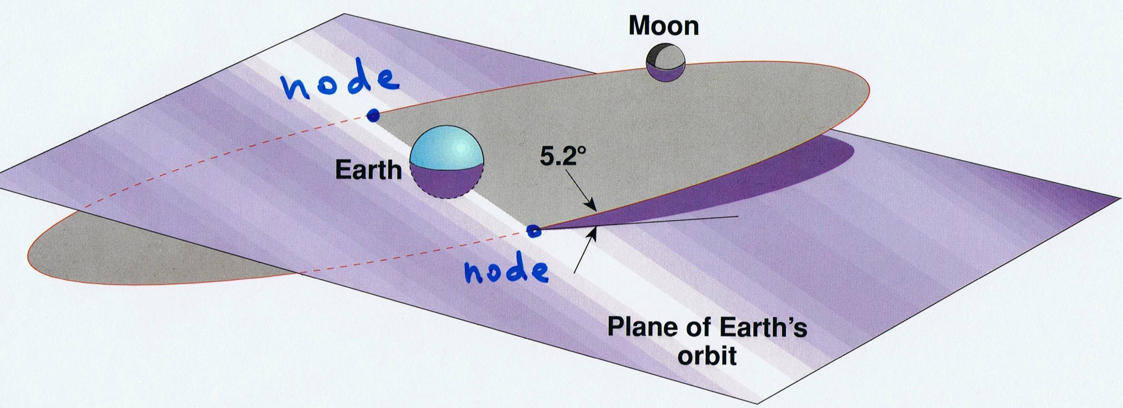
When do eclipses happen then?
Only at the Nodes, when
  the Moon’s orbit intersects Earth’s orbit
Node
Node

Slide 8
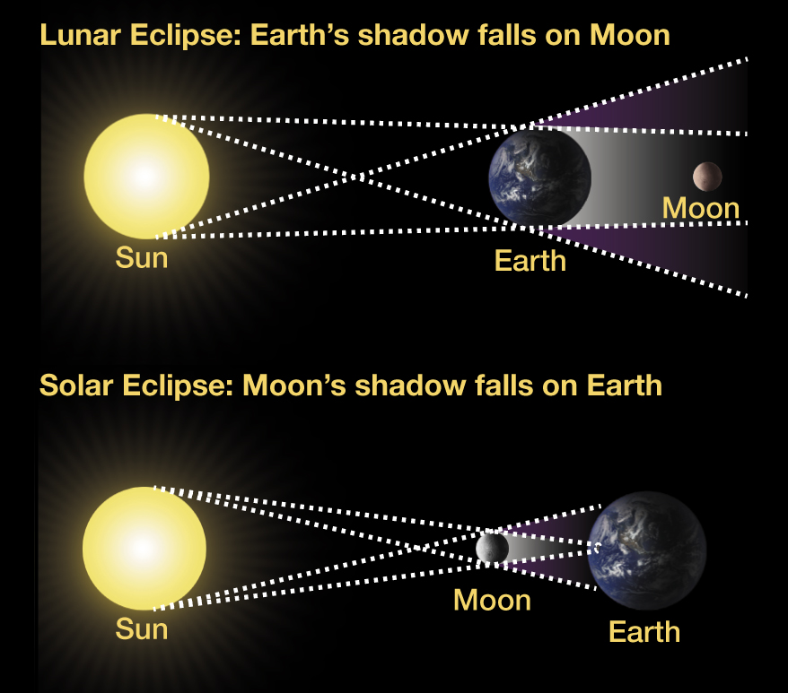
Recipes for eclipses
Lunar Eclipses:
- The Moon is at one of the Nodes
- The Moon is Full
Solar Eclipses:
- The Moon is at one of the Nodes
  - The Moon is New

Slide 9
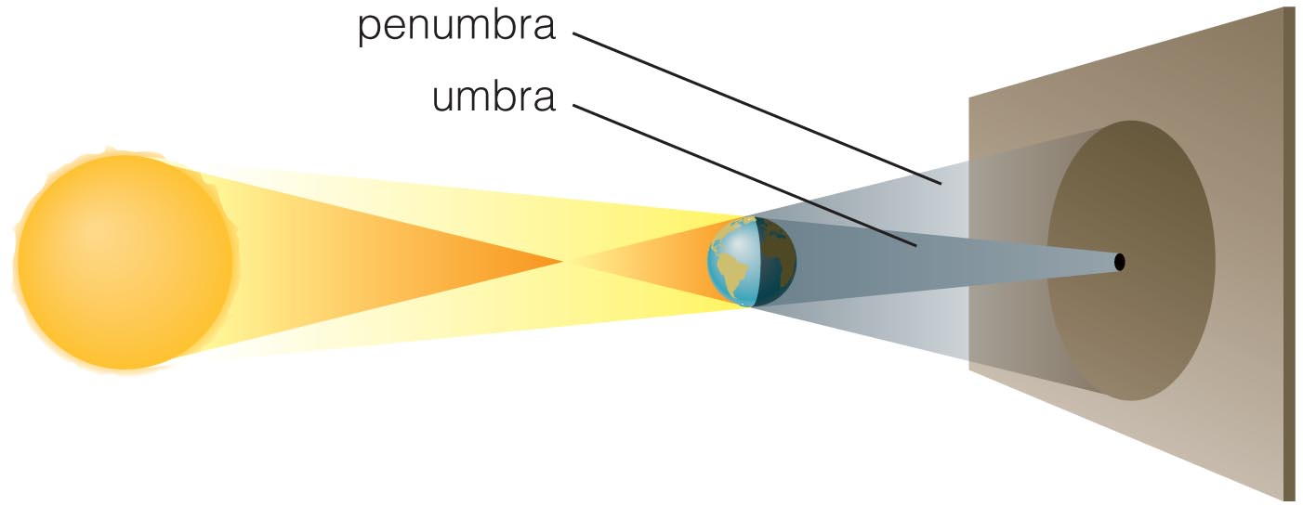
Understanding Eclipses
The geometry of shadows

Slide 10
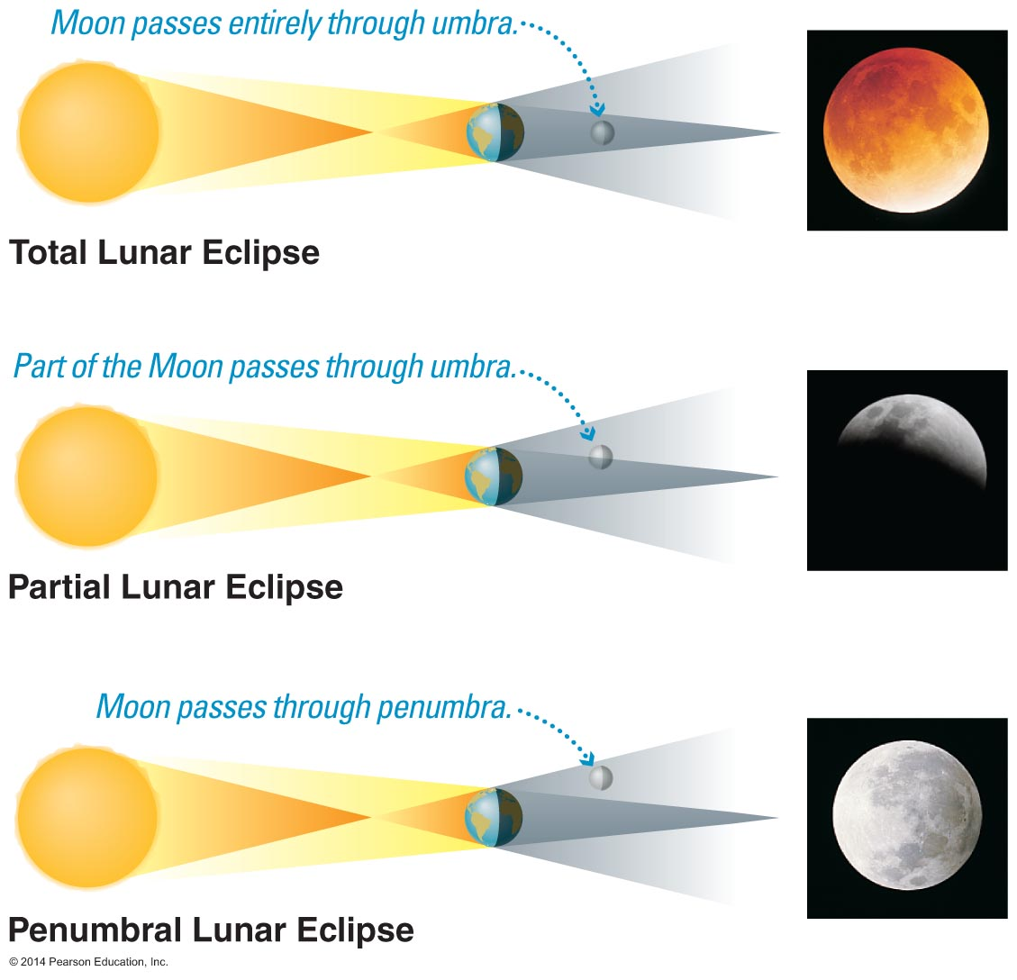
Lunar eclipses
Lunar eclipses occur only at Full Moon, when the Moon is directly behind our planet
Lunar eclipses can be penumbral, partial, or total

Slide 11
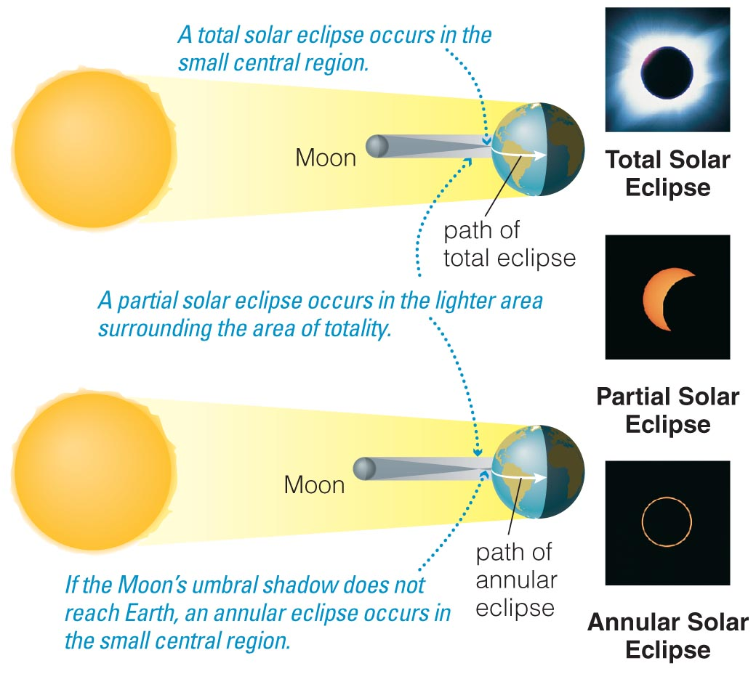
Solar eclipses
Solar eclipses occur only at New Moon,
when the Moon is
directly in front of
the Sun
Solar eclipses can be annular, partial, or total

Slide 12
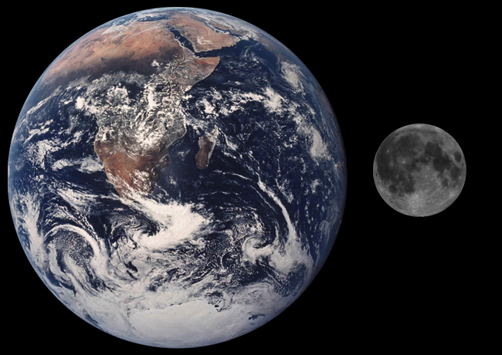
Size of Earth and Moon
The diameter of the Moon is 1/4 the diameter of the Earth

Slide 13
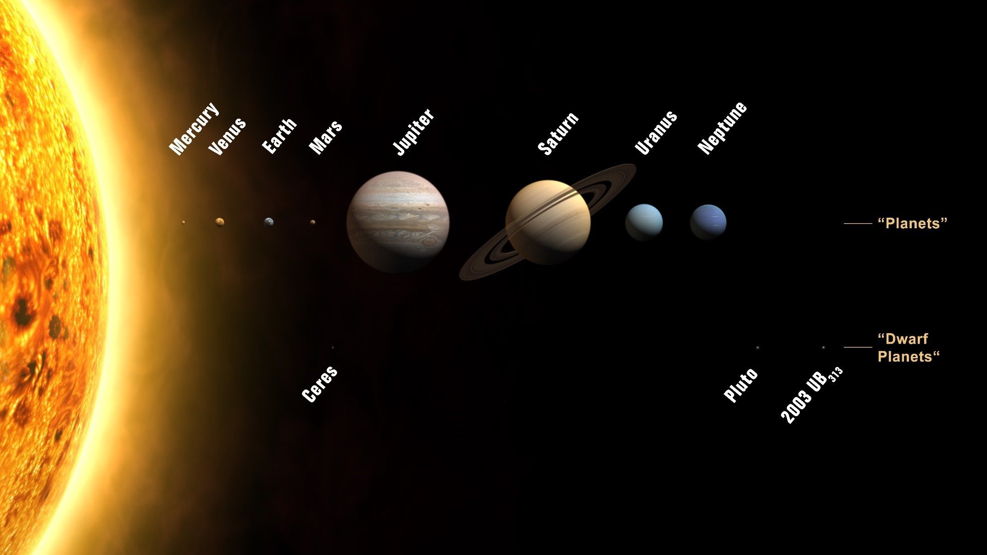
Size of Sun and Earth
The diameter of the Sun is 109 times the diameter of the Earth

Slide 14
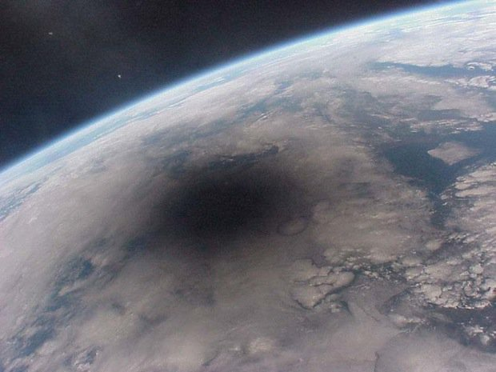
Solar Eclipses from Space
Penumbra
Umbra

Slide 15
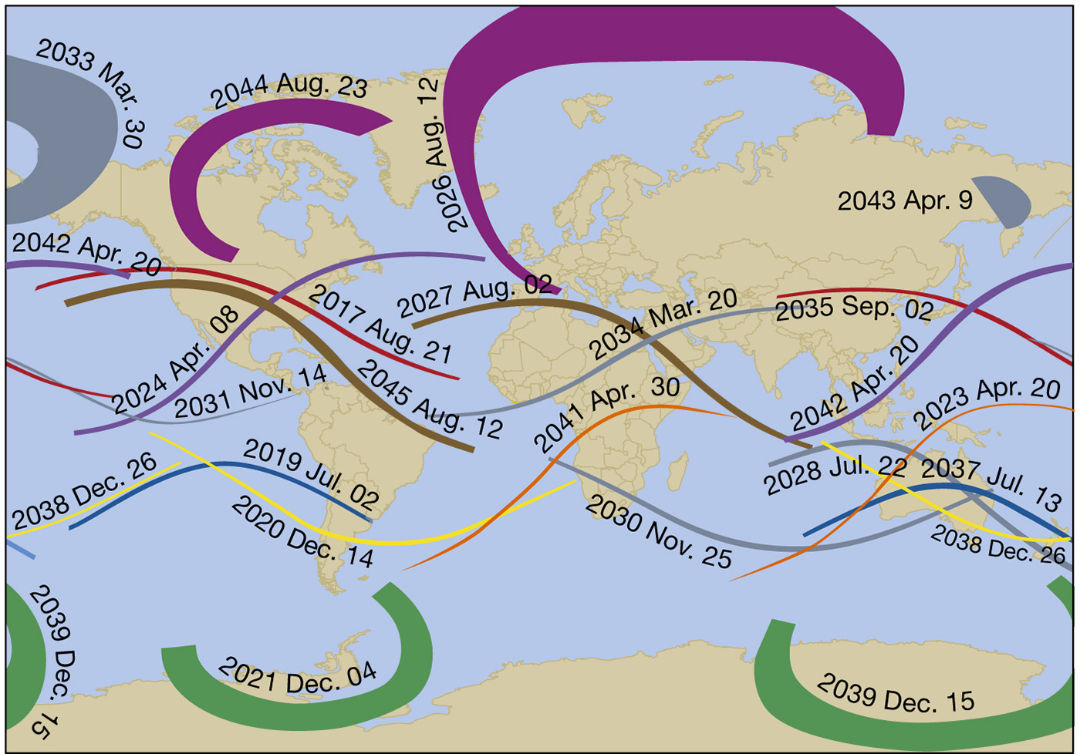
Solar Eclipses: 2017 – 2045

Slide 16
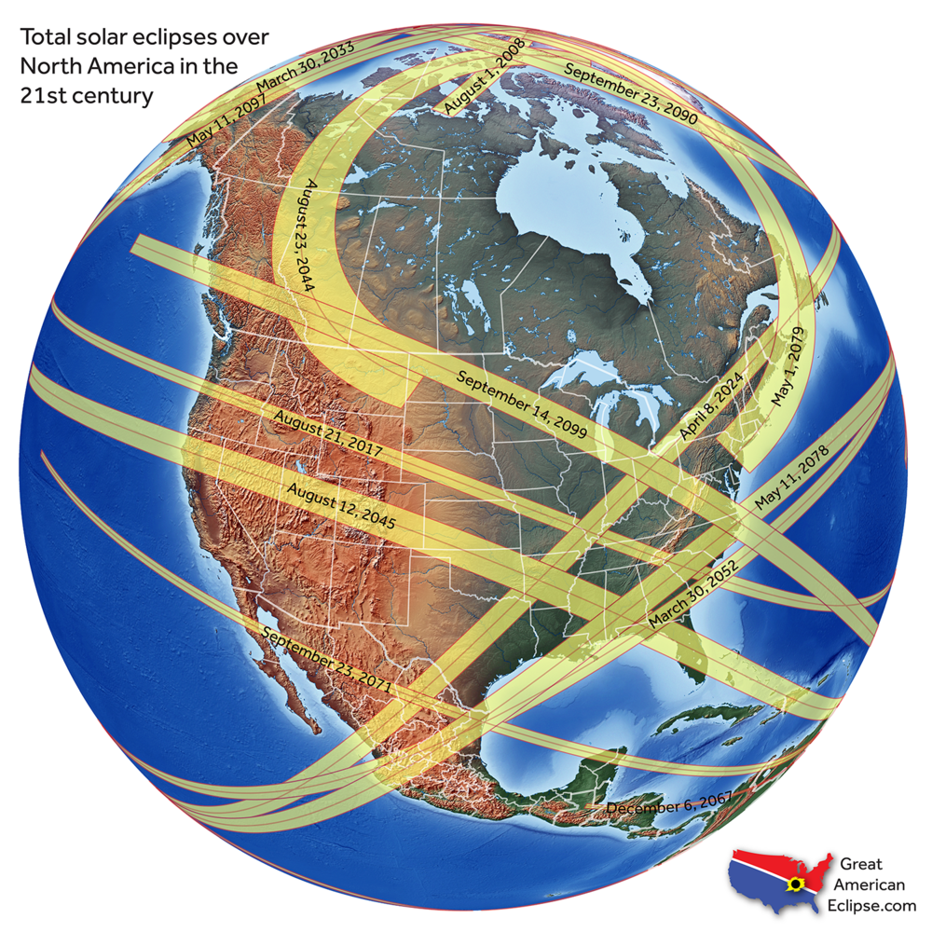
Future Total Solar Eclipses visible in the USA
2024
2078
2052
2099
2045
Last total eclipses visible across
the USA were in 1918, 1979, 2017

Slide 17
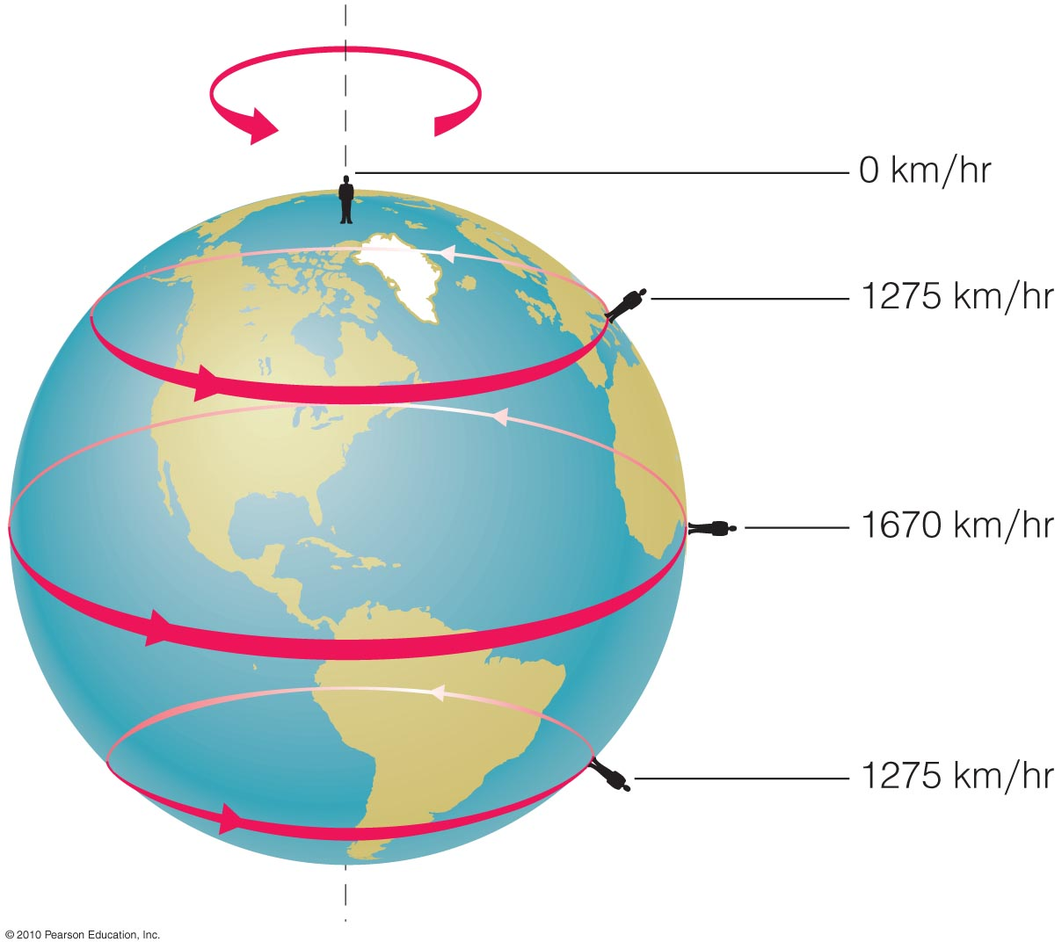
Why the Totality is so short
Earth spins very fast!
Duration of 2024 totality:
3 minutes and 56 seconds,
the time it takes the Moon to cover the Sun entirely

Slide 18
What does a Solar Eclipse look like:
  The sequence
  The diamond effect
  The solar corona
  What will we see in Michigan
  Catching totality

Slide 19
The Sequence – composite photo

Slide 20
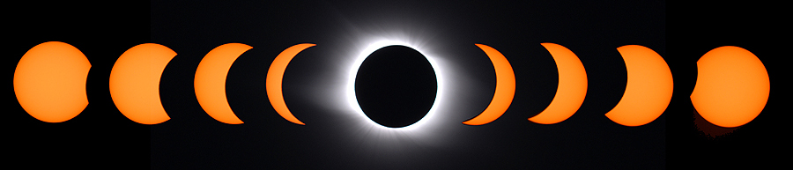
The Sequence – composite photo
We will not see this
Starts
1:58 pm
Ends
4:27 pm
Max Sun coverage in the Detroit area is about 98% at 3:14 pm

Slide 21
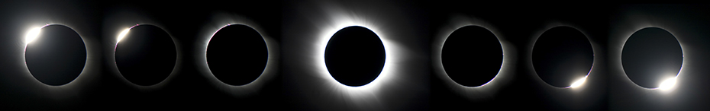
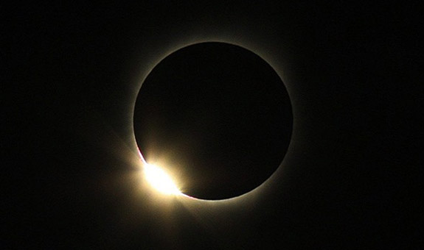
Just before Totality: the Diamond

Slide 22
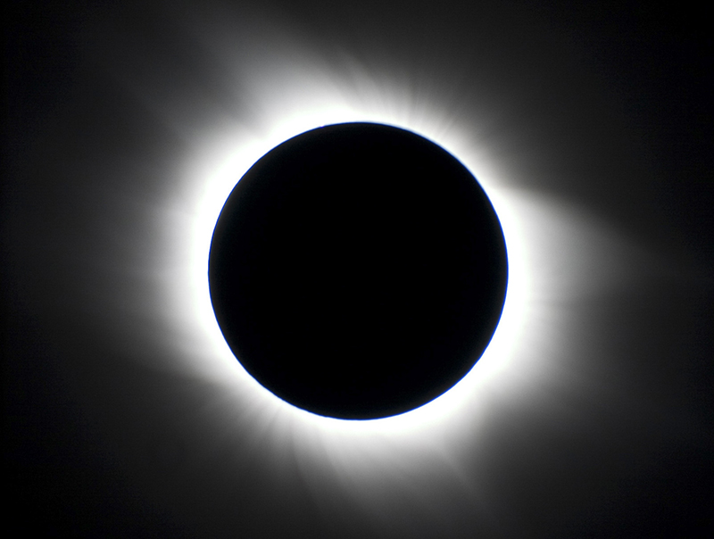
At Totality, the magnificent Corona appears

Slide 23
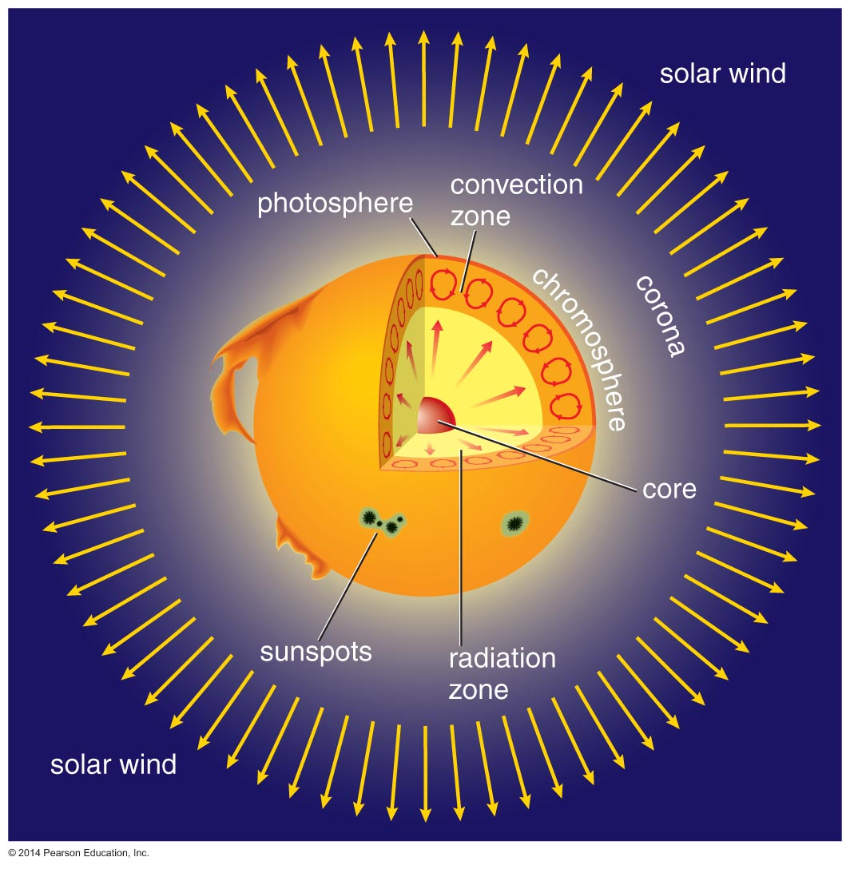
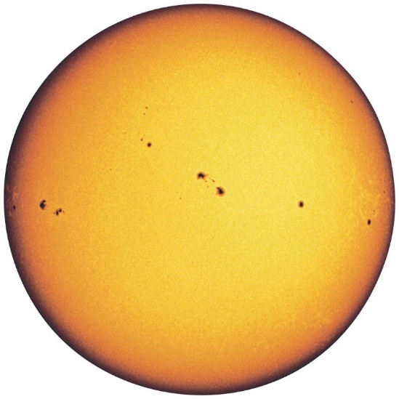
Our Sun: there is more than what catches the eye

Slide 24
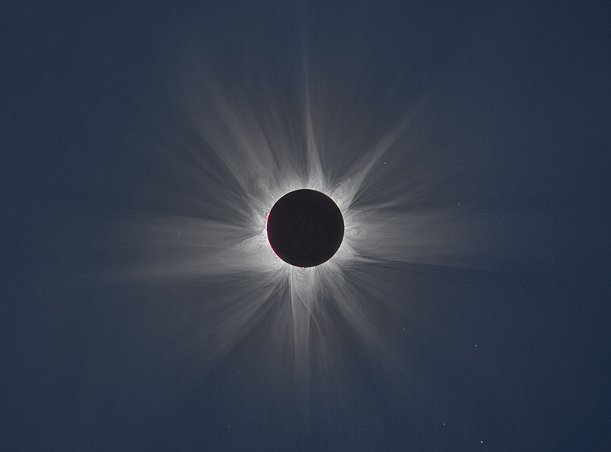
The Corona is only visible during Totality

Slide 25
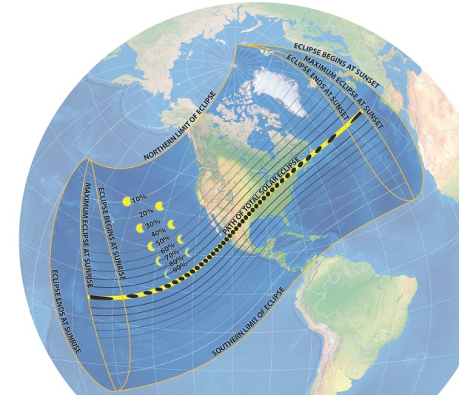
Map of Totality
2024 Eclipse

Slide 26
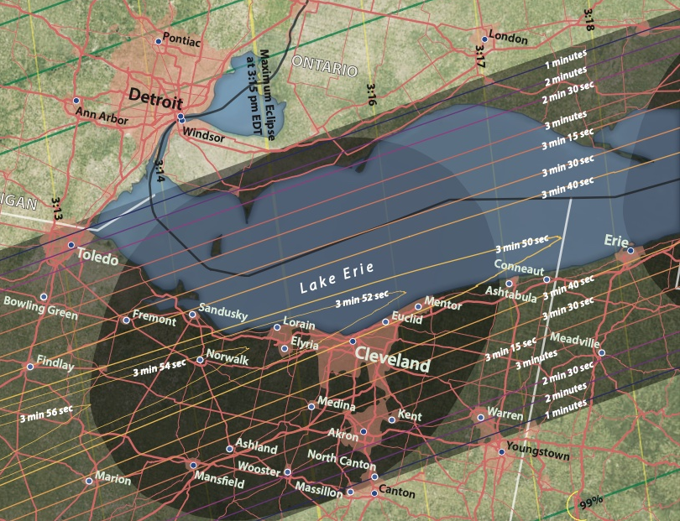
Rochester Hills, Michigan: 98% obscuration
98%
99%
100%
Starts: 1:58 pm
Max: 3:14 pm
Ends: 4:27 pm
Sun’s Altitude:
55º down to 38º

Slide 27
What will you see
Simulation:
https://www.timeanddate.com/eclipse/in/usa/detroit

Slide 28
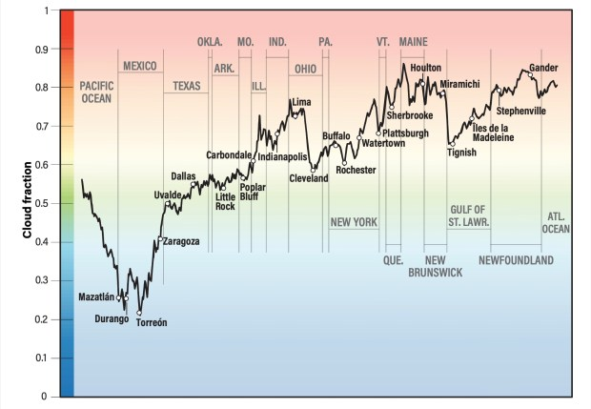
What about Michigan Weather?
Average April
cloud coverage
at 3:00 pm is
60 – 70%

Slide 29
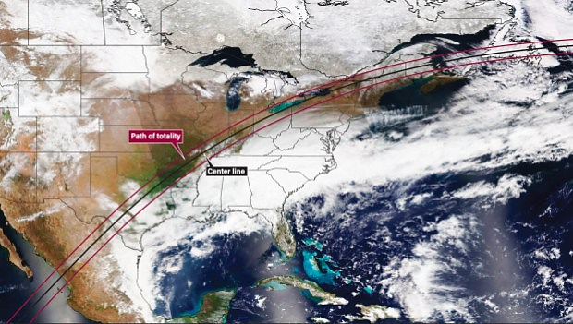
Cloud cover, 8 April 2023

Slide 30
Catching Totality
1 hr 20 min drive to
Toledo (2 min totality)
1 hr 45 min drive to
Bowling Green ( 3 min)
2 hr drive to Fremont (3 ½ min totality)
Be ready for the traffic!

Slide 31
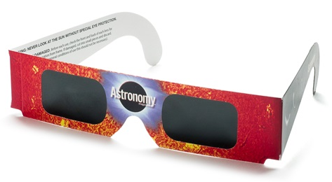
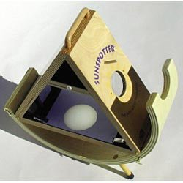
Tools for Viewing the Eclipse
Eclipse “Glasses”
Sunspotter (expensive)

Slide 32
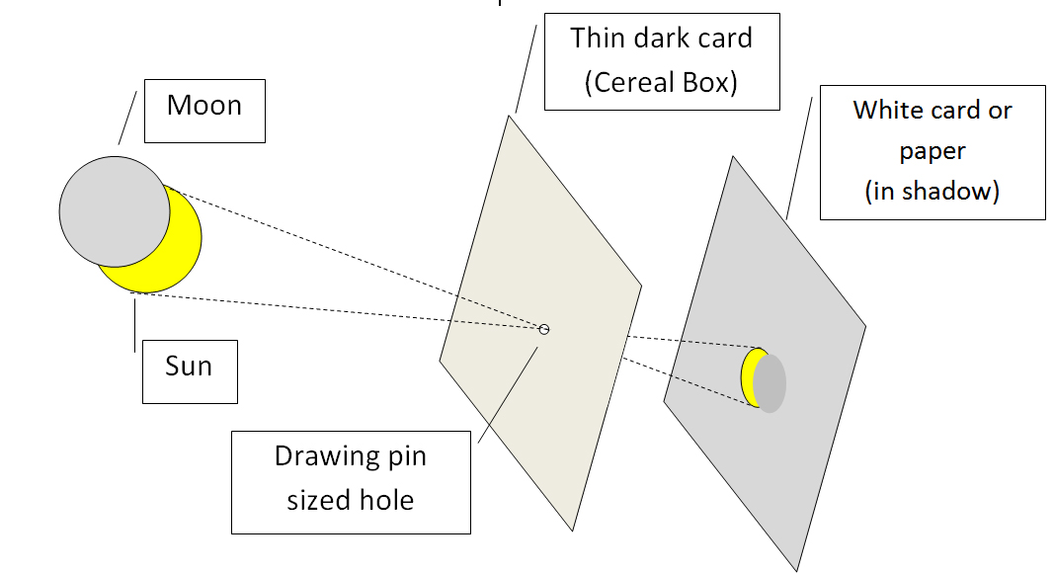
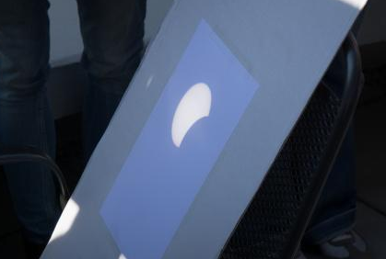
Tools for Viewing the Eclipse
Cardboard with pinhole projected on paper

Slide 33
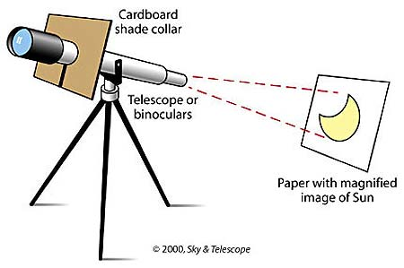
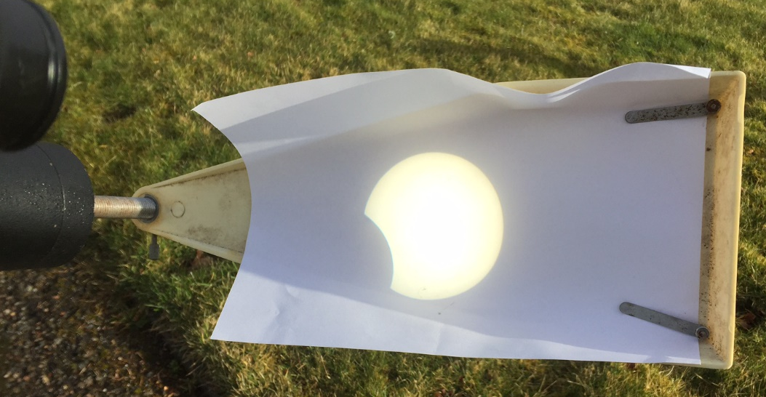
Tools for Viewing the Eclipse
Projecting the image off a telescope (don’t look through the lens!!!)

Slide 34


What not to do for viewing the Eclipse
Don’t look directly
at the Sun!
Do not use regular sunglasses – it will burn your retina
Do not use eclipse glasses
to take photos – purchase a solar filter for cameras

Slide 35
Viewing the Eclipse Online
NASA will stream the 2024 eclipse live:
https://science.nasa.gov/eclipses/future-eclipses/eclipse-2024/live/

Slide 36
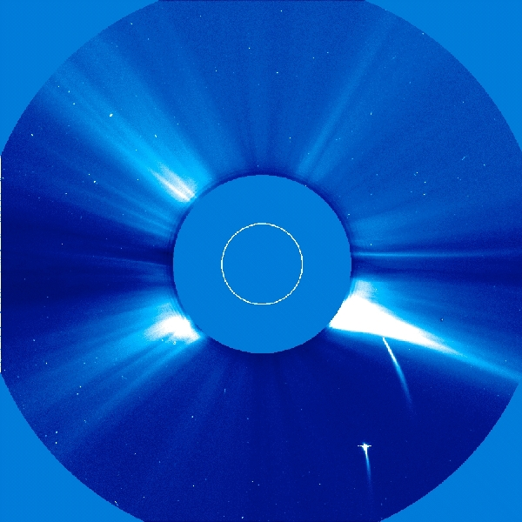
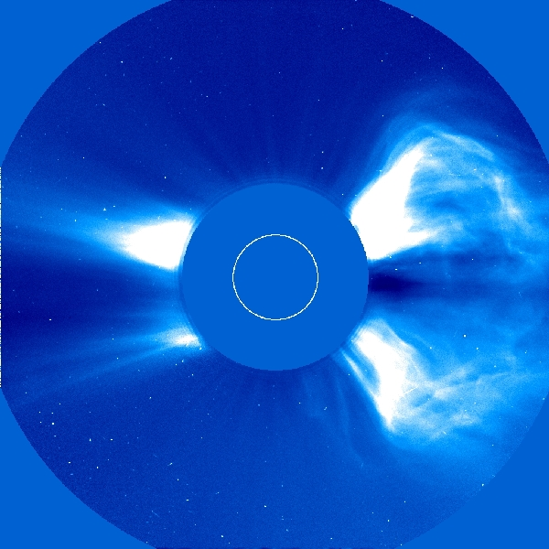
Solar Observatories: simulating the Eclipses
Coronagraph
covers the
disk of
the Sun
Images from NASA’s SOHO (Solar & Heliospheric Observatory)

Slide 37
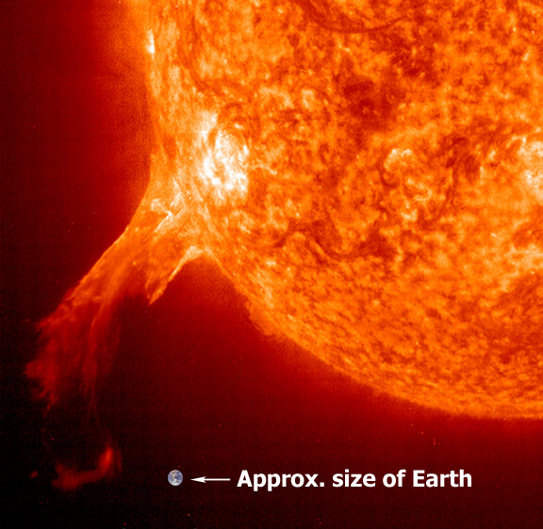
SOHO: prominences & filaments
Filament
Prominence

Slide 38
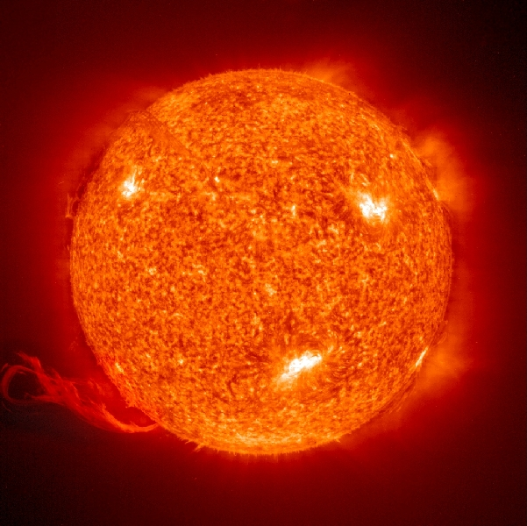
SOHO: prominences & filaments

Slide 39
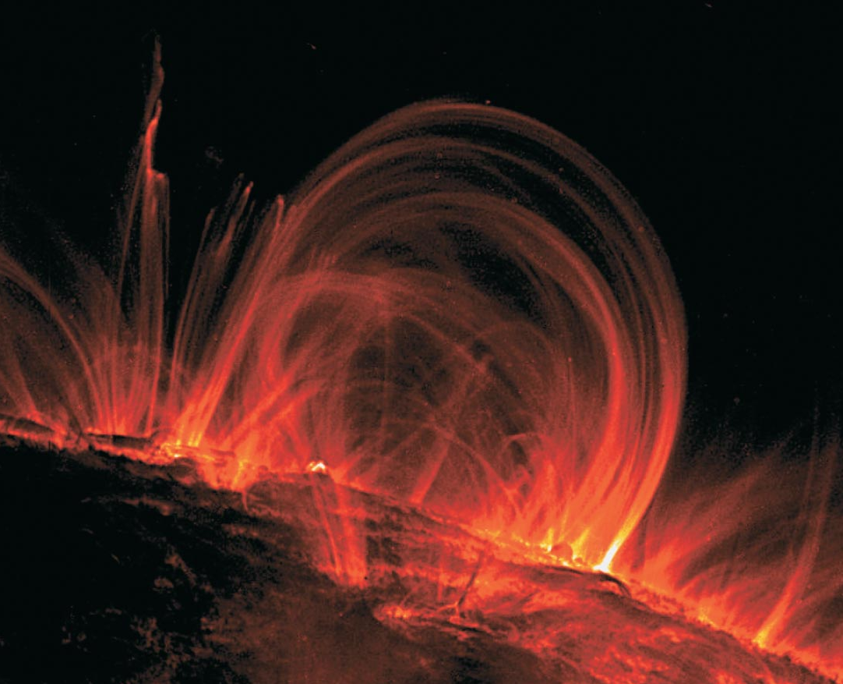
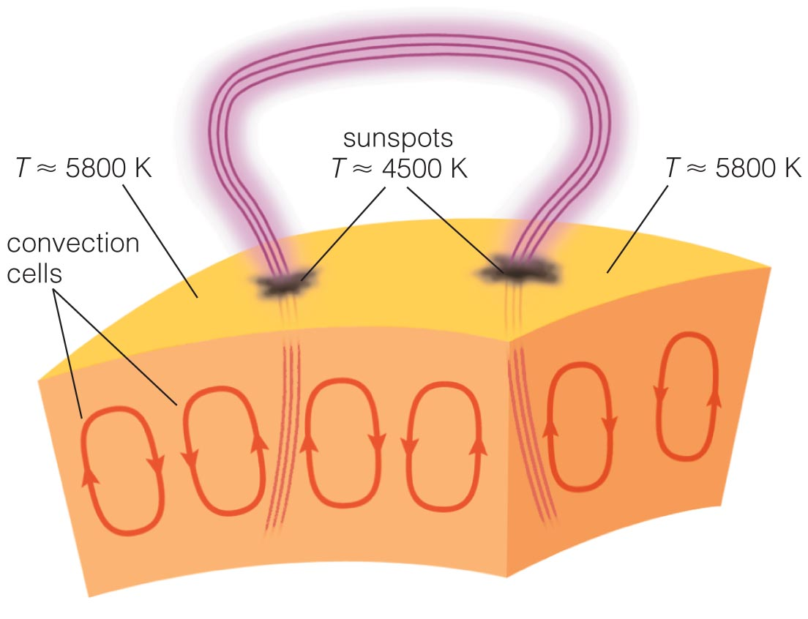
Prominences & the Sun’s Magnetism

Slide 40
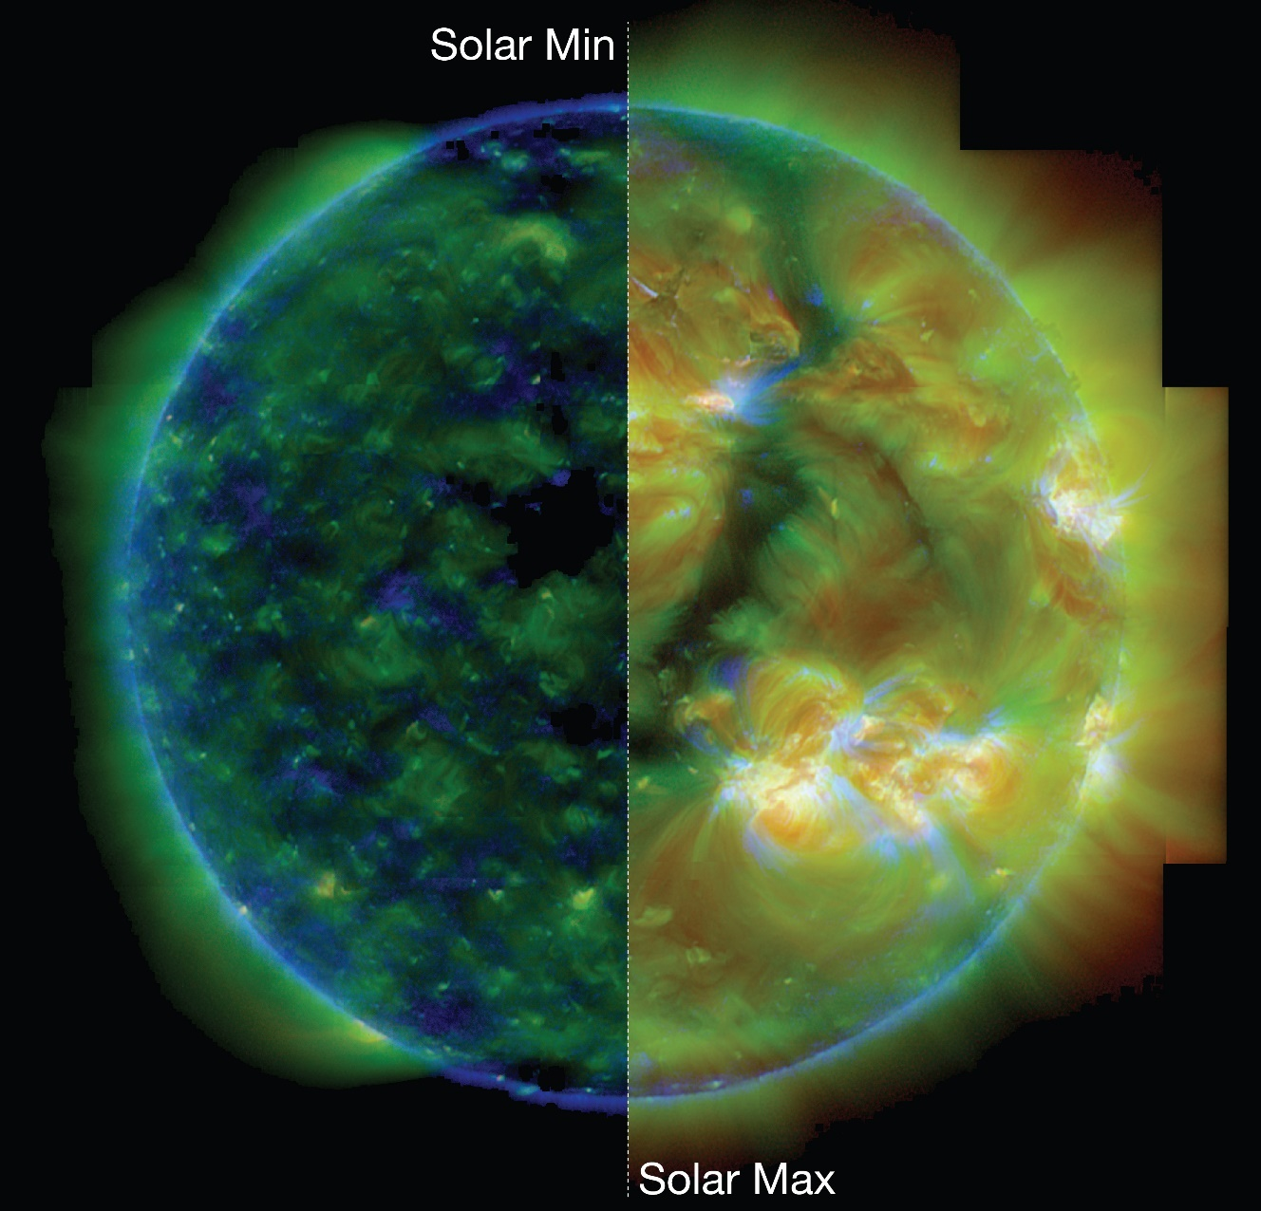
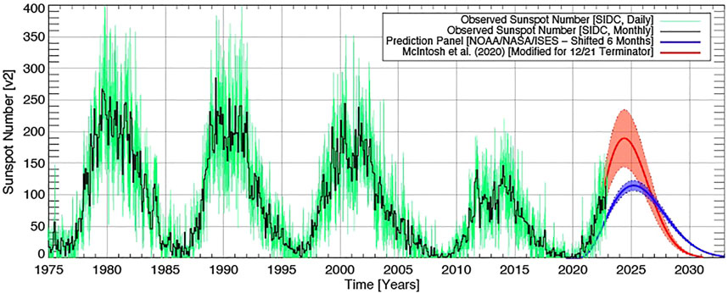
HINODE: Max & Min Solar Activity

Slide 41
Solar Observatories websites
SOHO – Solar & Heliospheric Observatory – NASA
soho.nascom.nasa.gov/gallery/bestofsoho.html
SDO – Solar Dynamic Observatory – NASA
sdo.gsfc.nasa.gov “The Sun now”
Hinode – Solar Optical (Space) Telescope – JAXA (Japan) & NASA
hinode.msfc.nasa.gov “Gallery”

