Slide 1
Student Organization Campus Resources

Slide 2
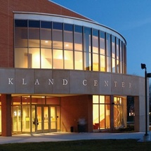
Oakland Center Policies
Decorations
NO: Stapling, tacking or adhering to any painted surfaces, brick walls, furniture, floors or glass doors. No glitter or confetti. No candles, pyrotechnics, fogging devices and decorations that "bleed" color
Groups that violate the decoration policies may be charged accordingly.
Materials Distribution
Distribution of material and solicitation of any kind are not permitted on OU's campus without prior approval
Posting Policy
All flyers and table tents must be approved by the CSA

Slide 3
Oakland Center Policies Cont.
User Groups
Group A
Recognized University groups including faculty and staff groups, all University departments, and registered student organizations associated directly with the University. FREE CHARGE
Group B
Recognized University groups that charge admission or registration fees, collect donations, generate funds in any manner, promote business products or services, or include event and or meeting participants primarily from off-campus but are related to University business. 50% Rate
Group C
Non-recognized groups (Group C) include all off-campus profit and non-profit organizations, groups, corporations, businesses, religious organizations, churches, clubs and individuals. 100% Rate

Slide 4
OC Reservations
Room/Table Reservations in the OC Form
All events will be booked on a first-come, first-served basis.
This form goes directly to the RESERVATIONS Office
Friday, October 23 is the first day to reserve rooms in the Oakland Center for the Winter 2016 semester.
Outdoor Events/Bonfire Request/Non-OC Room Reservations Form
This form goes to the CSA who coordinates with the appropriate offices (Registrar)

Slide 5
Chartwells Catering
With the exception of the University bookstore and vending machines all food and beverage sold or served in the Oakland Center must be provided by the Oakland Center in-house food service provider. Groups are not permitted to bring food or beverage into the Oakland Center. Violation of this policy may result in a suspension of facility scheduling privileges.

Slide 6
Chartwells Catering
How do I contact and how do I place an order?
Visit 121A Oakland Center and ask for help
Go to Dineoncampus.com/Oakland
E-mail catering@Oakland.edu
Put together an order at www.chartwellsou.catertrax.com
This is NEW to create the option to build your own quote/order
Quotes must be signed and confirmed one week in advance from your event date.

Slide 7
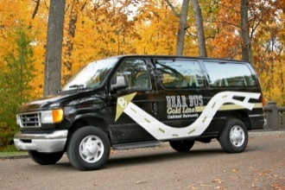
Bear Bus
You can rent the Bear Bus for your student organization!
Driver: $10/hour (minimum 1 hour)
Mileage: No Charge
Gas: Return vehicle with full tank of gas
Fill out the form at http://wwwp.oakland.edu/bearbus/ and submit within 14 days of desired usage.
Only trained Bear Bus drivers may operate the Bear Bus shuttles.
Shuttles may not be rented for overnight use, nor are they authorized to leave the State of Michigan. Shuttles may only be rented when not in use, and are available on a first come, first served basis.
Please contact bearbus@oakland.edu with further questions or inquiries.

Slide 8
Questions?
Allison Webster
Assistant Director of Student Organization Programs
248-370-2024
Webster@Oakland.edu
Emily Perry
Graduate Assistant for Student Organizations and Greek Life
248-370-4338
eeperry@oakland.edu

