Slide 1
Classroom Resources
George Preisinger and Adam Gordon – Classroom Support

Slide 2
Who We Are
CSITS also offers a broad range of Multimedia and Video production services including; audio, video & instructional technology consulting, engineering, and systems integration, in support of the University community. We also provide resources and services to aide in supporting the technical aspects of your programs, activities and events.

Slide 3
Contact Info
For Immediate Help: 248-370-2461
M - Th: 7 am – 8 pm, F: 7 am – 6 pm, S: 8 am – 4 pm
To Report A Problem:
www.oakland.edu/csits and click the ‘Contact Us’ link in the left sidebar.
Located in 116 Varner Hall
Panopto & Moodle training
e-LIS: 430 Kresge Library, 248-805-1625

Slide 4
Extron Control Panel

Slide 5
Crestron Control Screen I (EC, HH, DH, MSC)

Slide 6
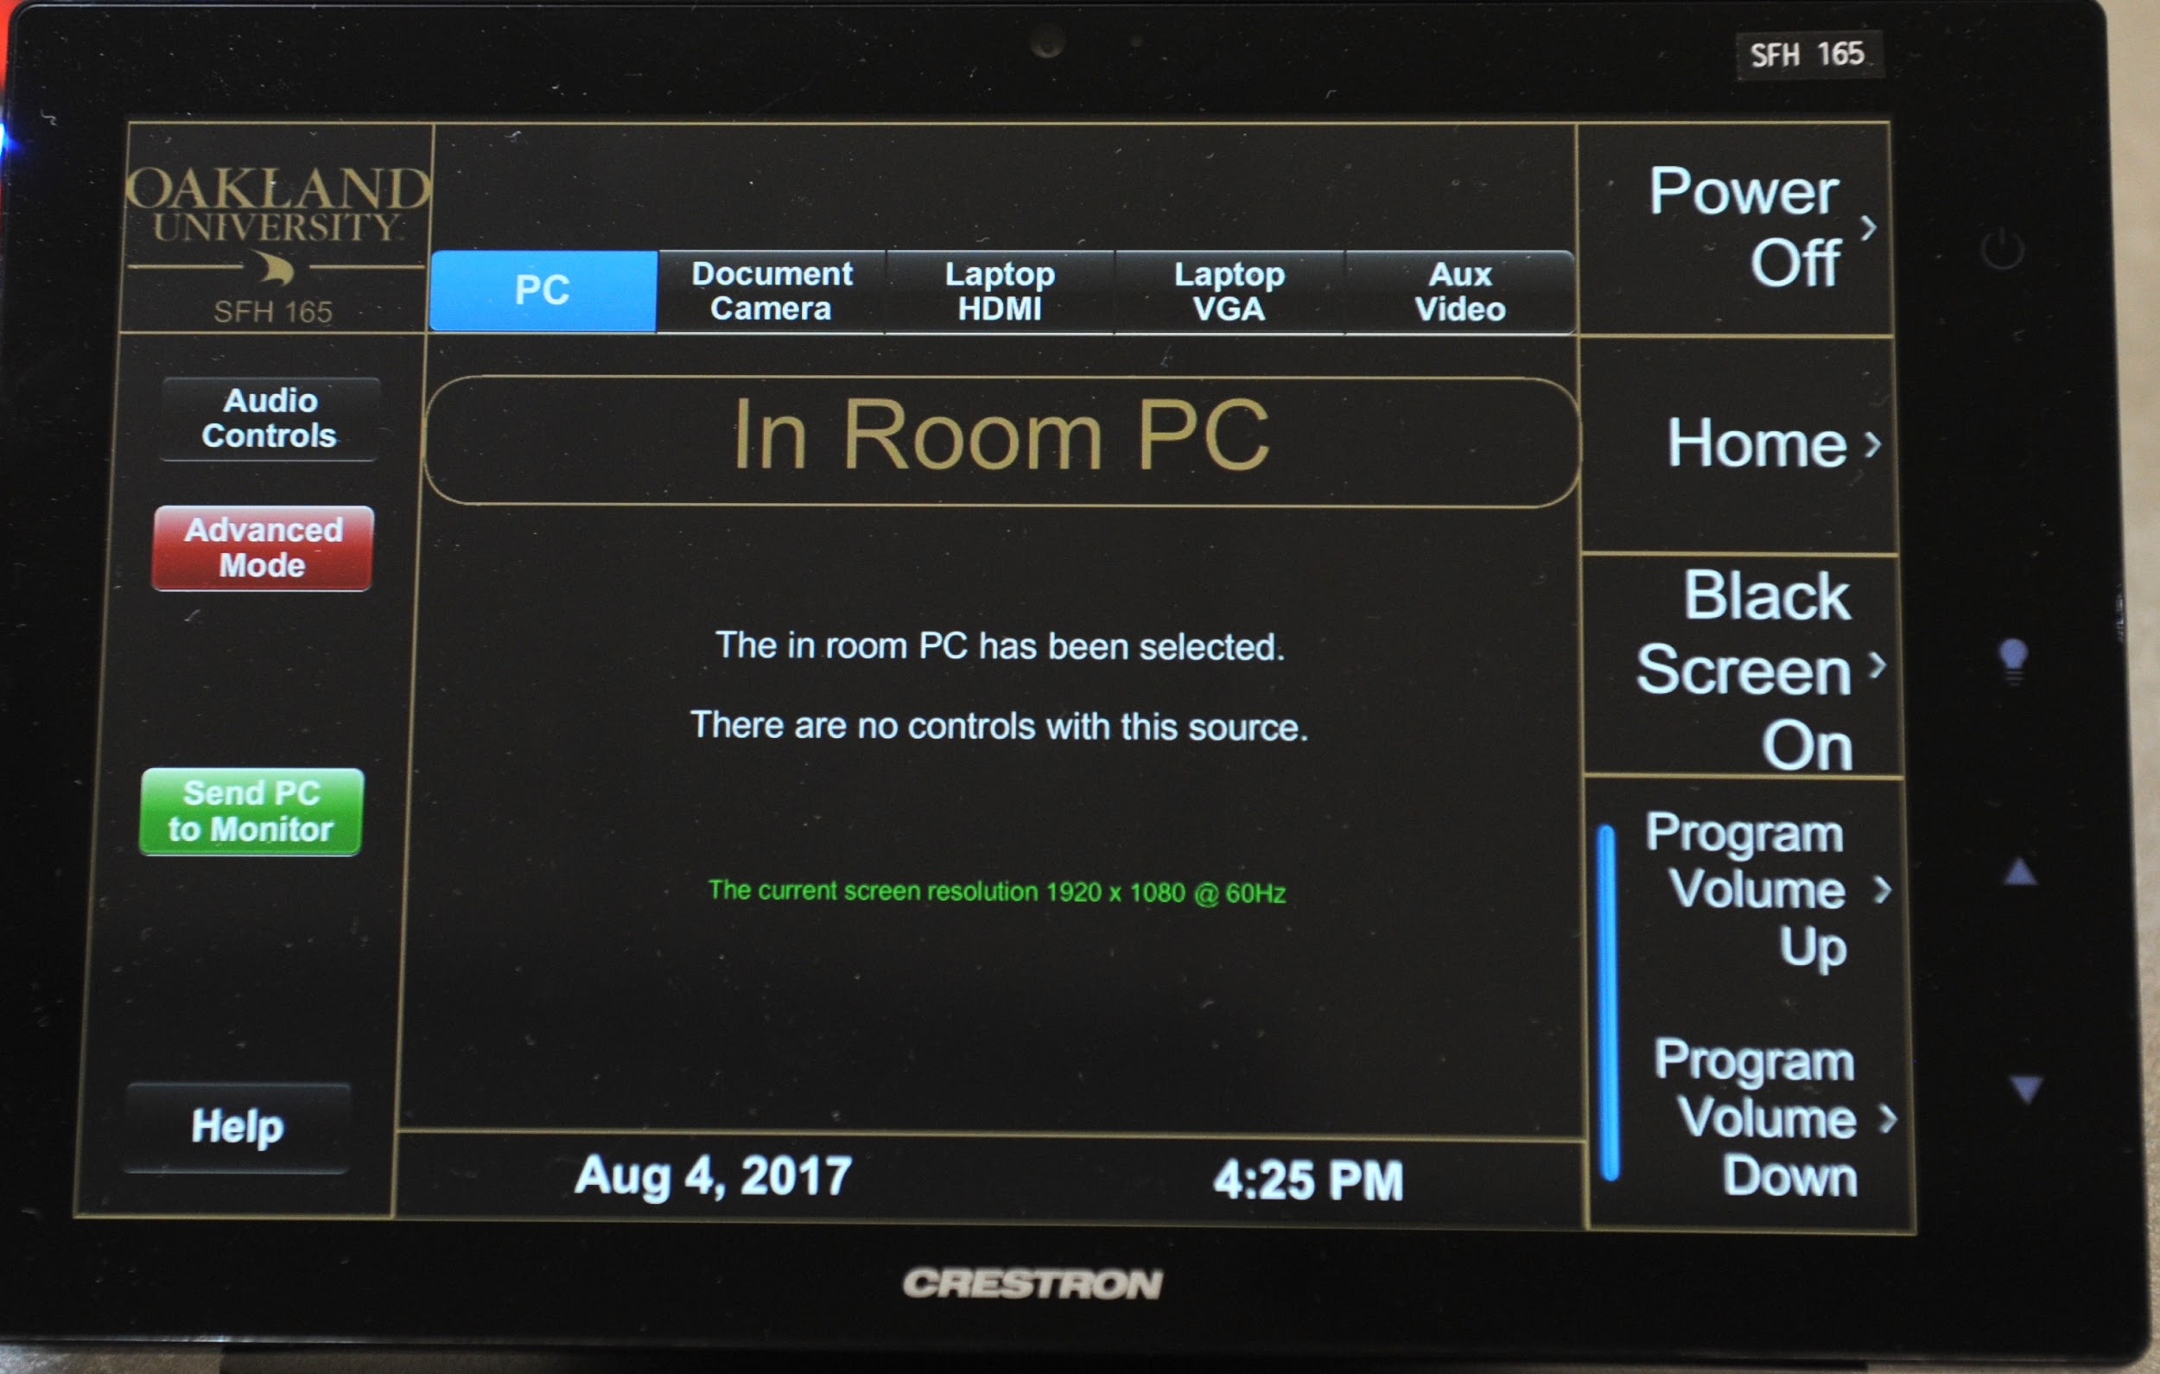
Crestron Touch Screen II (HHB, SFH, HH, MSC & others)

Slide 7
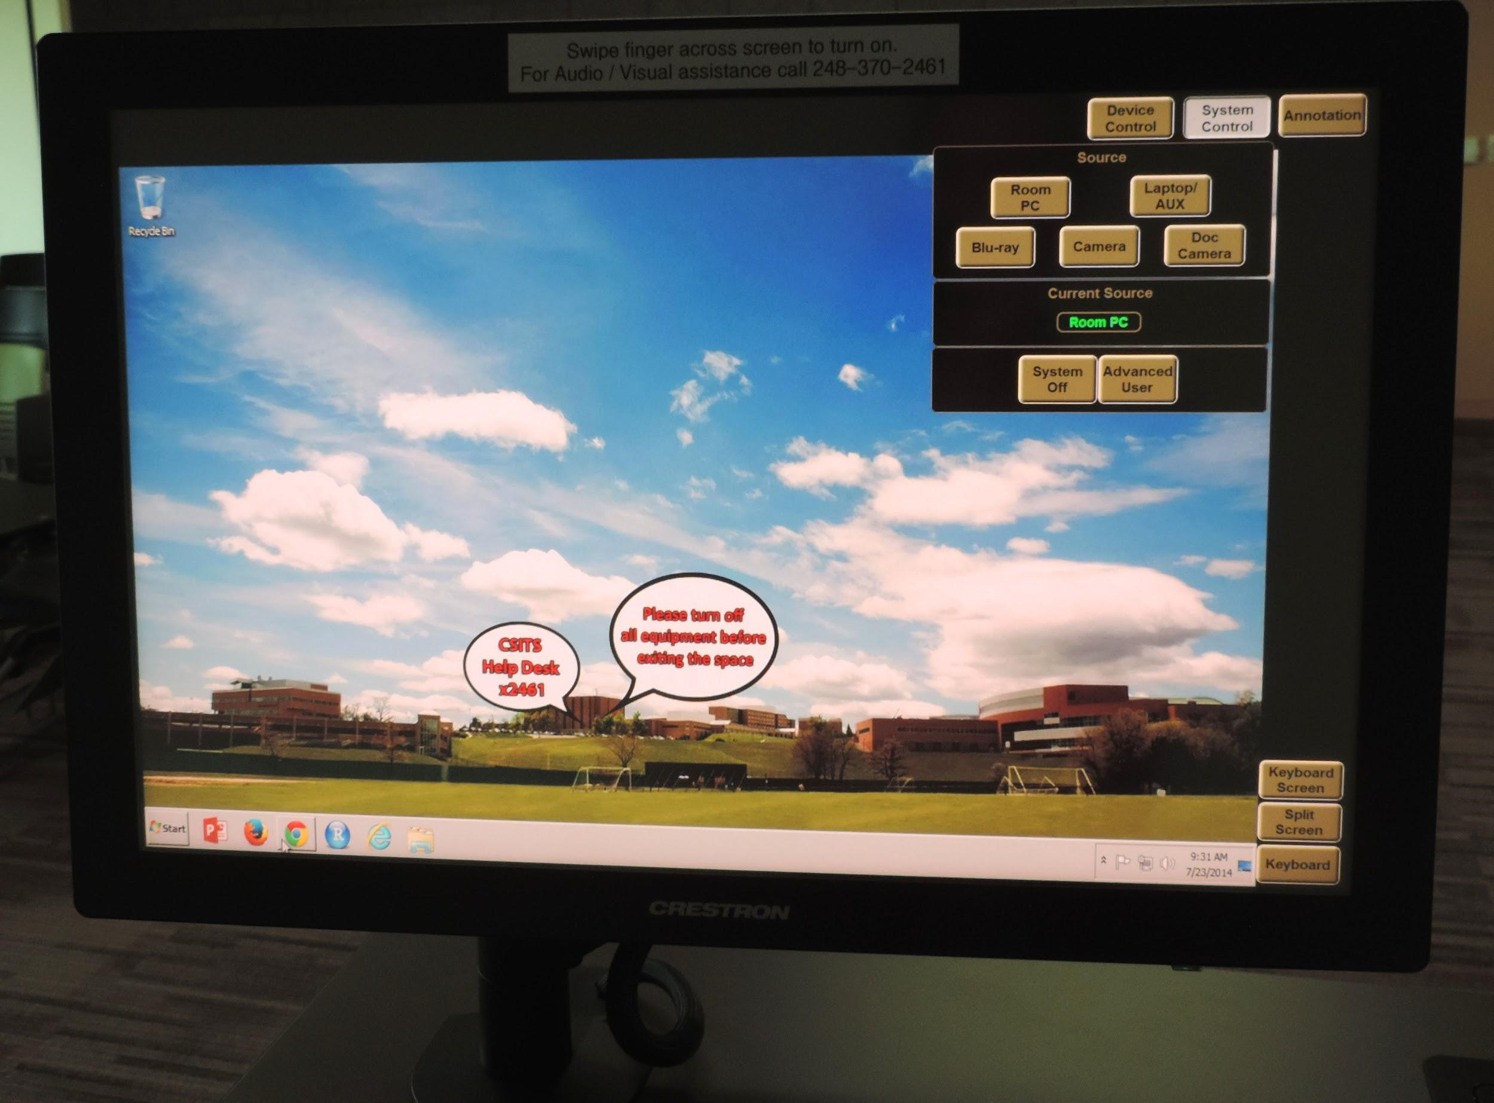
Crestron Control Monitor (HHB-Nursing, HS)

Slide 8
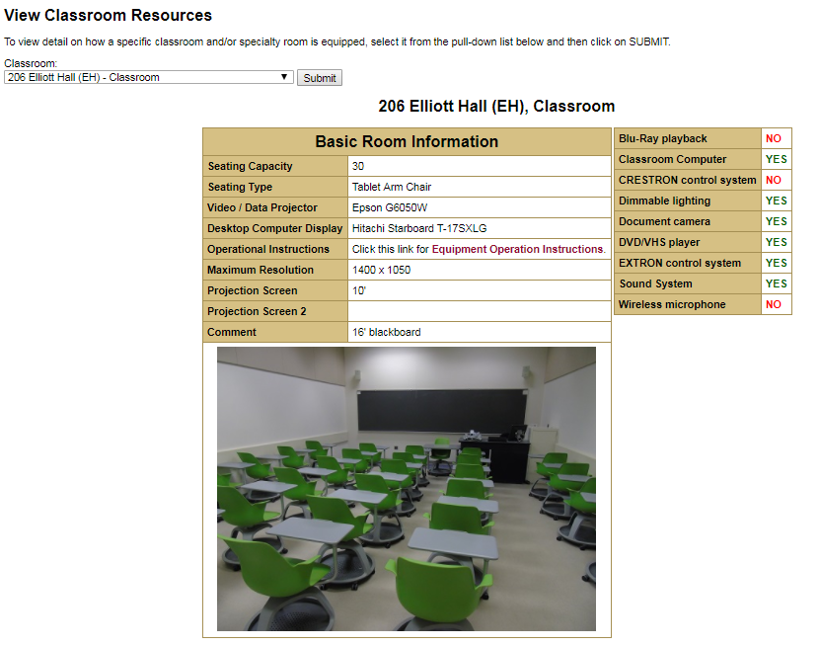
Classroom Inspector

Slide 9
Sample Instruction Sheet

