Slide 1
Improving Retention Rates
Using Institutional Data
Cassandra Barragan & Reuben Ternes
Office of Institutional Research and Assessment (OIRA)
Oakland University
March 2013

Slide 2
Presentation Outline
Introduction to OIRA
Section I: Sources of data
Surveys
University
Section II: Policy Analysis
Section III: Predictive Modeling

Slide 3
Session Goals
Why are we giving this presentation?
Answer:
Many institutions have a vibrant and robust institutional research office that do all kinds of really neat research about students and student retention.
Our goal is to familiarize you with the types of resources that you may already have at your campus
Partnering with your IR office can be a valuable way to boost your efforts to improve student success and retention!

Slide 4
Introduction to OIRA
About OIRA
The Office of Institutional Research and Assessment (OIRA) supports the planning, decision-making and self-assessment activities of the university community by providing and coordinating information about the progress of OU’s efforts to continuously improve itself.
Most institutions have an IR office
Other Names for IR offices: Budget & Planning, Institutional Effectiveness, Institutional Assessment, etc.
We fill out external surveys, conduct original research, organize internal surveys, report official statistics, and are otherwise responsible for producing a host of different institutional data for the consumption of the university.

Slide 5
What Data is on our Website?
Enrollment Data
Degrees Awarded
Information about the Assessment of Student Learning
National Student Survey Results
Research on OU Students
Comparative Departmental Information
Presentations
Historical trend data
Faculty numbers
And much more….

Slide 6
Section i: sources of data

Slide 7
Surveys
Internal Surveys – Committees, etc.

Slide 8
IRB approved protocol through Indiana University – Bloomington
Survey instrument: http://nsse.iub.edu/pdf/survey_instruments/2013/2013%20NSSE%20Instrument.pdf
Results : NSSE Results: http://nsse.iub.edu/html/reports.cfm
Predictive Validity for retention
Level of Academic Challenge (LAC) – significant for # credit hours earned
Student‐Faculty Interaction (SFI) - # credit hours & persistence
Supportive Campus Environment (SCE)
Deep Approaches to Learning (DAL)
Reliability
Measuring of concepts & constructs – internal consistency
Stability over time & repeat administration
Generalizable
Notes:
1500 colleges; 32% response rate

Slide 9
Areas Measured by
The area of Academic Challenge includes four areas—Higher-Order Learning, Reflective and Integrative Learning, Quantitative Reasoning, and Learning Strategies.
Higher-Order Learning—How much courses emphasize advanced thinking skills such as applying theories to practical problems or synthesizing information into new interpretations
Higher-Order Learning (α2004 = .82, α2005 = .82)
HL1 Analyzed the basic elements of an idea, experience, or theory, such as examining a
particular case or situation in depth and considering its components
HL2 Synthesized and organized ideas, information, or experiences into new, more complex
interpretations and relationships
HL3 Made judgments about the value of information, arguments, or methods, such as
examining how others gathered and interpreted data and assessing the soundness of
their conclusions
HL4 Applied theories or concepts to practical problems or in new situations

Slide 10
Established behaviors in high school;
Academic preparedness;
Admissions decisions;
Expectations of college;
Interactions with peers and faculty;
Student values and goals and
Student demographic characteristics; and
Concerns about financing college.
Psychometrics & Constructs: http://www.heri.ucla.edu/PDFs/constructs/technicalreport.pdf
http://www.heri.ucla.edu/constructfaq.php

Slide 11
University Departments
Student Affairs
Student group involvement
Learning community & housing
Registrar’s Office (Academic Affairs)
Class information
Credit hours
College and Major
Demographics
Grades
Much of it pulled from Banner (OU’s ERP system)
Financial Aid
Scholarships
Financial aid offers

Slide 12
Combining Data
Study habits
Personal beliefs
Plans for the future
Engagement in the educational process
Sense of satisfaction
Sense of campus community
Social environment
Faculty/staff involvement
Known predictors of retention
Examine policies
Longitudinal trends
Putting a face to the numbers…what does your student body look like?
Data is at aggregate & student level

Slide 13
Finding the data that fits your needs
Researchers
What populations are on your campus?
Educators
Can learn more about your students to tailor their education experience to be as relevant as possible
Administrators
Tell me about our students. What are they telling us & what can we learn from them?
But it should be granular enough to have meaning to individuals!
Data needs to be actionable.
(The retention rate for biology students means more to the biology department than the retention rates for all students)

Slide 14
Section II: policy analysis

Slide 15
Policy Analysis
How do you know you are meeting goals and benchmarks?
How do you know that university policies aimed at improving the student experience are working?
Do they impact retention?
What hurts retention efforts?
Where is the biggest “bang for your buck”?

Slide 16
Examples
1. Advising Policies
Data from internal university records
ACT scores
Enrollment/retention information
Number of credits
2. Financial Aid & Retention
Data from internal university records
ACT scores
Enrollment/retention information
Number of credits

Slide 17
Example 1: Advising Policies
Should we recommend that students take smaller class loads if they have lower ACT scores?
Rationale: We don’t want to ‘overload’ students that might not be academically underprepared.
What does the data say?
Retention rates do drop as ACT scores decline.
But the decline is small.
The data also show that the more credits a student takes, the more likely they are to be retained.
The data isn’t causative, its correlational.
However, there just isn’t any data to support the ‘overload’ theory.

Slide 18
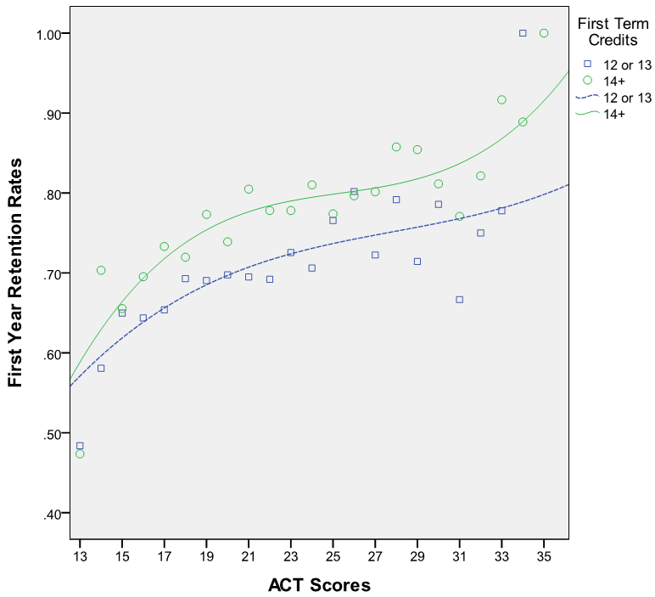
Retention Rates by ACT Score and 1st Term Credits

Slide 19
Augmenting University Data
You can get a good picture about retention through university data, but other sources may help to understand the “why”.
Advising policy findings: Students with more credits and higher ACT scores have higher retention rates but those with higher ACT scores and lower credits have a lower retention rate.
Question: Why is the retention rate low even for those with high ACT scores
Is there something in the demographic profile?
Personality profile?
Reasons to attend?

Slide 20
Example 2: Financial Aid Policy
In order to qualify for our large institutional grants you must have an ACT score of a 21 or higher.
Must demonstrate need
The grant size is usually substantial (several thousand dollars).
What is the impact of our need-based aid on student retention?
Can we get at a causative answer instead of just correlational?

Slide 21
Getting to causality…
We can get at a causative answer by using a regression discontinuity framework.
Basically, we graph things and look at the relationship right near the area where things are similar in criteria, but have vastly different in experience.
For us, we will look at students just below the cut-off score (ACT 21).
These students are similar to those just above them. But have vastly different experiences.

Slide 22
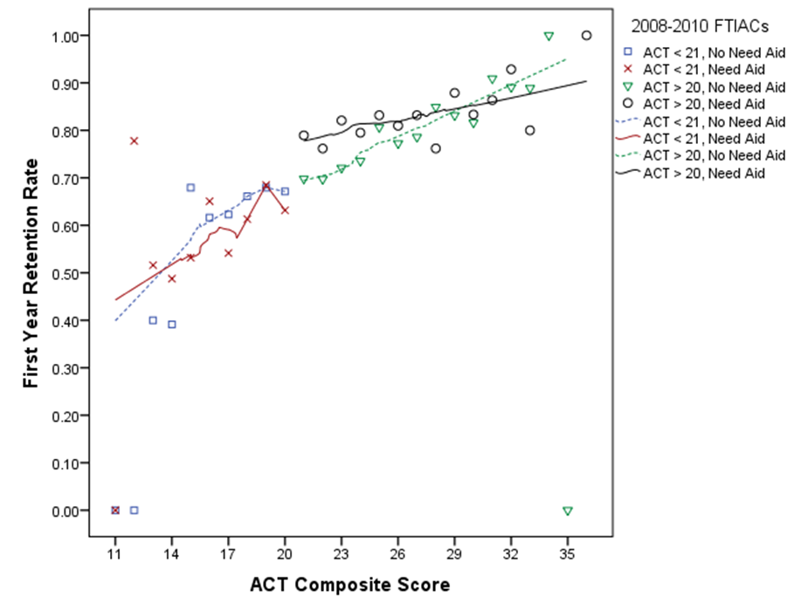
Retention Rates by ACT Score and Need Status

Slide 23
The Dashed Lines
The dashed lines represent students that have not demonstrated financial need.
They are separated into two groups, those with ACT scores 21 and above.
And those with scores below a 21.
Notice that there is NO gap, or discontinuity between the two groups.
The two dashed lines could be represented by the same color and you would never be able to tell where the discontinuity was.

Slide 24
Retention Rates by ACT Score and Need Status

Slide 25
The Solid Lines
The Red line (on the left) represents students with ACT scores of less than a 21.
These students did not qualify for a large portion of OU’s need-based aid.
The Black solid line (on the right) represents students with ACT scores of a 21 or more.
These students potentially qualify for additional need-based aid.
Notice the HUGE gap between the red and black lines.
This gap is causative evidence that need based aid had a positive impact on the retention of students near the cut-off.

Slide 26
Section III: predictive modeling

Slide 27
Risk Factors & Retention
One of the easiest ways to model retention is to categorize students into ‘risk factors’
First Generation
Minority Status
Low Incoming Preparation (ACT/HS GPA)
Pell Eligible
Etc.
Then count the number of risk factors for each student.
Use historical data to forecast new years.
Generally, the model is very good at the aggregate level.
But it’s still pretty crude.

Slide 28
Regression
Alternatively, IR researchers can use regression
Improved flexibility
Can include as many or as few variables as you’d like
Can build interactions
Increased sophistication (not all variables are equally important)
In theory, provides a more reliable retention probability for each student.
In practice, sometimes it does, sometimes it doesn’t.
Regression also has some inherent weaknesses such as:
over-fitting of data
categorical variable issues

Slide 29
Machine Learning Algorithms
A host of relatively new predictive tools are just becoming popular.
Including various machine learning algorithms (MLAs)
These algorithms have several advantages over regression
Have procedures to estimate missing data well
Can reduce the amount of over-fitting
Some MLAs are really easy to use
Can handle hundreds of different variables
Categorical (i.e. non-numerical) data is OK
Many do not make any assumptions at all non-parametric
Overall good performance relative to most regression methods

Slide 30
An Example MLA – Random Forest
Q: What is Random Forest?
A: A tool that makes really good predictions
Q: How does it work?
A: It builds lots of (decision) trees
Randomly
(That’s why it’s called Random Forest)

Slide 31
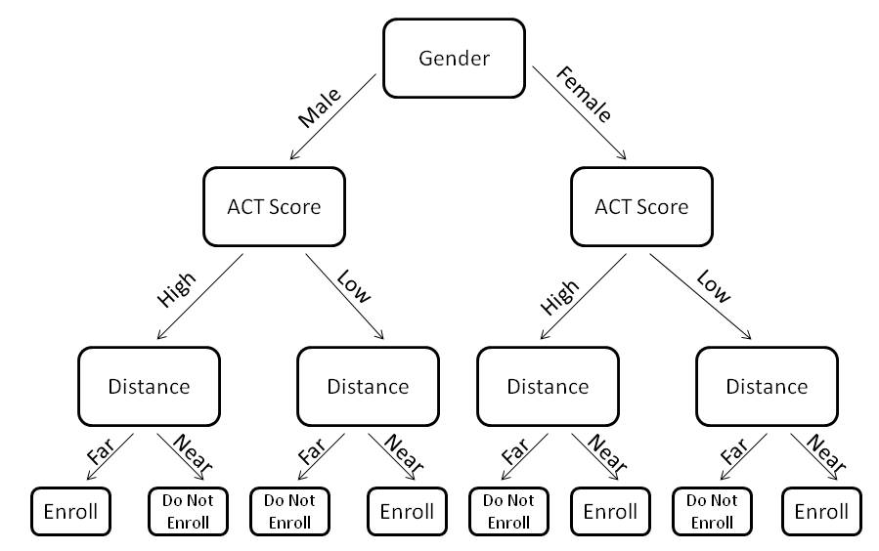
An Example Decision Tree

Slide 32
Advantages & Disadvantages
Advantages
Deals with missing data well
Robust to over-fitting
Relatively easy to use
Can handle hundreds of different variables
Categorical (i.e. non-numerical) data is OK
Makes no assumptions (non-parametric)
Overall good performance
Disadvantages
Probability values are the only statistics generated
List of variables in order of importance, but without statistics to draw your own conclusions
For more information about random forest methods: http://www.miair.org/web_documents/using_random_forest_101.pptx

Slide 33
Improving Retention Rates
Using Institutional Data
A. Introduction to OIRA
B. Section I: Sources of data
Surveys
University
C. Section II: Policy Analysis
D. Section III: Predictive Modeling
For a copy of this presentation:
http://www.oakland.edu/?id=14323&sid=250
Cassandra Barragan
Barragan@oakland.edu
Reuben Ternes
ternes@oakland.edu
Office of Institutional Research and Assessment (OIRA)
www.oakland.edu/OIRA
Oakland University
March 2013

