Slide 1
Boosting Retention:
How a Change in Advising Led to Retention Gains (and How We Know it was Advising)

Slide 2
Presenters
Reuben Ternes
Research Associate
Office of Institutional Research and Assessment
Sara Webb
Director
First Year Advising Center

Slide 3
First Year Advising
Then and Now
Notes:
Events leading to change:
Foundations of Excellence 2005-2006
Stagnant/declining retention and graduation rates

Slide 4
Philosophy of First Year Advising
Then:
Student-initiated
Reactive
Optional
Unit-specific
Now:
Proactive, intrusive, holistic
Mandatory
In conjunction with campus partners

Slide 5
Structure
Then:
All undergraduates advised in school/college advising units reporting to Dean/Associate Dean
Advising unit for undecided students reporting to Student Affairs
No designated advising unit for first-year students
Now:
All FTIACs advised in First Year Advising Center (FYAC) reporting to Student Affairs
Advising from second year to graduation in school/college advising units

Slide 6
Advising Caseloads
Then:
Vary in each advising unit*
1:1246 (highest)
1:594 (average)
1:192 (lowest)
*Ratios include all undergraduate students, including FTIACs
Now:
Caseloads based on position
1:360 (adviser)
1:280 (senior adviser)
1:130 (assistant director)
Key partnerships with other Student Affairs areas provide additional support

Slide 7
Frequency of Advising
Then:
Required orientation advising
Student-initiated appointments thereafter
Now:
Three required appointments during first year
Summer orientation
Fall semester
Winter semester
Accessibility of advisers at student demand

Slide 8
Advising Locations
Then:
Spread throughout campus in various buildings
Not typically connected to student “hubs”
May be difficult to find for new students
Now:
Advising located in “student service” building
Admissions
Career Services
Center for Multicultural Initiatives
Disability Support Services
Financial Aid
The Tutoring Center
Veteran Support Services

Slide 9
New Student Orientation
Then:
Advisers did not play a key role in the development of the program
Advising units provided time to advise students
No cohesion of advising and orientation outcomes for program
Now:
Orientation staff report to First Year Advising Center director
Orientation focused on first year success

Slide 10
Major/Career Exploration
Then:
Assumed student had “decided” since advising done in academic unit
Incumbent on student to ask for major/career exploration
Now:
Embedded exploration in all interactions with adviser
MBTI/SII available to all students
Parallel Plans

Slide 11
Student Transitions
Then:
Summer orientation only university-wide support for transition from high school
Students could opt-in to smaller programs if desired
No formal process for transition to second year
Now:
Focus on transition from high school and navigating first year of college
Collaboration with advising units to create successful transition to second year
Co-sponsored programming
Hand-off documents
Second Year Experience (SYE)

Slide 12
Communication to Students
Then:
Communication messages and frequency varied for all FTIACs
Dependent on advising unit
Now:
Full-time Communications Coordinator
Greater incorporation of university-wide expectations and messages
Robust communication plan includes various mediums

Slide 13
Endless Possibilities
It’s more than advising

Slide 14
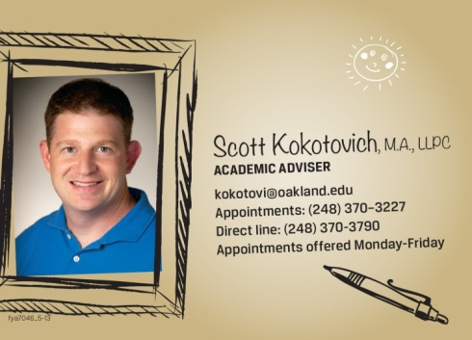
Personal Connection
Students are given direct contact information for adviser
Front desk staffed to personally answer all walk-in, phone and email inquiries
Most email communications come directly from adviser; video messages too!
Students regularly receive phone calls from FYAC staff
FYAC adviser in cafeteria every week

Slide 15
Paying Attention
Birthday greeting
Dean’s list congratulatory letter with hand-written note from adviser
Appointment no show follow-up
“We haven’t seen you” reach-out
Reach-out to those below full-time status or not registered

Slide 16
Support for At-Risk/Struggling Students
Conditional admits
Required success course, success coaches
Low ACT/HSGPA
Five touch-points in fall semester in collaboration with Housing and Center for Multicultural Initiatives
Students on academic probation
Academic Recovery Workshop, probation tutorial, success coaches

Slide 17
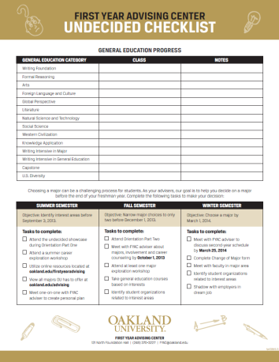
Decisions and Transitions
Undecided (or re-deciding) students
Pre-start workshops
Undecided Checklist
Fall series on exploring careers/majors
Transition to advising units in second year
Hand-off documents
Easy access to list of released students

Slide 18
What Are We Doing with Data?
Created scorecards to display trend data to track progress.
Aggressively displayed minority/majority differences in student outcomes

Slide 19
What kinds of metrics are we looking at?
Retention Rates
Spliced by: Minority Status, Housing Status, Undecided Status
Probation Rates
Success of students formerly on probation
By Minority Status:
GPAs (% getting 2.0, % getting 3.6)
Credits Attempted
Class Standing (i.e. credits earned)

Slide 20
What Did We Find?
Full-Time FTIAC Retention Rates by School & College
School/College | 2011 | 2012
Total | 70.3% | 78.1%
CAS | 75.9% | 79.5%
SBA | 66.4% | 75.7%
SEHS | 74.3% | 85.9%
SECS | 70.6% | 78.9%
SHS | 73.0% | 78.7%
SON | 63.8% | 78.2%
UP | 62.3% | 74.0%

Slide 21
Before & After Highlights
Retention up almost 8%!
Retention up for every group of students!
Up for every school and the college.
Minority retention up 9%
% of Students achieving Sophomore Status up!
GPAs are up!

Slide 22
Measuring Impact
Is the FYAC responsible for the increase in retention rates?
We think so, but how can we be sure?
Is it responsible for all of the increase?
Correlation ≠ Causation

Slide 23
Accounting for Other Explanations
When examining non-experimental data, like most educational interventions, one of the techniques researchers can use is to show that alternative hypotheses are unlikely.
By dismissing all plausible alternative explanations, your own hypothesis is strengthened.

Slide 24
Alternative Explanations
Regression towards the mean
Quality of the FTIAC population has improved – causing an increase in retention rates
Random Chance
Other University Intervention

Slide 25
2011 vs. 2012
2011 was a particularly poor year for retention rates.
So how much of the gain in 2012 is really just a return to ‘normal’
i.e. known as ‘regression towards the mean’ in statistical parlance.
Answer: Some.

Slide 26
What About the Quality?
2012 had the best FTIAC class in recent history
How might this have contributed to improvements in retention rates?
Answer: Some.
But even combining the quality of the class, and the return to normal, not all of the increased is explained.

Slide 27
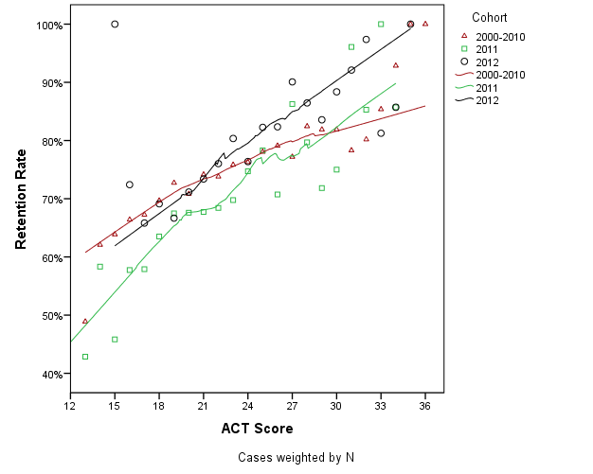
Retention Rates by ACT Scores

Slide 28
What About Chance?
Very unlikely.
Since 1992, retention rates have never topped 76%.
Retention rates have also never changed from year to year more than 3.1%.
The typical change is only 1.2%.
The change from 2011 to 2012 was 6 times higher than normal.

Slide 29
What About All Three of These Things in Combination?
Can the combination of regression towards the mean, incoming FTIAC quality, and random chance explain the increase in retention rates?
Traditional statistics useful here! (Regression)
Answer: No! The 2012 cohort lies outside of the 95% confidence of past retention rates, even after controlling for academic preparation.

Slide 30
Recap
While it’s true that some of the variation in retention rate is explained by the quality of the FTIAC class, a return to normal rates, and chance, there is still a significant amount of unexplained increase.
After accounting for all of this, about 3 to 4 percent of the improvement in retention rates is left unexplained.
This is OIRA’s best estimate of the current impact of the FYAC center on retention rates.

Slide 31
What About Other University Initiatives?
Could other university initiatives explain the improvement in retention rates?
No one has identified a university initiative that could have impacted so many students so evenly.
Improvements in all groups of FTIACs
Almost all other university initiatives target small pockets of students.
We saw improvements only in first year FTIACs, not in second year FTIACs.
Only FYAC Students saw an increase in retention.

Slide 32
Other Improvements
Retention Improvements:
Undecided student retention up 12%
Retention for housing students up 13%
Retention commuting students up 5%
Minority Retention up 9%
Non Retention Improvements:
NSSE satisfaction w/advisers up 16% in one year!
Fall probation student end-of-year-success up 12%
Sophomore standing percent up 10%
Minority Sophomore Standing up 16%
Students with good standing up 3%

Slide 33
Download This Presentation At
www.oakland.edu/oira
Institutional Research tab
Presentations

