Slide 1
Teaching Dickens and Victorian Afterlives
Natalie B. Cole, Oakland University
PICKWICKIAN ENDEAVORS: the Bi-Annual North American Dickens Conference
Salem State University
26 September 2014

Slide 2
I. Why Focus on the VICTORIAN ERA to Study Afterlives? The Victorian Era’s ELIGIBILITY is Postmodernism’s Cultural “Other” (Kucich & Sadoff, 2000)
“Postmodernism fetishizes notions of cultural
[rupture and] emergence and . . . The nineteenth
century provides multiple eligible sites for
theorizing such emergence including economics,
sexuality, politics, technology”
(Kucich and Sadoff xv).

Slide 3
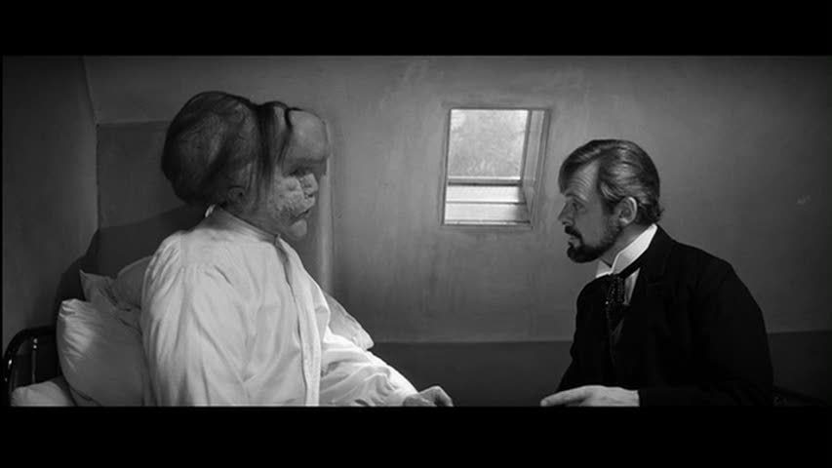
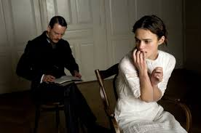
Medical and Psychoanalytical Discourses
ELEPHANT MAN, 1980
A DANGEROUS METHOD, 2011

Slide 4
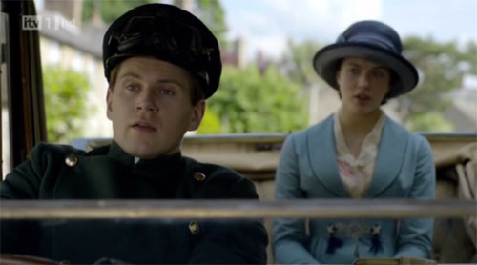
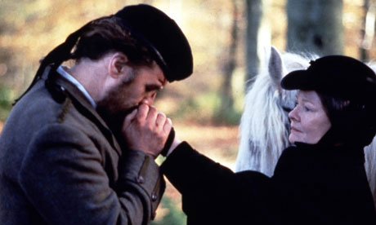
GENDER, SEXUALITY and CLASS CROSSING
Chauffeur Tom Branson and Lady
Sybil Grantham in DOWNTON ABBEY
ALBERT NOBBS, 2011
MRS. BROWN, 1997

Slide 5
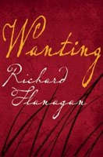
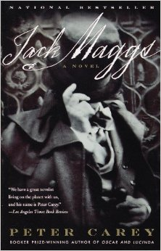
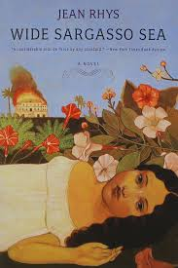
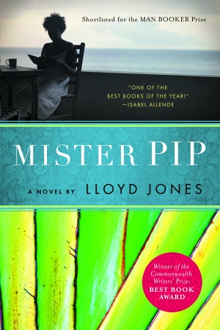
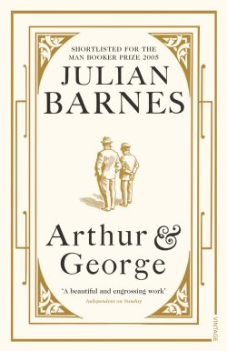
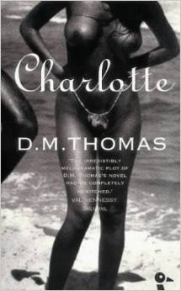
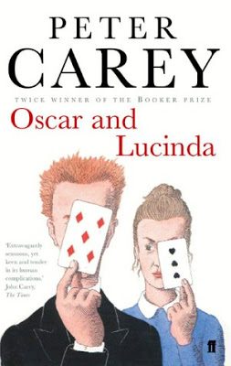
Post-Colonial Discourse

Slide 6
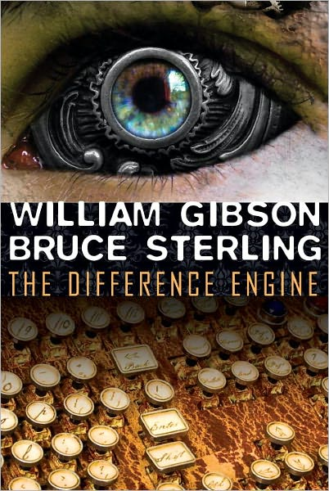
Technology

Slide 7
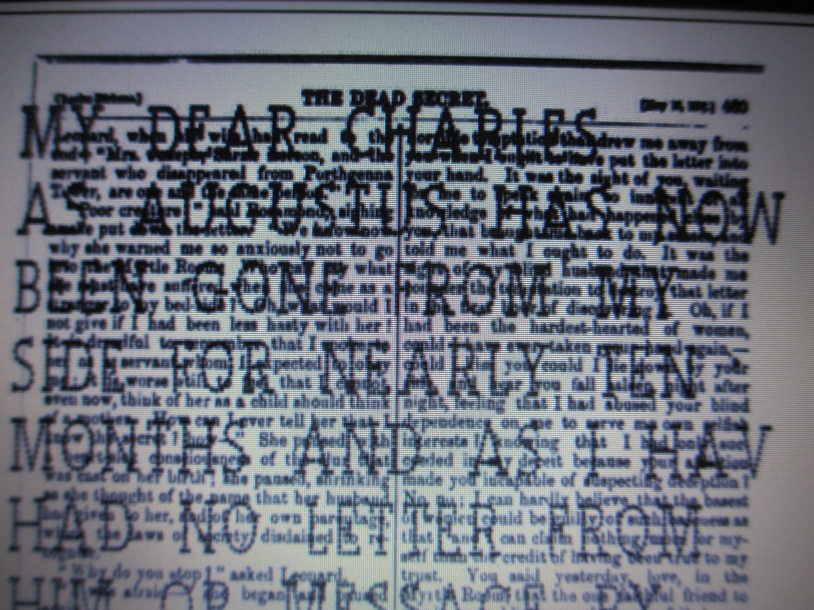
TECHNOLOGY, DISABILITY AND FAMILY FRICTION: Lillian Nayder. “Tangible Typography.” Journal of Neo-Victorian Studies. 5:2 (2012): 179-201.
Excerpt from Nayder’s Neovictorian novel
in progress, Letitia and
Harriet, in which Dickens’s blind sister-in-law
Harriet uses a new technology to write
letters, disturbing Dickens:
“the words were actually
impaled as the new text was created. In
jest, Harriet called her prick writing her
needlepoint but there was nothing domestic
or womanly about that work. Dickens
was indignant. The proofs of HOUSEHOLD
WORDS were not waste paper, but
Harriet had treated them as such . . .

Slide 8
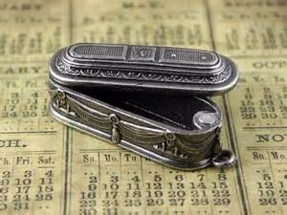
II. What’s an Afterlife and does it imply source texts are dead?!
Victorian necklace coffin-pendant
*most simply, “continued, or renewed use, influence” (OED)
*Afterlife texts invoke postmodernism: “…built into the novel as a form is a strong tendency to use prior texts as the basis for a new work. We might even go so far as to say that the novel from the beginning was engaged in an ‘aftering, even a postmodern project” (Anne Humpherys, 2002).
*“The resurgence of Victorian conventions and rewritings parallels [our own]resurgent anxieties about the erosion of culture itself” (Nancy Armstrong, 2000, xxvii in Kucich and Sadoff).

Slide 9
Degrees of afterlives
Hadley defines Neovictorian texts as “contemporary fiction that engages with the Victorian era, at either the level of plot, structure, or both” (Hadley 2010; qtd. Kirchknopf 2013, 28).
Heilmann and Llewellyn state that a Neovictorian text “[must] be self-consciously engaged with the act of (re)interpretation, (re)discovery and (re)vision concerning the Victorians (Heilmann and Llewellyn 2010, 4).
Metatextuality is “the critical relation between one text and another, whether the commended texts is explicitly cited or only silently evoked” (Stam 2004, 28).

Slide 10
A Journal of Its Own:
Journal of NeoVictorian Studies (University of Swansea, UK, first issue Fall 2008)
AIMS AND SCOPE
Neo-Victorian Studies is a peer-reviewed, inter-disciplinary eJournal dedicated to the exploration of the contemporary fascination with re-imagining the nineteenth century and its varied literary, artistic, socio-political and historical contexts in both British and international frameworks. Perhaps most evident in the proliferation of so-called neo-Victorian novels, the trend is also discernible in a recent abundance of nineteenth century biographies, the continuing allure of art movements such as the pre-Raphaelites, popular cinema productions and TV adaptations, and historical re-evaluations in such fields as medicine, psychology, sexology, and studies in cultural memory.
(http://www.neovictorianstudies.com/).

Slide 11
An Afterlife by any other name . . . (see Andrea Kirchknopf, 2013, for the significance & evolution of naming in this field)
Historiographic Metafiction
Historical fiction
Neovictorian
Post-Victorian
Victoriographies
Adaptation
Rewriting
Spectrality and Haunting
Memory
Mirrors
Refractions
Nostalgia
Trauma healing

Slide 12
Rise of Theories of Victorian Afterlives
Intertextualities
Adaptation Theories
Pretext, source text, hypotext
Latecome text, adaptation, hypertext
A “promiscuous inter-discipline” borrowing from many other disciplines
Have been around since the 1960s
Bloom and Riffaterre focus on intertextuality as “the conflict between text and intertext”
2 axes= texts entering via authors (who are, first, readers) and texts entering via readers
(above info from Intertextuality, eds. Worton and Still 1990: 1-44 passim).
“Intertextuality itself becomes a product and tool of social reproduction, reflecting hierarchies in society and reproducing them at the same time” (Wolfgang Karrer 130).
Getting rid of the fidelity argument in film adaptation study (Brian McFarlane,1996)
A “retracing of boundaries which allows for more inclusive categories, within which adaptation simply becomes simply another ‘zone’ on a larger and more variegated map” (Stam 2004:9.)

Slide 13
THEORY TAKES OFF: 2000-2004
Victorian Afterlives (Kucich and Sadoff 2000)
Nostalgic Post-Modernism: the Victorian Tradition and the Continental British Novel (Christian Gutleben 2001)
Functions of Victorian Culture at the Present Time (Ed.Christine Krueger 2002)
Science in the Neo-Victorian Novel ( Daniel Boorman 2002)
Charles Dickens in Cyberspace (Jay Clayton 2003)
Refracting the Canon in Continental British Literature and Film (Christian Gutleben and Susanne Onega 2004)
[Boldfaced: used in ENG 566]

Slide 14
Whole lotta Neovictorianism goin’ on: 2005-2014
Victorians in the Rearview Mirror (Simon Joyce, 2007)
Victorian Turns, NeoVictorian Returns: Essays on Fiction and Culture (Eds. Penny Gay, Judith Johnston and Catherine Waters, 2008)
NeoVictorian Fiction and Historical Narrative: the Victorians and Us (Louisa Hadley,2010)
NeoVictorianism: Victorians in the Twenty-First Century (Anne Heilmann and Mark Llewellyn 2010)
Haunting and Spectrality in NeoVictorian Fiction (Arias and Pulham 2010)
NeoVictorian Tropes of Trauma (Kohlke and Gutleben 2010)
Rewriting the Victorians: Modes of Literary Engagement with the Nineteenth Century (Andrea Kirchknopf, 2013)

Slide 15
III. Teaching Dickens and Victorian Afterlives A. Course Nuts and Bolts
ENG 566: Victorian Afterlives, M.A. level course
Schedule: Winter 2013, 14 Weeks, 6:00-9:20 p.m. Mondays
GRADING:
Presentation of an “afterlife” 10%
Presentation of critical essay 10%
In-class essay quizzes 20%
3 papers, 20% each 60%
(may do a creative project for one of these)

Slide 16
Creative Project Grading Rubric
Student:
Project Title/Description:
10%: Does project indicate a significant investment of time and energy as reflected in the project and project bibliography, comparable to that expended in writing a formal paper?
2. 25%: Does it have a well-theorized headnote explaining the rationale for, genesis of, and outcome of the project?
3. 50%: How does it offer a unique or creative interpretation of the ENG 566 course topic on Victorian Afterlives?
4. 15%: How does it add to student’s knowledge/understanding of topic?
Grade:

Slide 17
Oakland University
College of Arts and Sciences
Department of English
ENGLISH 566: Victorian Novels & Their Afterlives
Winter 2013, Thursdays, 6:00-9:20 p.m.
Professor N. Cole E-mail: cole@oakland.edu
Office: 521 O’Dowd Hall Office Hours: TH 3:00-4:30
Office: (248) 370-2270 & by appointment
TEXTS:
C. Bronte, Jane Eyre (1846)
Cusk, The Country Life (1997)
Dickens, David Copperfield (1849)
DuMaurier, Rebecca (1938)
Irving, The Cider House Rules (1985)
Ishiguro, Never Let Me Go (2005)
Pomerance, Elephant Man (1979)
Treves, Elephant Man & Other Reminiscences, (1923)
Moodle: Selected critical essays
All Moodle assignments must be printed, and brought with you to class.
PLEASE NOTE: This class requires we read at a brisk clip, so consider carefully if you can get the reading done this semester in balance with your other academic, work, and personal responsibilities.

Slide 18
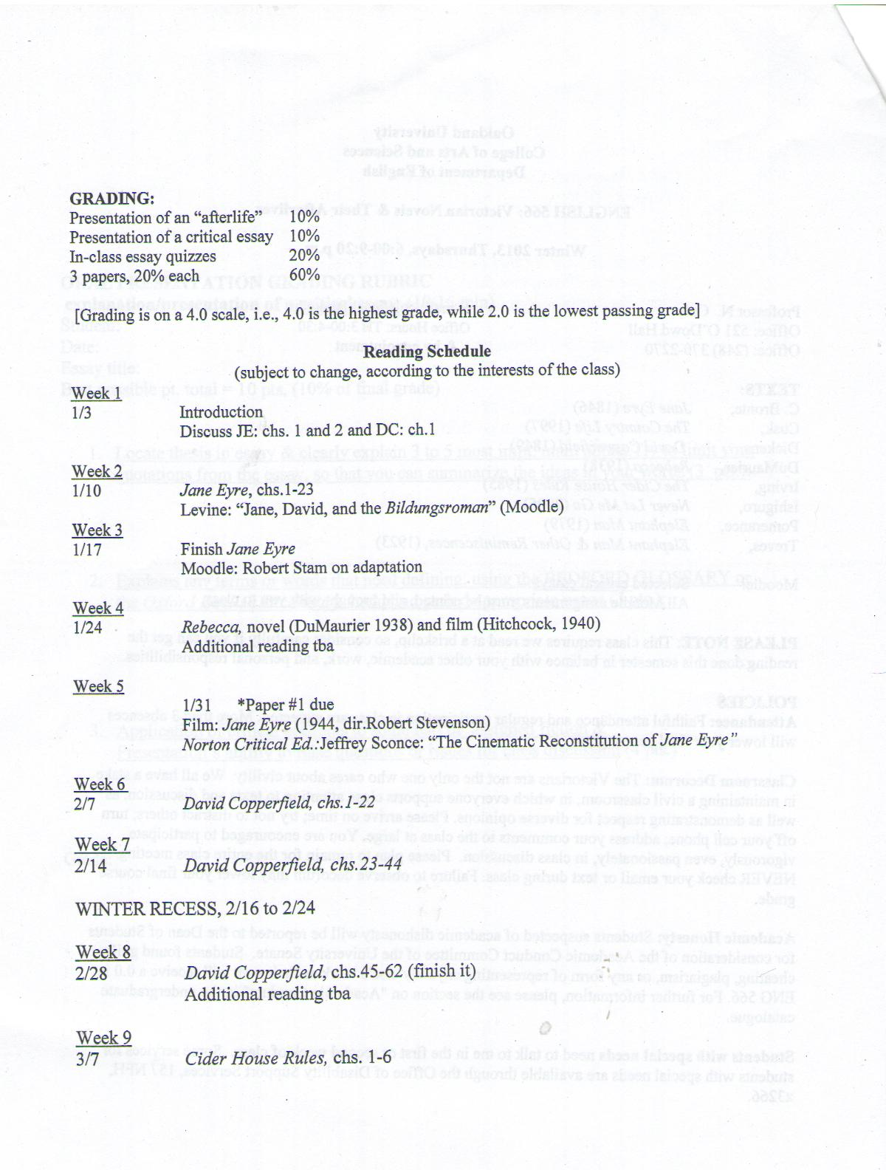

Slide 19
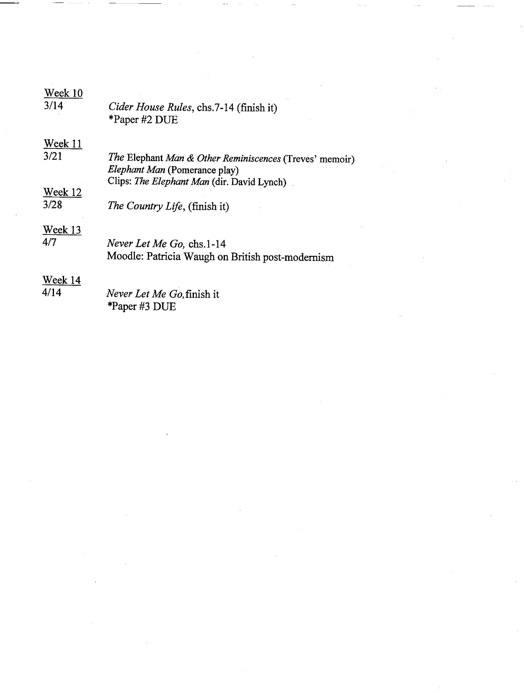

Slide 20
Paper Guidelines, Paper #2, for ENG 566: Victorian Novels and Their Afterlives
Due date: March 21, beginning of class
Length: 6-8 pages, double-spaced, 12 point font, exclusive of Works Cited
Research required: Concentrate most on your own independent analysis of the text(s), with judicious, limited use the articles posted on Moodle and limited, relevant research. Close-reading of specific passages is a must, as is analysis of the author’s language.
Format: MLA, with parenthetical citation and Works Cited
How will paper be graded?
20%: Thesis: strength, originality, completeness
40%: Textual support and analysis
20% Ability to theorize adaptation, genre, and historical context
20% Writing

Slide 21
Topics: you may choose one of these, revise one of these, or formulate your own
Discuss the evolution of the bildungsroman as it appears in David Copperfield and Cider House Rules. Pay special attention to POV and its effects on how readers understand the protagonist. You may consider how Irving’s literary realism reflects the writer’s post-modern era despite/because of, his use of the historical past.
2. Discuss the effect of specific omissions and transcoding of a specific character or in a specific scene, of an adaptation of David Copperfield, Cider House Rules, or Lynch’s The Elephant Man. Be sure to use appropriate theoretical key terms from Robert Stam’s essay on adaptation. Be sure to find production information and film reviews to inform your essay. [continued on next slide]

Slide 22
3. Discuss the challenges and successes of Bernard Pomerance in adapting material from Frederick Treves’ memoir about John Merrick, the “Elephant Man.” How does the drama genre adapt Treves’ medical memoir? As Patricia Hampl and Elaine Tyler May remind us, both the historian and the memoirist face “blank spaces” where they must “do the work of interpretation and imagination,” and while memoir “angles forward with strong claims for the individual voice,” “History charts the big picture” (Tell Me True: Memoir, History, and Writing a Life, 3-4).
4. Discuss the representation of orphans and fallen women in David Copperfield and Cider House Rules and the cultural ideologies that define and try to contain them. Stallybrass and White have argued, following Mikhail Bakhtin, that “that which is socially peripheral is symbolically central” to a culture and society. Further, one might consider how locations such as the hospital at St. Cloud’s and even the apple orchard, employ what Stallybrass and White describe as inversion: “the reversible world which encodes ways that carnival inverts the everyday hierarchies, structures, rules and customs of its social formation” (1986, ch.5:183).

Slide 23
III. B. Teaching Afterlives: Inspirations for this course: good question to consider
PROFESSOR’S INTEREST IN, ENJOYMENT OF, Neovictorian fiction, spurred by colleagues’ work and conversations at conferences like these
Follows frequent teaching of adaptations in Victorian, English Novel, and Brit Lit Survey Courses and specific 2 adaptation courses I taught: DICKENS AND ADAPTATION [OLIVER TWIST, GREAT EXPECTATIONS],
ADAPTATION (Lit. to Film: A CHRISTMAS CAROL, PRIDE AND PREJUDICE, DRACULA, DOUBLE INDEMNITY)
Academy’s emphasis on keeping humanities “relevant” to growing number of STEM students (current Honors College enrollment at Oakland University, 650 students, comprised of 35% pre-med, 25% engineering)
New Cinema Studies Major in English Department and shifting organization of English Department, decentering literary period studies

Slide 24
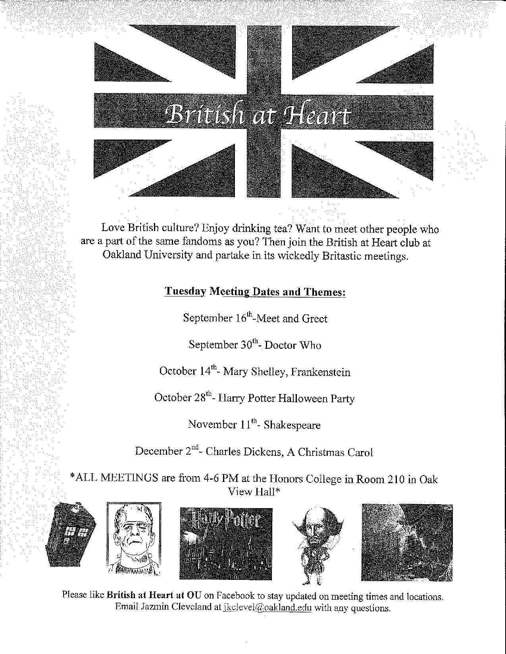
Expansion of the canon since
Mid-70s in the Academy has
shifted status/position of
British Literature.
The British at Heart
Faculty/Student Club at my
university is a
response to that and follows on
the heels of such groups for
Creative Writing, American
Studies, and Cinema Studies.

Slide 25
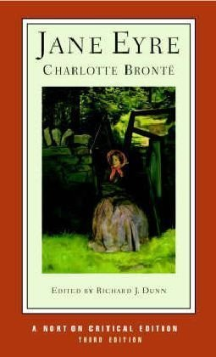
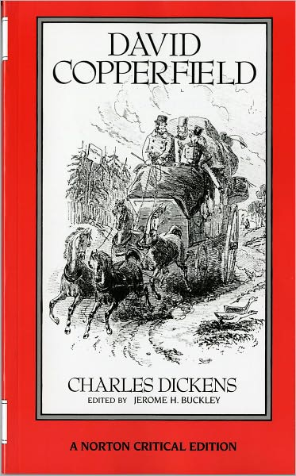
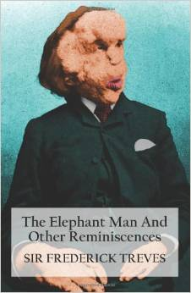
III. C: Texts for English 566: Victorian Afterlives

Slide 26
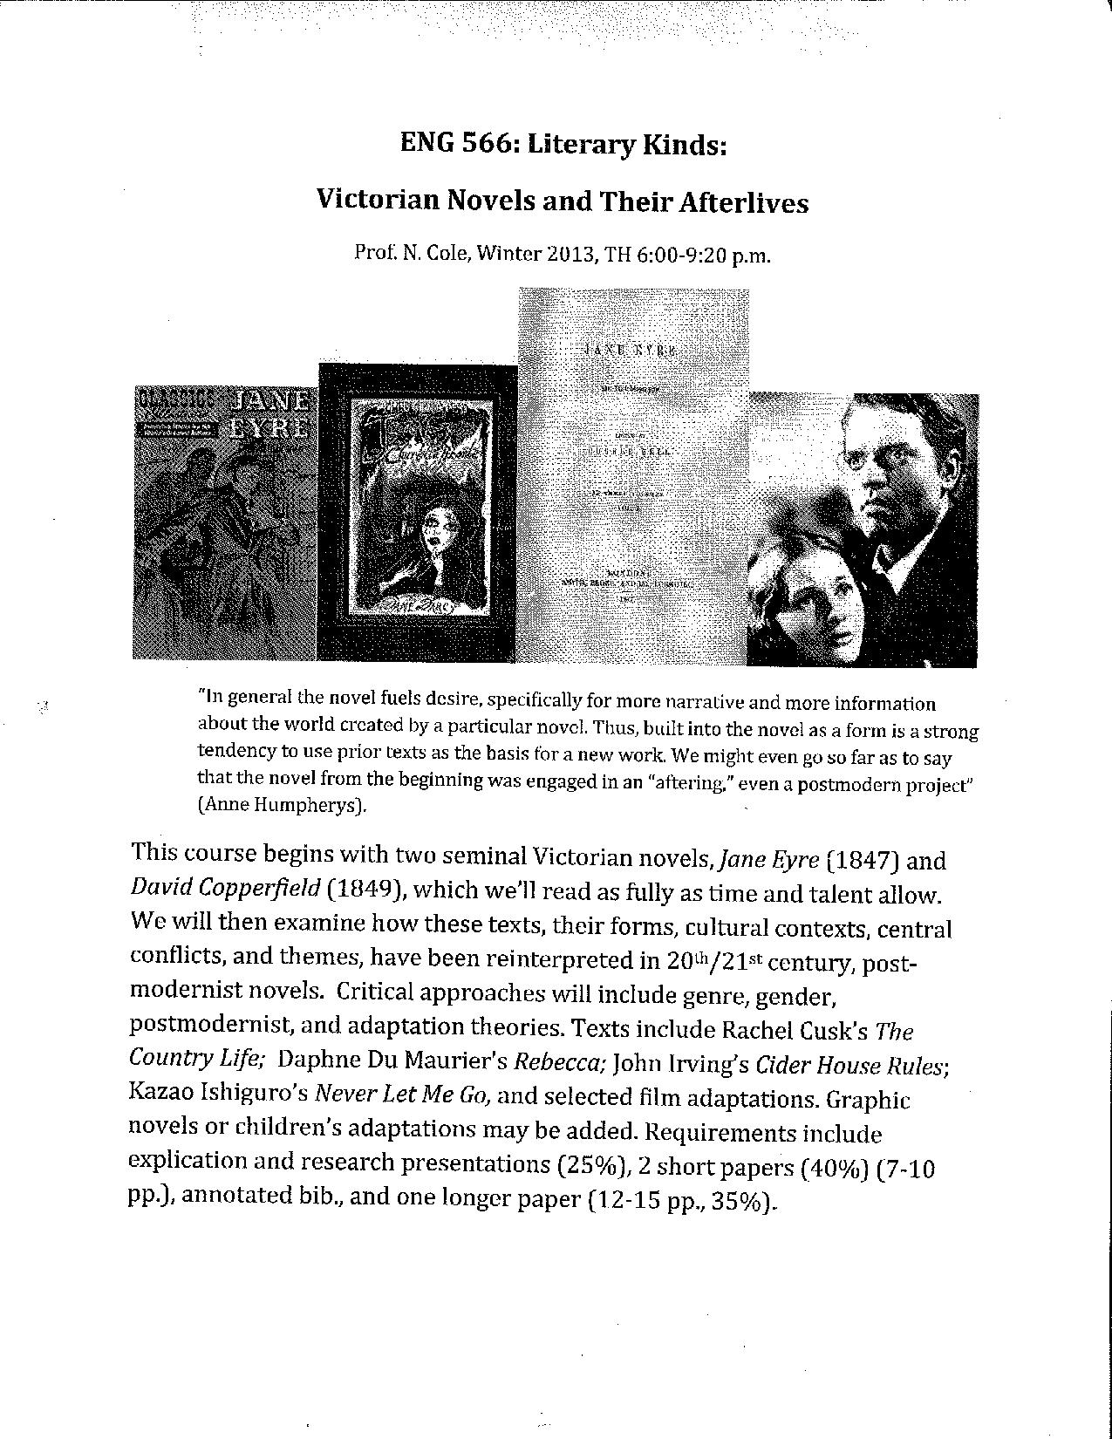
With enrollments
dropping, flyers help
advertise classes. This
is the flyer for ENG 566, which
enrolled 12 students.

Slide 27
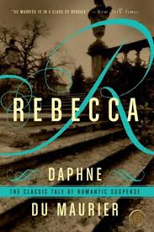
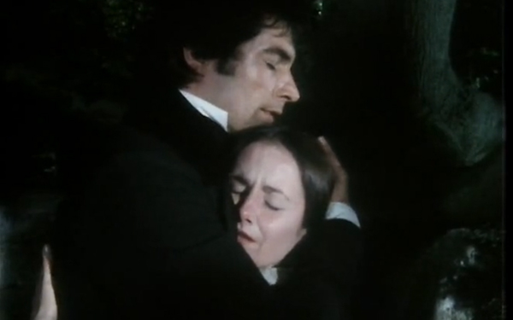
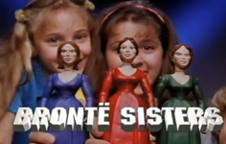
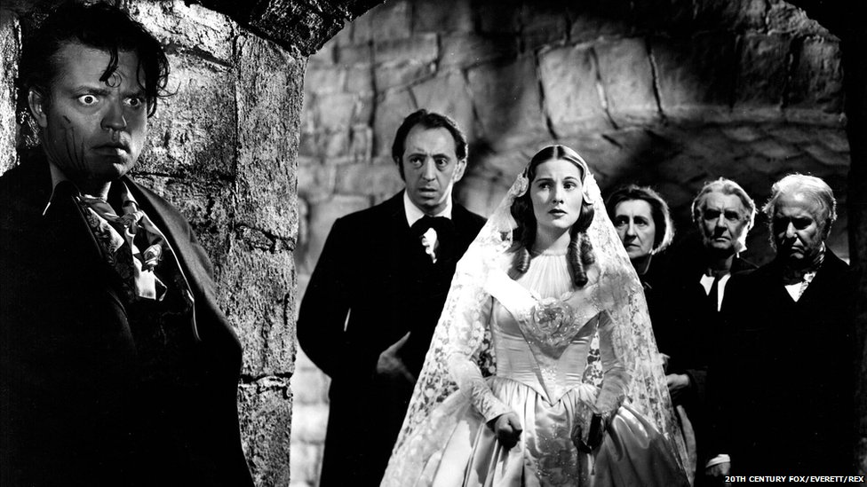
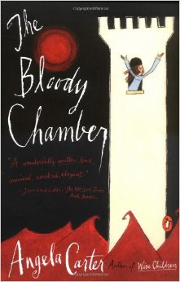
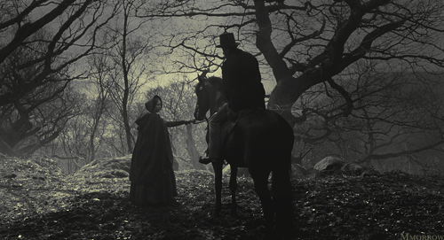
JANE EYRE INTERTEXTS
https://www.youtube.com/watch?v=-NKXNThJ610

Slide 28
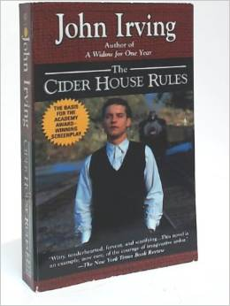
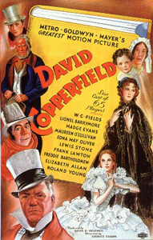
David Copperfield Intertexts
Novel 1985, film 1999
Novel 2005, film 2010)
1935

Slide 29
DAVID COPPERFIELD (1849-50)
Bildungsroman of orphan
Mentor figure: Micawber
Move from province to city
Education: formal and informal
Nicknames: Daisy, Doady,
Trotwood
Fairy godmother: Betsy Trotwood
School days: Salem House boys school
Peer influence: Steerforth
Trauma: Shipwreck
Becomes a writer
Achievement of Adulthood
but ambiguous autonomy
Cider House Rules (1999)
Bildungsroman of orphan
Dr. Larch
St. Cloud to Ocean Breeze
Sunshine
Candy and Wally
Orphanage days
Peer Influence: Melony
Traumas: unwanted
Pregnancies; abortions;
WWII (Wally),
Incest abuse
Becomes a doctor/abortionist
Achievement of adulthood
but ambiguous autonomy
Never Let Me Go (2005)
Bildungsroman of clone
Miss Lucy
Move from Hailsham to
travel as a carer
None
Song: “Never Let Me Go”
Hailsham
Peer influence: Tommy & Ruth
Traumas: “Donations”; awareness
of no future for clones
Carer, then donor (regression)
Achievement of humanity
but tragically limited autonomy

Slide 30
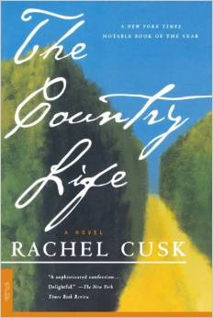
JANE EYRE (C. Bronte, 1846)
Governess
Status incongruence
Observer of gentry class
Secret past
Lands amidst complex
family dynamics
Critique of English country
House as patriarchal
symbol and setting
Bildungsroman,
Gothic romance
Attic/roof
Madness, dreams
Future w/disabled “Other”
Intertext: “Bluebeard”
THE COUNTRY LIFE (R. Cusk, 1997)
Companion,special needs aide
Status incongruence
Observer of gentry class
Secret past
Lands amidst complex family
dynamics
Critique of English country
House and alienating setting for
urban dweller
Bildungsroman elements,
Countryside becomes gothic
through strangeness
Cottage, rose garden,
swimming pool
PTSD? Mental illness?
Future with disabled “Other”
Intertexst: REBECCA, JANE EYRE

Slide 31
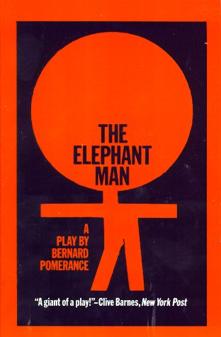
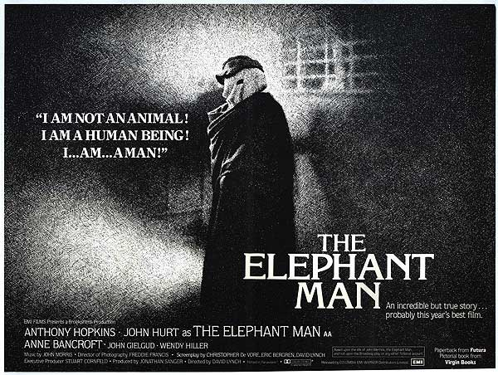
THE ELEPHANT MAN by Bernard Pomerance
London debut 1977; Broadway 1979
THE ELEPHANT MAN
dir. David Lynch, 1980
“Professor
Cole, why
Is ELEPHANT
MAN in this
course?”

Slide 32
IV. Evaluating the Course: What Worked Well:
Topic and choice of texts
Paper assignments
Forum posts and class discussion
Student presentations: one on a critical essay and one of an “afterlife” (Dickens theme park, film adaptation, advertisement/produces based on source text, Steampunk, others); these gave students good experience in analyzing critical discourse
Creative option for final project

Slide 33
Areas to rethink and improve
*Presentations took up a lot of class time. Maybe have one formal 20 min presentation and one shorter explication/kick-off discussion of primary text
Greater focus on Neovictorian fiction set in 19th century?
Inclusion of Biofiction
Greater engagement with post-colonial Neovictorian fiction
Reconfigure balance of fiction and theory?
Inclusion of children’s adaptations, graphic texts, marketing?
Ask for fuller theorizing of creative projects
More fun and fostering of Dickensian conviviality!

Slide 34
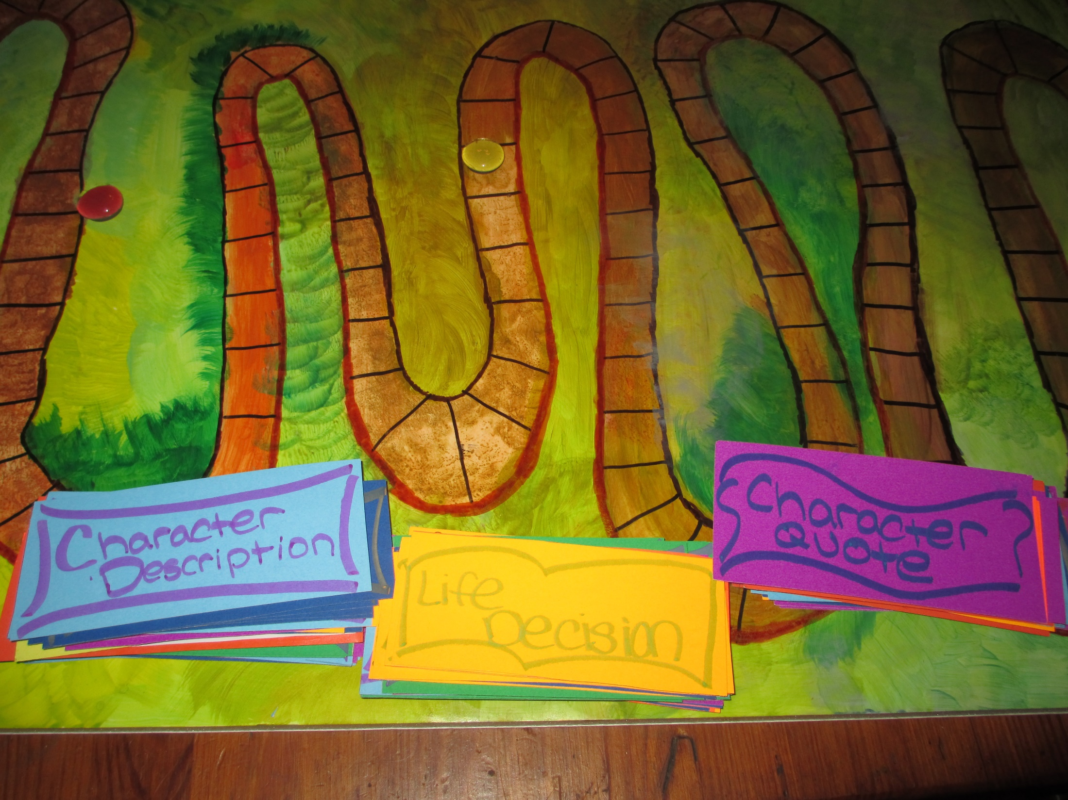
V. STUDENT CREATIVE PROJECTS:
People mutht
be amuthed—
“My Victorian
Journey” GAME
Based on
DAVID
COPPERFIELD
and JANE EYRE

Slide 35
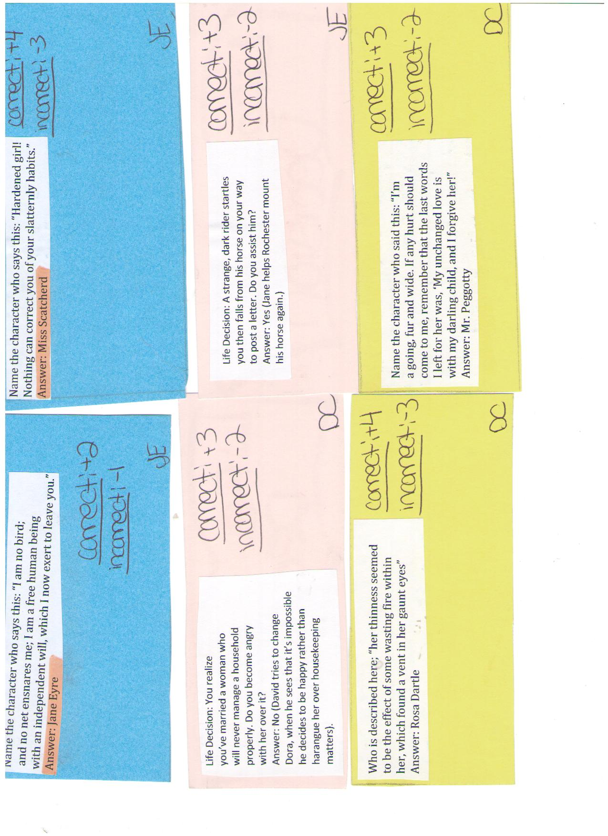

Slide 37
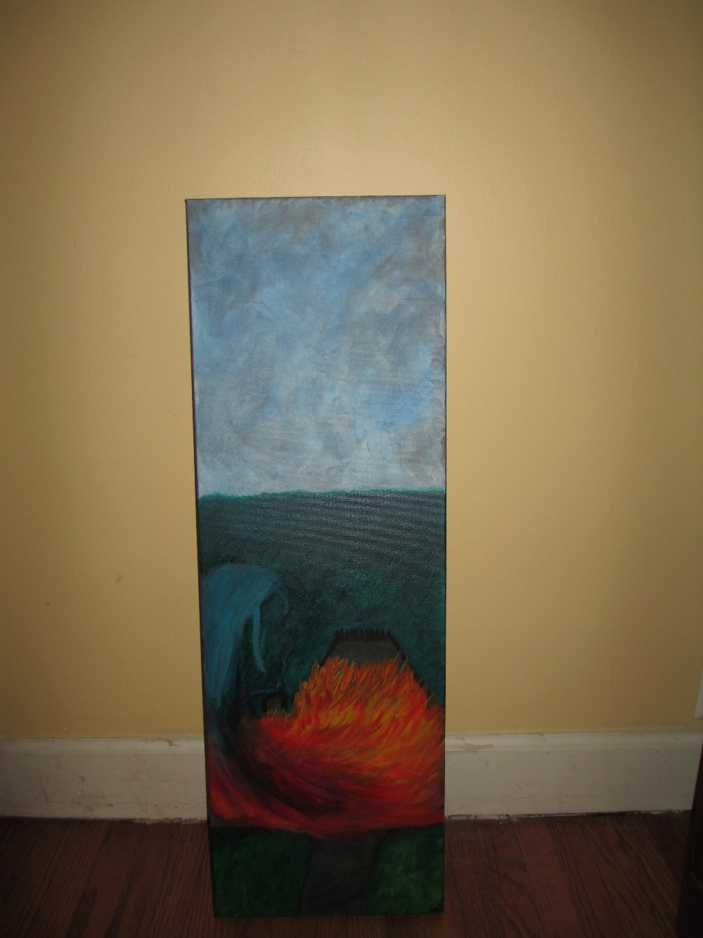
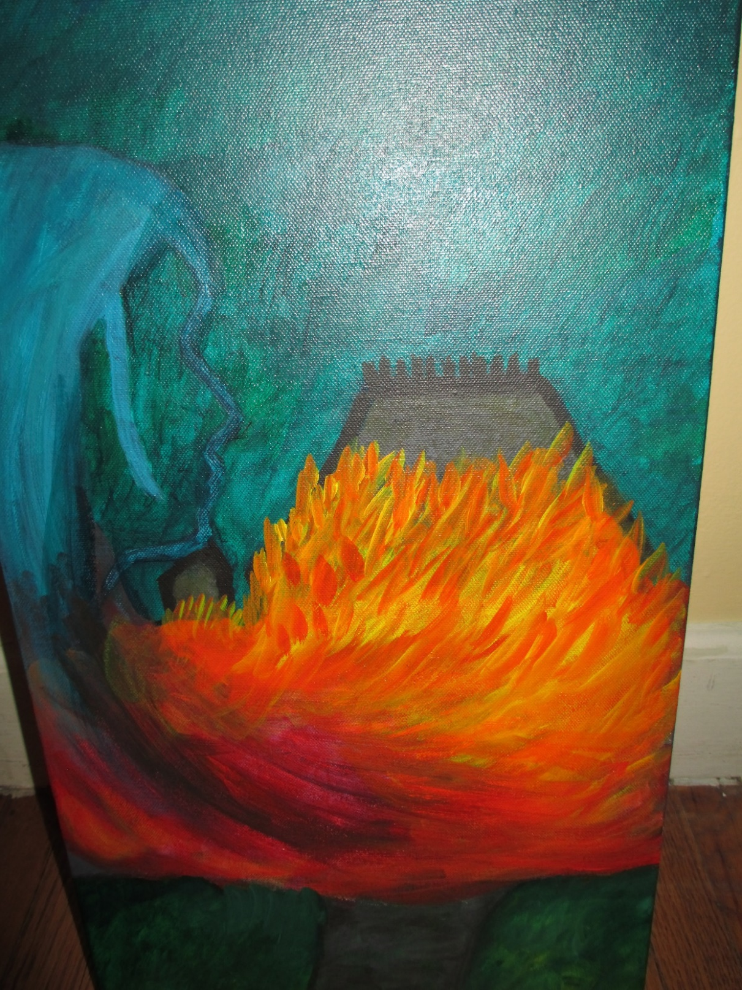
Painting interpreting JANE EYRE and REBECCA
By MC

Slide 38
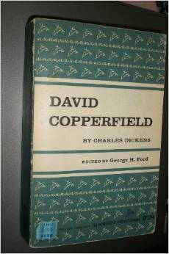
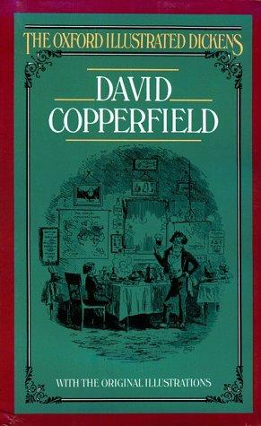
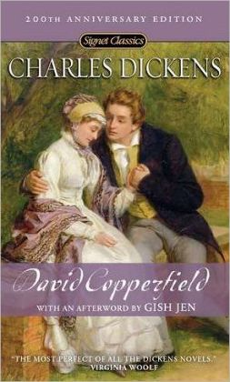
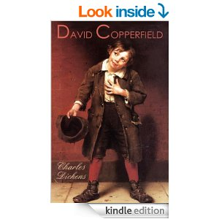
As editions change, classroom teaching
changes: DC 1958 to 2014

Slide 39
NEOVICTORIANISM Has Arrived:
this blog explains how to write a Neovictorian Novel
March 15, 2006 [http://littleprofessor.typepad.com/the_little_professor/2006/03/rules_for_writi.html]
Rules for Writing Neo-Victorian Novels
All middle- and upper-class Victorian wives are Sexually Frustrated, Emotionally Unfulfilled
and possibly Physically Abused. If they're lucky, however, they may find Fulfillment with a)
a man not their husband, b) a man not their husband and of the Laboring Classes, c) a man not their husband and of Another Race,
or d) a woman not their, er, husband.
Christians may be Good, as long as they are not evangelicals. Evangelicals, however
, are Bad, and frequently Hypocritical.
All heroes and heroines are True Egalitarians who disregard all differences of Class,
Race, and Sex. Heroines, in particular, are given to behaving in Socially Unacceptable
Ways, which is always Good.
All heroes and heroines are Instinctively Admired by members of
Oppressed Populations.
Any outwardly respectable man will a) have frequent recourse to Prostitutes,
b) have a Dark Secret, and/or c) be Jack the Ripper.
There must be at least one Prostitute, who will be an Alcoholic and/or have
a Heart of Gold. If the novel is about a prostitute, however, she will have at least one
Unusual Talent not related to her line of work.
.

Slide 40
Continued from previous slide:
March 15, 2006 [http://littleprofessor.typepad.com/the_little_professor/2006/03/rules_for_writi.html]
Rules for Writing Neo-Victorian Novels
All children are subject to frequent Physical, Emotional, and Sexual Abuse.
Nevertheless, they will grow up to become Sensitive and Caring Adults.
Any novel based on an actual Victorian literary work must include
considerable quantities of Sex.
There must be at least one scene set in a Wretched Slum,
which will be very Dirty and Damp.
The novelist must make the prose more Antique by eliminating all Contractions
and using Period Slang (whether or not it is actually appropriate).
Finally, the novel's publicist should use the adjective "Dickensian" at least once

Slide 41
VI. Recommended Reading in NeoVictorian Fiction: Selected Texts
Arnold, Gaynor. Girl in a Blue Dress.
Atwood, Margaret. Alias Grace.
Bayard, Louis. Mr. Timothy.
Barnes, Julian. Arthur & George.
Bermejo, Lee. Batman: Noel.
Boyne, John. This House Is Haunted.
Busch, Frederick. The Mutual Friend.
Byatt, A.S. Possession.
Carey, Peter. Jack Maggs.
Oscar and Lucinda.
Carr, Caleb. The Alienist.
Clark, Clare. The Great Stink.
Cusk, Rachel. The Country Life.
Donoghue, Emma. The Sealed Letter.
Du Maurier, Daphne. Rebecca.
Faber, Michel. The Crimson Petal and the White.
Fforde, Jasper. The Eyre Affair.
Fowles, John. The French Lieutenant’s Woman.

Slide 42
Neo-Victorian Fiction: Selected Texts
Flanagan, Richard. Wanting.
Gibson, William and Bruce Sterling. The Difference Engine.
Holman, Sheri. The Dress-Lodger.
Irving, John. Cider House Rules.
Jones, Lloyd. Mr. Pip.
Palliser, Charles. The Quincunx.
Pearl, Matthew. The Last Dickens.
Priest, Christopher. The Prestige.
Rhys, Jean. Wide Sargasso Sea.
Simmons, Dan. Drood.
Tennant, Emma. The French Dancer’s Bastard.
Thomas, DM. Charlotte.
Waters, Sarah. Affinity
Fingersmith.
Tipping the Velvet.

Slide 43
WORKS CITED
Albert Nobbs. Dir. Rodrigo Garcia. Mockingbird Pictures. 2011. Film.
Armstrong, Nancy. “Contemporary Culture: How Victorian Is It?” Victorian Afterlives: Postmodern Culture Rewrites the Nineteenth Century. Eds. John Kucich and Diane Sadoff. Minneapolis and London: University of Minnesota Press, 2000. 311-326.
Boorman, Daniel. Science in the Neo-Victorian Novel. Bern, Switzerland: Peter Lang, 2002. Print.
Bronte, Charlotte. Jane Eyre. New York: W.W. Norton, 2001. Print.
“Bronte Power Dolls.” Phil Lord and Chris Miller. On-line video clip. YouTube. YouTube. Web. 24 Sept. 2014.
Clayton, Jay. Charles Dickens in Cyberspace: the Afterlife of the Nineteenth Century in Post Modern Culture. 2003. Oxford: Oxford UP, 2003. Print.
Cusk, Rachel. The Country Life. New York: Great Britain: Picador. 1997. Print.
A Dangerous Method. Dir. David Cronenberg. RPC. 2011. Film.
Dickens, Charles. David Copperfield. New York: W.W. Norton, 1990. Print.
David Copperfield. Dir. George Cukor. Metro-Goldwyn-Mayer. 1935. Film.
.

Slide 44
WORKS CITED continued
Downton Abbey. Masterpiece Theatre. Created by Julian Fellowes. PBS. 2010-2014. Television.
DuMaurier, Daphne. Rebecca. New York: Harper, 2006. Print.
The Elephant Man. Dir. David Lynch. BrooksFilms. 1980. Film.
The Functions of Victorian Culture at the Present Time. Ed. Christine Krueger. Athens, OH: Ohio UP, 2002. Print.
Gutleben, Christian. Nostalgic Post-Modernism: the Victorian Tradition and the Continental British Novel. Amsterdam and New York: Rodopi, 2001.Print.
Hadley, Louisa. NeoVictorian Fiction and Historical Narrative: the Victorians and Us. Houndmills, Basingstoke, Hampshire: Palgrave Macmillan, 2010. Print.
Hampl, Patricia, Elaine May, et al. Tell Me True: Memoir, History, and Writing a Life. Borealis, 2011. Print.
Heilmann, Anne, and Mark Llewellyn. NeoVictorianism: Victorians in the Twenty-First Century: 1999-2009. Houndmills, Basingstoke, Hampshire: Palgrave Macmillan, 2010. Print.
Humpherys, Anne. "The Afterlife of the Victorian Novel: Novels about Novels" in A Companion to the Victorian Novel. Ed. Patrick Brantlinger and William Thesing. Malden, MA: Blackwell, 2002: 442-457. Print.
Intertextuality. Eds. Michael Worton and Judith Still. Manchester and New York: Manchester UP, 1990. Print.
Joyce, Simon. Victorians in the Rearview Mirror. Athens, OH: Ohio UP, 2007. Print
.

Slide 45
WORKS CITED continued
Journal of Neo-Victorian Studies. http://www.neovictorianstudies.com/). Web.
Karrer, Wolfgang. “Titles and Mottoes as Intertextual Devices.” IntertextualityEd. Heinrich F. Plett. Berlin and New York: Walter de Gruyter, 191. Print.
Kirchknopf, Andrea. Rewriting the Victorians: Modes of Literary Engagement with the 19th Century. Jefferson, NC and London: McFarlane, 2013. Print.
Kohlke, Marie-Luise and Christian Gutleben. Neo-Victorian Tropes of Trauma: The Politics of Bearing After-Witness to Nineteenth-Century Suffering. Amsterdam and New York: Rodopi, 2010. Print.
Mrs. Brown. Dir. John Madden. BBC Scotland. 1997. Film.
Nayder, Lillian. “Tangible Typographies.” Journal of Neo-Victorian Studies 5:2 (2012): 179-201. http://www.neovictorianstudies.com/). Web.
Suzanne Onega and Christian Gutleben. Refracting the Canon in Continental British Literature and Film. Amsterdam and New York: Rodopi, 2004. Print.
Pulham, Patricia and Rosario Ari. Haunting and Spectrality in Neo-Victorian Fiction: Possessing the Past. New York: Palgrave Macmillan, 2009. Print.
Pomerance, Bernard. Elephant Man. New York: Grove Atlantic, 1979. Print.

Slide 46
WORKS CITED concluded.
Stallybrass, Peter and White, Allon. The Politics and Poetics of Transgression. Ithaca and London:Cornell UP, 1986. Print.
Stam, Robert. “Introduction: the Theory and Practice of Adaptation.” Literature and Film: A Guide to the Theory and Practice of Adaptation. Eds. Robert Stam and Allesandra Raengo. Hoboken, NJ: Wiley-Blackwell, 2004. 1-52. Print.
Treves, Frederick. The Elephant Man and Other Reminiscences. Oxford: Benediction Classics, 2012. Print.
Victorian Afterlives: Postmodern Culture Rewrites the Nineteenth Century. Eds. John Kuich and Diane Sadoff. Minneapolis and London: University of Minnesota Press, 2000. Print.
Victorian Turns, NeoVictorian Returns: Essays on Fiction and Culture. Eds.Penny Gay, Judith Johnston and Catherine Waters, Newcastle Upon-Tyne: Cambridge Scholars, 2008. Print.

