Slide 1
Actualizing the Vision for the Center for Excellence in Teaching and Learning (CETL): From the Perspective of the Director
Judith Ableser Ph.D.
Director- Center for Excellence in Teaching and Learning
ableser@oakland.edu

Slide 2
What I bring to this Role: Who I am
EXPERIENCE
Associate Professor/Coordinator of Special Education/Director of Education Graduate Programs
Ph.D. in Curriculum and Instruction
Teacher Education/Special Education
Supervision/Mentorship of Student Teachers/Teachers/Faculty
Assessment and Evaluation- course, program, Accreditation
Research in Exemplary Teaching in Higher Education
Program /Curriculum Design and Evaluation
Advisory Board of Center for Learning and Teaching
On-line /mixed-mode teaching
Innovative and Effective Teaching Practices
LEADERSHIP SKILLS
Leader and Learner
Collaborative Consultation
Organized and Systematic
Problem solving and conflict resolution
Effective and Efficient
Action Plan/Follow-through
Vision and Goal Directed
DISPOSITIONS
Passionate about teaching
Effective communication skills
Supportive
High Standards for all with plan to reach goals
Organized and systematic
Embrace life long learning
Reflective Practioner
KNOWLEDGE
Pedagogy-Best Practices
Curriculum and Instruction
Exemplary Teaching Practices
Universal Design of Learning/
Differentiated Instruction
Authentic Assignments/Assessments
Service Learning/Experiential
Special Education/Diversity
Learning Outcomes
Assessment and Evaluation
Course and Program Design
VALUES/BELIEFS/PHILOSOPHIES
Teaching for All to Learn-Supporting Diversity
Constructivist
Transformative
Social Action
Critical/Higher Level Thinking

Slide 3
Vision for CETL….
OU’s VISION + MY VISION= OUR SHARED VISION
Dream Big…Plan Realistically…Implement Effectively…..Evaluate for ongoing improvement
Plan Realistically- based on practical support and resources

Slide 4
Build upon Oakland’s Strong Foundation for Teaching and Learning
1. Mission of the Center for Excellence in Teaching
i) To support faculty efforts to improve teaching by creating learning environments in which our diverse student body achieves maximal learning potential
ii) to promote a culture throughout the university which values and rewards effective teaching, and respects and supports individual differences among learners
2. Mission of the University
i) Excellent and Relevant Instruction ***
ii) Research and Scholarship
iii) Public Service
iv) Student Development
3. Foundations of Excellence
4. NCA Self- Study
5. Advisory and support from the Teaching and Learning Committee
6. E-Learning and Instructional Support Services

Slide 5
GOAL: TO ENHANCE THE UNIVERSITY COMMUNITY BY PROMOTING A CULTURE OF TEACHING AND LEARNING EXCELLENCE
Learning- learning outcomes, assessment of learning, critical thinking, skills, knowledge, dispositions
Students- ways to enhance meeting diverse student needs, engaging students, faculty-student interactions, student success and student satisfaction
3. Teaching- exemplary practice, strategies and techniques, UDL, D.I., inquiry, service-learning, field, experiential, problem-based, authentic assignments and assessments, rubrics, constructivist approaches, teaching for all to learn, on-line effective strategies

Slide 6
Continued…
4. Faculty Support- Mentorship, reflective practice, new faculty, adjunct support, exemplary faculty fellows, reward and recognize value of teaching.
Assessment- of learning, of class, of course, of program, etc.
Curriculum- course design, new program development, program evaluation
7. Research and Dissemination of faculty work in teaching and learning- Raise awareness of excellence on campus

Slide 7
Ideas for Implementation based on the Mission of the Center
To support faculty efforts to improve teaching by creating learning environments in which our diverse student body achieves maximal learning potential
1. Mentor New Faculty- in teaching strategies, understanding diverse
learners, balancing and integrating teaching research and service,
building upon the mentorship program
2. Support for adjuncts- improved communication, teaching support, blogs

Slide 8
Engage tenured faculty in ongoing learning and reflective practice
Provide 1:1 support to faculty for improvement (not evaluative…that is the role of the deans and tenure committees) using reflective practice, video analysis
To continue to develop assessment of learning and learning outcomes
To enhance Course Evaluations and other assessment tools- to assess course + student satisfaction (most evaluations focus on satisfaction of students…which is important but doesn’t necessarily allow for effective reflective practice by the faculty)
To collaborate with E-Learning and Instructional Support Services

Slide 9
Continued…
To enhance Curriculum Development and enhance New Program Development- Support in designing, implementing and evaluating curriculum
To provide resources- journals, conferences, grants, workshops, seminars, webinars, videos, video analysis
9. To provide opportunities for ideas to be shared and flourish- , Professional Learning Communities/Teaching Circles, blogs, newsletters, place to simply sit, have coffee and brainstorm

Slide 10
Continued…
To promote a culture throughout the university which values and rewards effective teaching, and respects and supports individual differences among learners
To develop a “Niche” or “identity” to be known by within the university, in the community, and nationally (i.e. Teaching for All to Learn, Transformative Education)
2. To engage in increased research on Teaching and Learning
3. To disseminate research by publishing an on-going journal or writing a scholarly book on teaching and learning with exemplary faculty contributing

Slide 11
Continued….
4. To continue to sponsor Conferences (i.e. with University of Windsor)
5. To create and host a “consortium” of Centers for Teaching Excellence
6. To market effective teaching strategies that faculty are using through University website, newspaper, facebook, etc.
To reward and recognize teaching excellence through awards, grants, incentives, recognitions, fellows
8. To recognize and honor excellence in teaching through a respected Fellows program

Slide 12
Continued…
9. To continue to develop opportunities for grants to develop courses, curriculum, attend conferences, acquire teaching resources, teaching research mini-sabbaticals
10. To be a voice throughout the university community to promote teaching excellence (i.e. self-study, general education, strategic planning, budget, etc.)

Slide 13
My Action Plan
Learn Culture of University
Listen and learn about university
Listen and engage administration, faculty and staff
Listen to voice of students- interests, needs, concerns, ideas
Work with an Advisory Board or Committee
Work with E-Learning and Instructional Support
Look to other Centers
Look at research
Develop a 5-year plan-Long Range Planning that meshes with University plan
Develop a 1-year plan- goals, implementation plan and evaluation plan

Slide 14
The Match
What I bring to the University
My passion for teaching and learning
My belief in Teaching for All to Learn-meeting diverse needs of students
My background and experience in teaching in special education, pedagogy, exemplary teaching practices, supervision, and role as advisory member of UM-Flint’s Center for Learning and Teaching
Research in Teaching and Learning in Higher Education
Role model
Leadership skills and experience
Curriculum background
Program development
Assessment and Evaluation
Fresh outside perspective can add to your current way of thinking
What the University will offer me
The opportunity to actualize what I am most passionate about

Slide 15
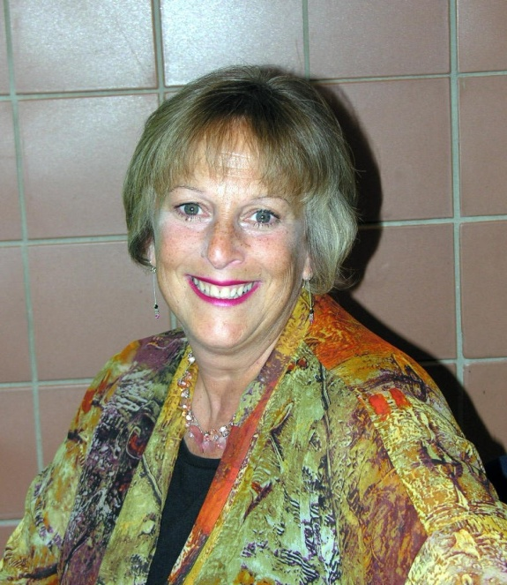
Looking forward to Hearing from You
Judith Ableser Ph.D - Director
Center for Excellence in Teaching and Learning
Oakland University
200D Elliot Hall
Rochester, MI 48309-4401
248-370-2455
ableser@oakland.edu

