Slide 1
A ‘Portrait’ of At Risk University Learners:
All names and identifying traits have been removed or changed within the presented student data
Andrea Prier
University of
Waterloo
&
Geri Salinitri
University of
Windsor
Exploring Belief Systems, Personality Type, and Emotional Intelligence in Relation to Two Students Academic Progress
Notes:
How do we get ‘at risk’ students to improve their understanding, transferability and retention of the information that they are learning? By speaking to them through the voices of their peers. A review of two student’s journeys within a first year retention program, which includes a Strategies and Skills for Academic Success course, will explore how ‘at risk’ students’ beliefs systems, personality type, and emotional functioning influenced their learning approaches. Examples of student voice will be showcased and outcomes surrounding their engagement, course mastery, and retention will be highlighted. Strategies, and practical examples of how to incorporate student voice into the ‘at risk’ university classroom will also be discussed.
For a learner who is struggling academically, understanding why they should put the effort into learning about personality, and emotional intelligence can be difficult. Instead of teaching this content at them, we as instructors, must afford students the practical opportunities to see how a heightened self-awareness around their personality type, and emotional functioning can improve their level of understanding of the information being taught, their motivation to learn the material, their retention of the information that they are learning, and ultimately, their success in the classroom (Hofer & Pintrich, 1997; Chen & Pajares, 2010). This paper explores two student’s journeys within a strategies and skills course which has been designed to foster self awareness around belief systems, personality type, and emotional intelligence.

Slide 2
What does the ‘At Risk’ University Learner Look like?
Notes:
Speed dating: Five minutes to write down thoughts, discuss with a partner, share with the group

Slide 3
What does the ‘At Risk’ University Learner Look like?
What did you consider in your analysis?
Academic Ability (?)
Socio – Economic Factors (?)
Socio – Cultural Traits (?)
Metacognitive Awareness (?)
Personality (?)
Emotional Functioning (?)
Other …

Slide 4
Becoming Aware
We must afford students practical opportunities to see how a heightened self-awareness around their personality type and emotional functioning can improve their level of understanding of the information being taught, their motivation to learn the material, their retention of the information that they are learning, and ultimately, their success in the classroom (Hofer & Pintrich, 1997; Chen & Pajares, 2010).
Notes:
So… how do we get ‘at risk students’ to become aware of their current academic situation – and their own academic and personal strengths and challenges …. ???

Slide 5
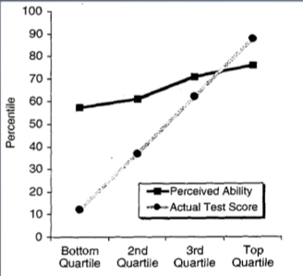
Becoming Aware
Kruger & Dunning, 1999
Notes:
The Dunning–Kruger effect is a cognitive bias which can manifest in one of two ways:
1. Unskilled individuals suffer from illusory superiority, mistakenly rating their ability much higher than is accurate. This bias is attributed to a metacognitive inability of the unskilled to recognize their ineptitude.[1]
2. Those persons to whom a skill or set of skills come easily may find themselves with weak self-confidence, as they may falsely assume that others have an equivalent understanding.
Kruger and Dunning conclude, "the miscalibration of the incompetent stems from an error about the self, whereas the miscalibration of the highly competent stems from an error about others".[2]
Students within our ‘at risk’ classroom can be seen as identified by Kruger and Dunning. There are those who drastically over estimate their skills – because they could ‘do it in high school … so something is wrong with the university, there profs etc. AND there are those who strive to be perfect, overwork themselves as they strive for this perfection, and fail … as they can no longer be ‘perfect’, and this poor self confidence leads to sever anxiety, depression and an inability to preform in pressure filled situations.

Slide 6
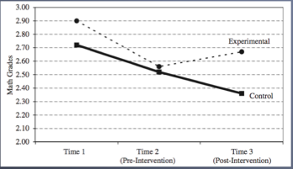
Becoming Aware
Blackwell, Trzesniewski & Dweck, 2007
Notes:
Math study which monitored belief systems of math students at different time points in their math degree based on the Dunning & Kruger Effect .
Experimental group was given lessons to assist in the improvement of their self awareness and metacognitive abilities between time point 2 and time point 3.
Time One: Math Grades before the start of the semester
Time Two: Math Grades during the semester
Intervention for Experimental Group
Time Three: Post intervention Math grades also correlated with positive motivational trends and positive beliefs in ability to be successful vs. control group which continued to decline.

Slide 7
Two ‘At Risk’ Students Journeys to Understanding Themselves
Notes:
Looking at a retention program which focuses on metacognitive awareness … and uses emotional intelligence and personality types to help students to gain a level of understanding around themselves.

Slide 8
Application of Student Voice
“Through scheduling, organization, self-awareness, academic skills including problem solving, note taking, reading, essays, report writing, midterm preparation, test taking strategies, and last but not least, memory and learning, I was able to rediscover myself and see myself in a new light. I feel that I really understand myself better now after having done personality tests, application assignments and e-portfolios. E-portfolio’s acted like a diary to me which is cool because I never really written a diary before and because I’m able to go back and read what I wrote really allows me to see how much I’ve grown. Although the course was meant to help students improve their grades by learning basic skills and strategies, I feel that this course offers so much more then just that. Maybe it’s only me that feels this way but I really enjoyed learning about myself in an academic way….”
MODULES
ASSIGNMENTS
OUTCOME & CONNECTION FORWARD
Notes:
Geri to read quote and andrea to pause her at each place to explain the sections .. .
In an effort to create A ‘Portrait’ of At Risk University Learners and Explore these two learners Belief Systems, Personality Type, and Emotional Intelligence in Relation to their Academic Progress student voice which has been directly quoted from the students Ongoing ePortfolio assignment from their strategies and Skills for Academic Success course will be used.
A brief overview of the course: This strategies and skills course consists of modules which the students explore to support the creation of their own academic strategies and life skills around predefined topics.
Assignments – including the ePortfolio are completed, and feedback is provided on a weekly basis to create behavior change.
Outcomes of students thoughts / discoveries around the modules material are intentionally reflected on using student voice (or student photos’ / quotes / videos they have chosen) at the beginning of the next module to create connections between the materials – and between the students.
Pass out material on the 4 different types of assignments…

Slide 9
Learning to Say ‘No’
“I would consider myself to be a "yes" person because I always help others before working on myself. “
Notes:
Student one’s journey:

Slide 10
Meet Sandy
Your Life as a Student:
Your Life Outside of the Classroom:
What's your program? “I am currently an Honours Science student. I haven't really decided what I want to focus on during my time at UW but I have been fascinated in my Introduction to Microbiology course.”
Where's your favourite place to study on campus? “As of right now, I have not found a place on campus that I enjoy studying. I’ve tried everywhere from the SLC to MC but nothing seems to keep me more focused than when I am at home.”
What surprised you the most when you arrived at Waterloo? “Being from a small town in Northern Ontario, I was most surprised by how many different cultures there were that all came together for one common goal of an education.”
What do you like to do for fun? “In my spare time I enjoy doing many different activities, it all depends on the kind of mood that I am in. If I need to relax my mind I will either play the piano or do some Vinyasa Yoga. When I am going to hang out with my friends we will usually play oldschool video games or watch a movie. ”
Where do you call home? “For me, I have many different "homes". Although born in Sudbury, I was raised in Petawawa, Ontario for most of my life. Currently, my father and two youngest sisters live in Raleigh, North Carolina and my mother lives in Edmonton, Alberta. I guess you could say that I technically live in Cambridge now, although I wouldn't exactly call it "home" yet.”
Notes:
Geri Ask questions .. Andrea to answer …

Slide 11
First Year Grades
57% First Term AVG
51% Second Term AVG
Failed and Required to WD → Entered into Retention Program

Slide 12
Goals
“Although most people probably aren't very enthused by the idea of taking a UNIV 101 course, I am excited to attend class each week. I am hoping to learn more about myself. And although I am aware that it is not a substitute for a psychologist, but I am hoping that the course will help me figure out some of the reasons why I did not do well in the past and hopefully guide me into the right direction for the future.”
Notes:
Goals for the strategies and skills course

Slide 13
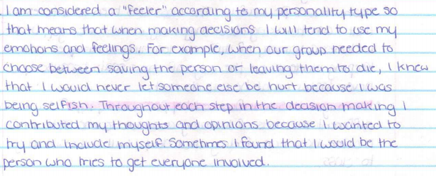
ISFJ
As Part of the Module on ‘’Self Awareness”

Slide 14
Emotional Intelligence
As rated in week 2 of the term

Slide 15
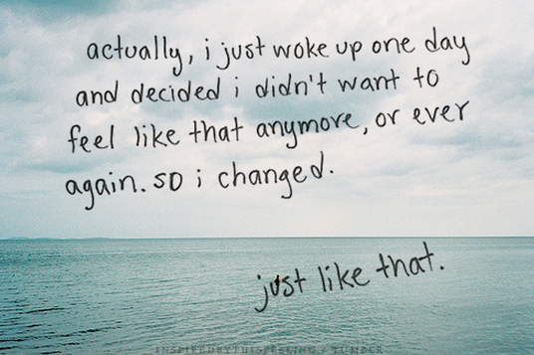

Slide 16
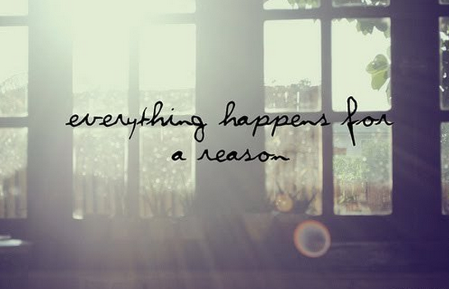
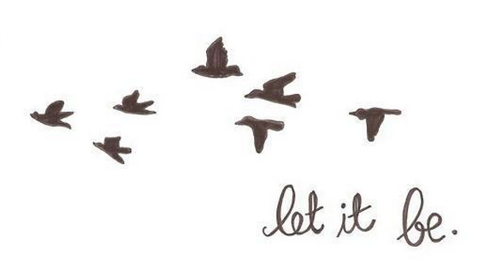
Reflections….
“My most important value is my family which can often tie into another one of my important values of happiness. …..I know that if I did talk to my family more it would probably make me a happier person. ….My family has always been very close but in the past year there have been many changes made which encouraged me to limit the communication between myself and my family. I think I am strong enough now that I can handle speaking with them more.”

Slide 17
Personal Outcomes …
“In the past I have allowed other peoples problems to take control of my life… Since I tend to focus most of my energy on helping others, I forget to do my own things. I need to focus on myself before I try to help others.”
“I have become aware of the mistakes I have made last year that may have caused me to not do as well as I should have…I've learned how to time manage with my agenda in a way that is more helpful for me.”

Slide 18
Term Outcomes …
73% Term AVG in Foundation Term
78% in Strategies and Skills Course
Met Conditions for Foundation Term → Re-admitted to her Faculty

Slide 19
Where she is now…
Entering into her final Academic Term in Fall 2014 with the hopes to graduate with her Bachelors Degree in Winter 2015

Slide 20
Learning Reality Testing
“I constantly compare myself to others and reason that they're better then me … I tend to over think things to myself. I assume I know how others feel without actually asking them so I jump to conclusions which often affects my mood.”
Notes:
Student Two’s Journey

Slide 21
Meet Darrell
Your Life as a Student:
Your Life Outside of the Classroom:
“Greetings! My name is Darrell and I'm currently a second year student at UW. I am in a General Science program, hoping to get into a Pharmacy program either at UW or at the UofT. My first impressions of Waterloo before I arrived was that it was going to be a quiet little city with not many people around but to my surprise, Waterloo was crowded to the point where I thought this city was at the verge of being over populated. The number of students I saw on the first day of class was overwhelming but after a couple of days, maybe even weeks, I got used the cluster. I was able to walk freely without bumping into fellow students. Waterloo's campus is full of scenery and liveliness everywhere I go but I prefer to be in the Student Life Centre (SLC). The SLC to me would be my favourite place to study on campus because it seems like it is the heart of the university. Everyday, many students visit the SLC for a number of reasons whether it may be for food, to meet up with friends, or even for the restrooms. For me, this is the environment I like to study in.”
“When classes are over, I usually like to hang around the SLC to go on YouTube. Occasionally, I would see my friends so I end up conversing with them for a while. At home, I usually enjoy cleaning my room with music on and going through old year books and photos while reminiscing of the past. Doing that leads me into thinking of all the idiotic things I've done in the past, but there's a famous quote by Siddhartha Buddha which states, "Do not dwell in the past, do not dream of the future, concentrate the mind on the present moment.” ….When I was asked where and what home is to me years ago, I remember saying that home to me is in Toronto, where my family and friends are at. As I grew up, I realized that home can be almost anything and anywhere. I like to think of myself as an adventurous individual so to me, the Earth is where I call home. My friends and family are all around the world, as well as a billion other people who can potentially be my friend. So, I would probably be able to live anywhere on the world!”
Notes:
Geri Darrell … andrea to

Slide 22
First Year Grades
55% First Term AVG
55% Second Term AVG
Failed and Required to WD → Entered into Retention Program

Slide 23
Goals
“By taking the course, University 101, I hope to learn life long skills which will improve my studies and also learn more about myself as an individual….
Throughout the module on Orientation and Organization, I identified what my goals this year were going to be. My long term goal is to finish university with a GPA of 3.0 or higher. The reason why I chose this as my long term goal is because I know that this is reasonable and within my grasp.”

Slide 24
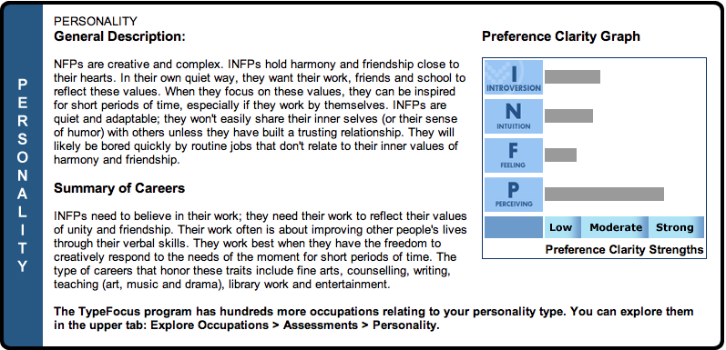
Personality Type
As part of the module on self awareness

Slide 25
Emotional Intelligence
As Rated in Week Two
“Early this week, I attended a meeting with one of the success coaches and learned more about my personality and emotional intelligence.
Some of my strengths are my impulse control, flexibility and happiness. I think this reflects me very well because I'm usually very composed and I don't over react to little things where as some people I know would be swearing and such if someone were to cut in front of them while driving.
My friends usually refer to me as the happy go lucky kind of guy but that's because of my weaknesses. My assertiveness is very low so I end up being more passive and non-confrontational. I may seem like I'm always happy but it's usually because I don't know what to say to them when I am actually upset.
…my independence is rather low. This makes me sort of disappointed in myself because I wanted to become a more independent person. On the other hand, I can look at this and tell myself that I should slowly do things on my own instead of always depending on others. “
“The EQI test really reflects myself and it gives me a better perspective of myself. It shows me areas I need to improve and also areas I should continue maintaining. The first picture below is how I feel but can't express it and the second one is how I feel when everyone else is sort of down and gloomy over small matters!”

Slide 26
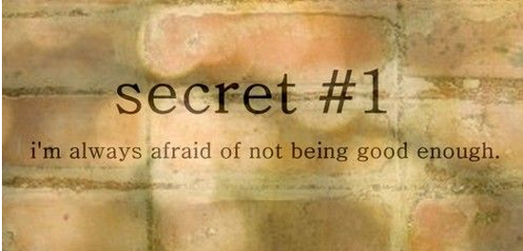

Slide 27
Reflections….
“Now that I sit back and think about this term … I was able to really get my act together and do well in my courses. It all started with a simple question of “What are your goals”. This question allowed me to really think about myself and allowed me to come up with my own goals that I wish to complete one day… In the past, I just saw school as just a place where you are either smart or not so smart. I did not have any goals, which meant I had no motivation towards school. This resulted in a terrible first year experience for myself. Currently, I feel that I am on the right track with regards to my goals and learning. I set realistic goals for myself and I am a lot more focused and serious about school.“

Slide 28
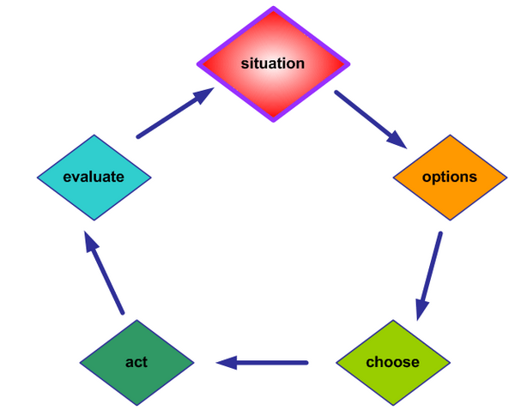
Personal Outcomes …
“If I want to become more objective and have a wider perspective on things, I should try to see things in more then one angle.”
“Instead of always siding with my close friends, I need to take a step back and analyze carefully what everyone is saying. This will allow me to understand the situation more clearly and make the right decision.”
“If I am still unsure I can ask others around for their opinions and decide once I've collected enough information on the situation. By asking others for their opinions on the situation, it is in a sense a way of seeing things from a different perspective.”
“My thoughts are not the same as everyone else. These simple strategies can help me start becoming a wiser person and a better decision maker when it comes to a situation.”

Slide 29
Term Outcomes …
73% Term AVG in Foundation Term
93% in Strategies and Skills Course
Met Conditions for Foundation Term → Re-admitted to his Faculty

Slide 30
Where he is now…
Entering his fourth year in Fall 2014 in the Faculty of Science

Slide 31
Becoming Aware
Blackwell, Trzesniewski & Dweck, 2007
Kruger & Dunning, 1999
Notes:
While not every learner in our retention program can move from the bottom quartile to between the 3rd and 4th quartile. For 65% of our students this has become a reality.
Teaching the principles of metacognitive awareness around who they are, and why they are here, and how they learn allows each student to take ownership over their own learning endeavours – and if they buy in to the experience, they are more likely to be successful during their next period of stress, low mark, or other difficult life event, or, at least to rebound from this event.

Slide 32
What does the ‘At Risk’ University Learner Look like?
What else could you consider in your analysis?
Notes:
5 minutes for thoughts to be compared to before, written down , and then discussed
What else could we help students to become more aware around?!?!

Slide 33
What does the ‘At Risk’ University Learner Look like?
What else could you consider in your analysis?
Yes People: Always putting other before themselves
Struggles with Reality Testing
Low Happiness and Optimism levels
Perfectionistic tendencies
Highly empathic and / or a high sense of social responsibility
Relatively low stress tolerance and impulse control
Poor Life Balance
‘P’ type (live ‘in the moment’, laid back, not time oriented ) Personality Traits or traits which do not align with their chosen field of study

Slide 34
Questions

Slide 35
References
Blackwell, L. S., Trzesniewski, K. H., & Dweck, C. S. (2007). Implicit theories of intelligence predict achievement across an adolescent transition: A longitudinal study and an intervention. Child development, 78(1), 246-263.
Chen, J., & Pajares, F. (2010). Implicit theories of ability of grade 6 science students: Relation to epistemological beliefs and academic motivation and achievement in science. Contemporary Educational Psychology, 35(1), 75.
Hofer, B. K., & Pintrich, P. R. (1997). The development of epistemological theories: Beliefs about knowledge and knowing and their relation to learning. Review of Educational Research, 67, 88–140.
Kruger, J. & Dunning, D. (1999). "Unskilled and Unaware of It: How Difficulties in Recognizing One's Own Incompetence Lead to Inflated Self-Assessments". Journal of Personality and Social Psychology 77 (6): 1121–34.
Morris, Errol (20 June 2010). "The Anosognosic's Dilemma: Something's Wrong but You'll Never Know What It Is (Part 1)". New York Times. Retrieved 7 March 2011.

