Slide 1
Student Engagement in Statistics Classes
Does the source of data used in statistical problem solving have any impact in student learning?
Fouzia Baki, DeGroote School of Business, McMaster University, Hamilton, ON, Canada
M. Fazle Baki, Odette School Business, University of Windsor, ON, Canada

Slide 2
Agenda
Discussion of Learning outcomes of this session
Introduction to the topic
Literature review
Discussion about data, data collection, statistical methods that are taught in introductory statistics class
Discussion of two simple statistical concepts using two different types of data
Conclusion and Discussion

Slide 3
Learning Outcomes (LO)
LO1. How simple methods can be used to involve students in classes to generate data for statistical analysis
LO2. How to uncover issues related to student learning dilemma. Sometimes students think that they would learn better if something was done differently but in reality that might be wrong. But going through the process of identifying the real issue might uncover something important that needs attention.

Slide 4
Introduction
A survey was done to learn student experience in statistical problem solving
Some of the statistical techniques are shown using data provided in textbook
Other few concepts are shown using data gathered from students
Students were asked to answer a few questions to identify relationship between learning the statistical concepts and the data used

Slide 5
Related Literature
Strasser and Ozgur (1995) reports that statistics instructors believe that a greater use of more relevant data in teaching statistics can improve the teaching and learning in statistics courses.

Slide 6
Related Literature
Tanner (1985) and Ledolter (1995) strongly believe that student involvement in data generation and/or collection process in statistics classes will make students more involved in the learning process. As a result, it ensures a deep learning.

Slide 7
Related Literature
Bisgaard (1991) says that the best way to learn it (statistics) is by participating in all phases in details of real experimentation and through data analysis of real data sets (not simulated).

Slide 8
Related Literature
Kvam (2000) suggests that long-term memory might be more easily recollected using a learning method for which the student is familiarized with the material through understanding real examples, rather than studying only the mathematical concepts and artificial problems practiced for homework.

Slide 9
What Students Learn in Introductory Statistics Classes
Tools and methods to:
Collect data
Analyze small and large amounts of data
Analyze data real time
Interpret the results and help organizations in their decision making
The limitations of the data to analyze and the methods to use to get meaningful results

Slide 10
What Are Data?
Data values or observations are information collected regarding some subject
Data can be numbers, names, etc., and tell us the “Who and What”
Data are useless without their context
Data are often organized into a data table like that below
Notes:
QTM1310/ Sharpe
10

Slide 11
Let Us Generate Some Data
Please fill out the form that are circulating in the classroom
Without asking your name or any other personal information, we request you to give us your gender, # of siblings, shoe size, and height. You also need to answer the question, “Do you believe that the source of data play an important role in learning statistical concepts?”
We are planning to use this set of data to learn one statistical concept at the end of the session

Slide 12
Two Simple Statistical Concepts
We are planning to discuss two simple statistical concepts
First concept will be shown using data given in textbook
Second concept will be shown with the data generated in class
Then we are going to see whether there is a difference in learning experience

Slide 13
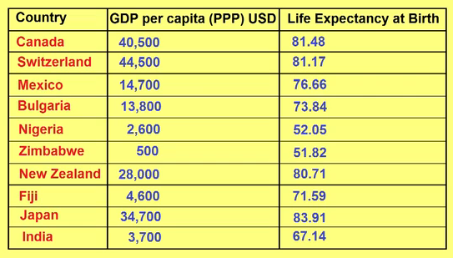
How to Make Scatter Plot Using Data Given in the Textbook (Correlation of Two Variables)

Slide 14
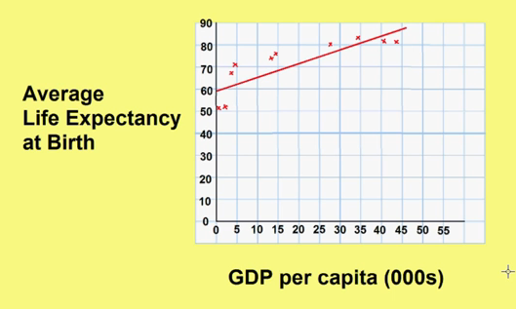
How to Make Scatter Plot Using Data Given in the Textbook (Correlation of Two Variables)

Slide 15
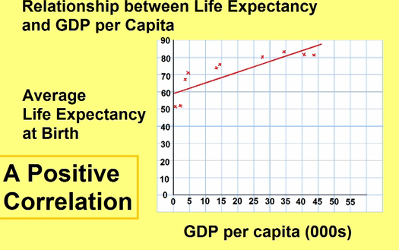
How to Make Scatter Plot Using Data Given in the Textbook (Correlation of Two Variables)

Slide 16
How to Make Scatter Plot Using Data Given in the Textbook (Correlation of Two Variables)

Slide 17
How to Make Scatter Plot Using Data Given in the Textbook (Correlation of Two Variables)

Slide 18
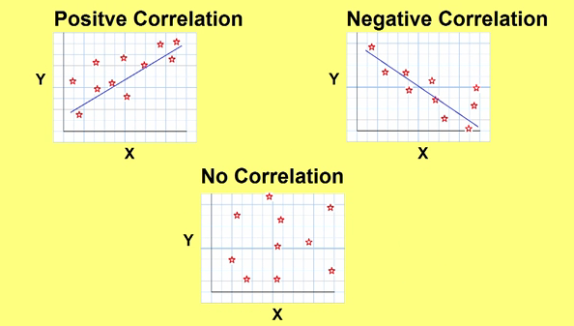
How to Make Scatter Plot Using Data Given in the Textbook (Correlation of Two Variables)

Slide 19
Understanding Correlation
Now we are going to focus on exploring relationship between two variables

Slide 20
Assigning Roles to Variables in
Scatterplots
One variable plays the role of the explanatory or predictor variable, while the other takes on the role of the response variable
We place the explanatory variable on the x-axis and the response variable on the y-axis
The x- and y-variables are sometimes referred to as the independent and dependent variables, respectively
Notes:
QTM1310/ Sharpe
20

Slide 21
Understanding Correlation
Correlation Conditions
Correlation measures the strength of the linear association between two quantitative variables
Notes:
QTM1310/ Sharpe
21

Slide 22
Understanding Correlation
Correlation Properties
The sign of a correlation coefficient gives the direction of the association
Correlation is always between –1 and +1
Correlation treats x and y symmetrically
Correlation has no units
Notes:
QTM1310/ Sharpe
22

Slide 23
Understanding Correlation
We are going to use participant generated data to show how to find correlation using Excel
Notes:
QTM1310/ Sharpe
23

Slide 24
Conclusions and Discussion
In our own study we identified that students do not see any difference data source can make in their learning statistical concept.
It is different than studies argued in literature.
What is your opinion?
Notes:
QTM1310/ Sharpe
24

Slide 25
Thank you
This study was done using grant money from Centre for Learning at the University of Windsor.
Notes:
QTM1310/ Sharpe
25

Slide 26
References
Bisgaard, S., Teaching statistics to engineers, The American Statistician, Vol. 49, No. 1, February, 1991.
Kvam, P.H., The effect of active learning methods on student retention in engineering statistics, The American Statistician, Vol. 54, No. 2, pp. 136-140, May 2000.
Strasser, S.E., and C. Ozgur, Undergraduate business statistics: a survey of topics and teaching methods, Interfaces, Vol. 25, No. 3, pp. 95-103, May-June, 1995.
Tanner, M.A., The use of investigations in the introductory statistics course, The American Statistician, Vol. 39, No. 4, Part 1, pp. 306-310, November 1985.
Notes:
QTM1310/ Sharpe
26

