Slide 1
Overview of Classroom Resources
George Preisinger
Classroom Overview – The OU Perspective
Recognize how furniture influences the learning environment
Learn how room attributes and amenities can make the learning environment comfortable, productive, and safe.
Adam Gordon
Identify the technology available and how you can us it
Explore BYOD options for student learning

Slide 2
CSITS - General Purpose Classroom Support Responsibilities
Develop, install, support and maintain classroom technology resources – replace/upgrade 5-8 year cycle (In our dreams!)
Help develop classroom standards and be an advocate for classroom improvement proposals specific to the needs of the academic community
Provide stewardship oversight on all physical plant aspects of general purpose classrooms and initiate, support and implement improvement proposals to Academic Affairs as it relates to: Room design, Furniture, Walls/floors, Lighting, HVAC, ADA/Safety, Cleaning
Field and address classroom complaints by faculty and students
Seek annual funding to help maintain general purpose classrooms

Slide 3
Current State of OU Classrooms
Master Plan - Classroom Usage Study Results
General Purpose Classrooms
Department Managed Classrooms
Event Activity taking place in Classrooms
Lowest square footage of academic building space/FTE of all State Supported Universities
Limited near future solutions for more classrooms (Southern Housing, SFH & Elliott Hall Additions)

Slide 4
Dodge Hall |  | Engin. Center |  | Hannah Hall |  | Human Health |  | Math & Science |  | Pawley Hall |  | S. Foundation |  | Varner Hall
Room | GPC? | Room | GPC? | Room | GPC? | Room | GPC? | Room | GPC? | Room | GPC? | Room | GPC? | Room | GPC?
DH 127 | YES | EC 116 | YES | HH 113 | YES | HHB 1005 | YES | MSC 034 | NO | PH 150 | NO | SFH 163 | YES | VAR 109 | NO
DH 135 | YES | EC 170 | NO | HH 120 | NO | HHB 1006 | YES | MSC 062 | NO | PH 154 | NO | SFH 164 | YES | VAR 110 | NO
DH 136B | YES | EC 178 | NO | HH 123 | YES | HHB 1031 | YES | MSC 093 | YES | PH 158 | NO | SFH 165 | YES | VAR 112 | NO
DH 167 | NO | EC 254 | YES | HH 190 | YES | HHB 1050 | YES | MSC 102 | YES | PH 162 | NO | SFH 166 | YES | VAR 127 | NO
DH 200 | YES | EC 275 | YES | HH 195 | YES | HHB 1051 | NO | MSC 120 | YES | PH 163 | NO | SFH 167 | YES | VAR 128 | NO
DH 201 | YES | EC 279 | YES | HH 204 | NO | HHB 2018 | NO | MSC 124 | YES | PH 165 | NO | SFH 168 | YES | VAR 132 | NO
DH 202 | YES | EC 281 | YES | HH 215 | NO | HHB 2023 | YES | MSC 130 | YES | PH 202 | NO | SFH 169 | YES | VAR 133 | NO
DH 203 | YES | EC 356 | NO | HH 220 | YES | HHB 2085 | YES | MSC 164 | YES | PH 204 | NO | SFH 170 | YES | VAR 134 | NO
DH 204 | YES | EC 360 | NO | HH 225 | YES | HHB 2086 | YES | MSC 168 | YES | PH 208 | NO | SFH 171 | YES | VAR 136 | NO
DH 206 | NO | EC 454 | NO | HH 230 | NO | HHB 4001 | NO | MSC 172 | YES | PH 220 | NO | SFH 172 | YES | VAR 139 | NO
DH 207 | NO | EC 455 | NO | HH 233 | YES | HHB 4005 | NO | MSC 185 | YES | PH 224 | NO | SFH 173 | YES | VAR 200 | NO
DH 209 | NO | EC 458 | NO | HH 269 | NO | HHB 4042 | NO | MSC 187 | YES | PH 230 | NO | SFH 174 | YES | VAR 205 | YES
DH 212 | NO | EC 460 | NO | HH 302 | NO | HHB 4043 | YES | MSC 284 | NO | PH 250K | NO | SFH 176 | YES | VAR 206 | YES
DH 213 | NO | EC 461 | NO | HH 318 | NO | HHB 4050 | YES | MSC 290 | NO | PH 302 | YES | SFH 263 | YES | VAR 218 | NO
DH 236 | YES | EC 466 | NO | HH 330 | NO | HHB 5001 | NO | MSC 337 | NO | PH 306 | YES | SFH 265 | YES | VAR 220 | NO
DH 237 | YES | EC 468 | NO | Wilson Hall |  | HHB 5002 | NO | MSC 364 | YES | PH 307 | YES | SFH 266 | YES | VAR 222 | NO
Elliot Hall |  | EC 550 | NO | Room | GPC? | HHB 5015 | NO | MSC 372 | YES | PH 308 | YES | SFH 268 | YES | VAR 228 | NO
Room | GPC? | EC 554 | NO | WH 102 | YES | HHB 5016 | NO | MSC 376 | YES | PH 309 | YES | SFH 269 | YES | VAR 229 | NO
EH 200C | NO | EC 555 | NO | WH 105 | YES | HHB 5020 | NO | MSC 378 | YES | PH 310 | YES | SFH 270 | YES | VAR 230 | NO
EH 202 | NO | EC 556 | NO | WH 107 | NO | HHB 5023 | NO | MSC 384 | YES | PH 312 | YES | SFH 271 | YES | VAR 231 | NO
EH 204 | YES | EC 562 | NO | WH 109 | NO | HHB 5035 | NO | MSC 386 | YES | PH 314 | YES | SFH 272 | YES | VAR 237 | NO
EH 206 | YES | EC 566 | NO | WH 110 | NO | HHB 5036 | YES | MSC 388 | YES | PH 316 | YES | SFH 273 | YES | VAR 317 | NO
EH 208 | YES | EC 568 | NO | WH 114 | NO | HHB 5037 | YES | MSC 657 | NO | PH 318 | YES | SFH 274 | YES | VAR 433 | NO
EH 210 | YES | O'Dowd Hall |  | WH 124 | YES | HHB 5045 | YES | MSC 742 | NO | PH 320 | YES | SFH 276 | YES | VAR 479 | NO
EH 212 | YES | Room | GPC? | WH 301 | YES | HHB 5050 | NO | MSC 757 | NO | PH 360 | NO | SFH 363 | YES | VAR 515 | NO
EH 214 | YES | ODH 115 | NO | WH 312 | NO | HHB 5054 | NO |  |  | PH 436 | NO | SFH 364 | YES | Vandenburg
EH 223 | NO | ODH 202A | YES | WH 313 | YES |  |  |  |  | PH 480K | NO | SFH 365 | YES | Room | GPC?
EH 235 | YES | ODH 202B | YES | WH 400 | NO |  |  |  |  | PH 488 | NO | SFH 366 | YES | VBH 105 | NO
EH 237 | YES | ODH 202C | YES | WH 400A | NO |  |  |  |  | PH 493 | NO | SFH 367 | YES | VBH 106 | NO
EH 239 | YES | ODH 328 | NO | WH 409 | NO |  |  |  |  | PH 494 | NO | SFH 368 | YES | VBH 119 | NO
EH 327 | NO | ODH 544A | NO | WH 416 | NO |  |  |  |  | Pryale Hall |  | SFH 369 | YES
N. Foundation |  | Oakview Hall |  |  |  |  |  |  |  | Room | GPC? | SFH 370 | YES
Room | GPC? | Room | GPC? |  |  |  |  |  |  | PRY 130 | NO | SFH 371 | YES
NFH 156 | YES | OVH 208 | NO |  |  |  |  |  |  |  |  | SFH 372 | YES
 |  | OVH 210F | NO |  |  |  |  |  |  |  |  | SFH 373 | YES
 |  |  |  |  |  |  |  |  |  |  |  | SFH 374 | YES
 |  |  |  |  |  |  |  |  |  |  |  | SFH 376 | YES
Total KNOWN classrooms/learning spaces = 257
Help Desk Support
Classroom Technology Engineering & Support
General Purpose
Classrooms
119
11
Department Managed
Classrooms
118*
Off-campus
Supported
Classrooms
11
4
2
2
1
Main Campus
Anton Frankel
Focus Hope
Auburn Hills UC
Baldwin Center
WHRC - Pontiac
* Credit Course Offered Winter 2016

Slide 5
Main Campus General Purpose Classrooms
Seat Counts
“Classroom Inspector” online resource for more detail.
https://wwwp.oakland.edu/csits/classrooms/
What size and types of classrooms are needed moving forward?
New classroom scheduling software should help answer this question.
314 | 1
187 - 200 | 4
144 | 1
92 - 112 | 7
80 - 85 | 9
70 - 75 | 8
60 - 65 | 7
50 - 55 | 10
40 - 49 | 47
30 - 38 | 21
25 - 28 | 3
15 | 1

Slide 6
Classroom Types
Auditorium
201 DH
Lecture Hall
1050 HHB & 116 EC
Tiered Classroom
205 VH, 200 DH
Flat Classroom (tablet arm or table/chair or combo)
SFH (37)
Computer Classroom – Desktop/Laptop
No general purpose desktop computer classrooms
Active Learning Classroom
479 VH
Square Footage per Seat
9.5 sq. ft.
25.7 & 22.5 sq. ft.
11.8 & 8.5 sq. ft.
14 & 21.5 sq. ft.
> 20 sq. ft.
> 25 sq. ft.
Redesign, Repurpose and Right-size classrooms

Slide 7
Seven Principles for Classroom Design: The Learning Space Rating System by Malcolm Brown
© 2015 Malcolm Brown. The text of this EDUCAUSE Review article is licensed under theCreative Commons Attribution-ShareAlike 4.0 license.
A great body of evidence makes a strong case for the value of active learning compared to its transmission-based predecessor, lecture-based learning.
if active learning is the goal, then our classrooms and other learning spaces are a means to achieve that goal. The built pedagogy of our campus must serve to promote, not hinder, active learning practices.
We know that learning is not confined to a single kind of physical space. Hence we use the term "learning spaces" as the name for the category that captures that aspect of our built environment designed for learning activities.
Room layout and furnishings are to classroom design as rhythm and melody are to music. Successful learning space design anticipates not just what the learners will be using but how they will be using it.
Does the existing learning space technology adequately support the activities anticipated for the classroom? (electronic, display, writing surfaces, etc.)

Slide 8
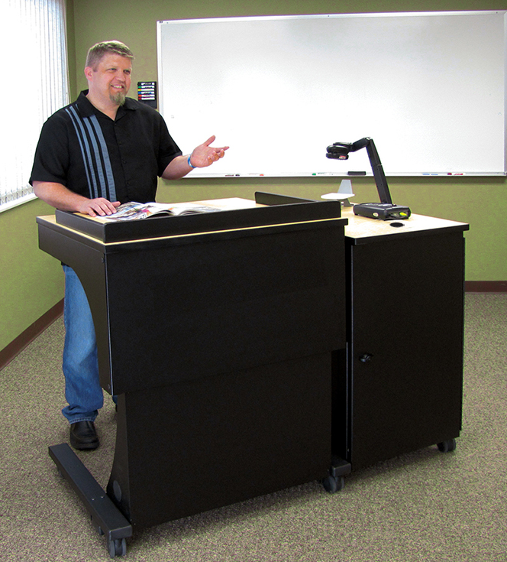
Current Instructor Desk Standard
Freedom One Sit-to-Stand Lectern

Slide 9
Supplemental Current Instructor Table
One 4’ long instructor station for front of room

Slide 10
Student furniture standard (table & chair)
5’ table for two chairs
7.5’ table for three chairs
2.5’ min table top space per chair
Table depth = 20” – 24”
Casters on tables
Tables with “nesting” desired for optimum flexibility

Slide 11
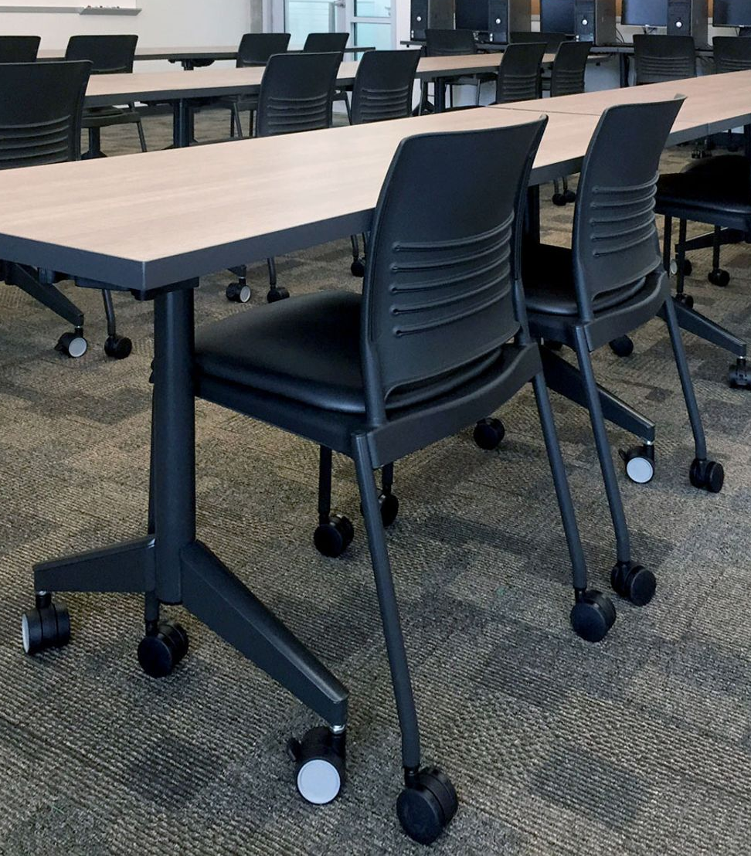
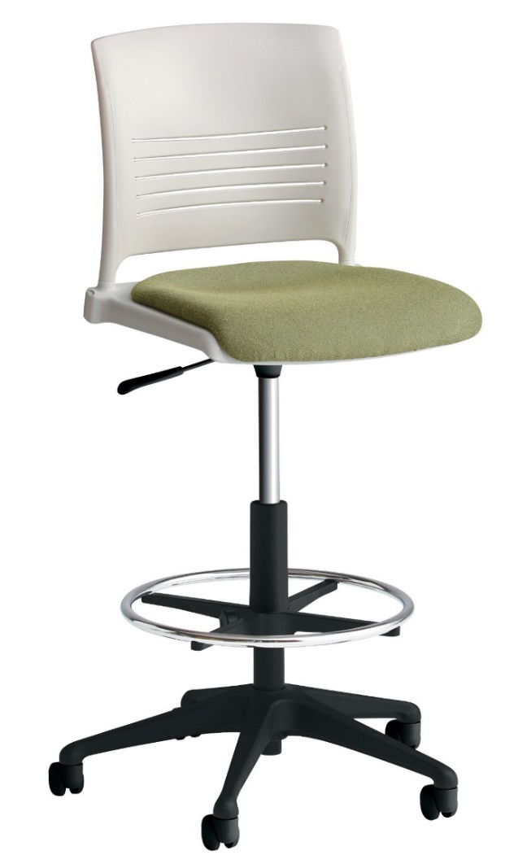
Strive Stack Chair
&
Strive Task Stool
Casters and upholstered seat

Slide 12
Convert room 102 MSC from a 108 seat classroom to two 48 seat active learning classrooms
Table Casters
Whiteboards
AC Power
Storage closet
Right-size

Slide 13
Room 164 & 168 South Foundation Hall (30 seat capacity)
Collaboration/Group Work Table Arrangement
Room layout example configured with 35 seats (budget reflects 25 seats)

Slide 14
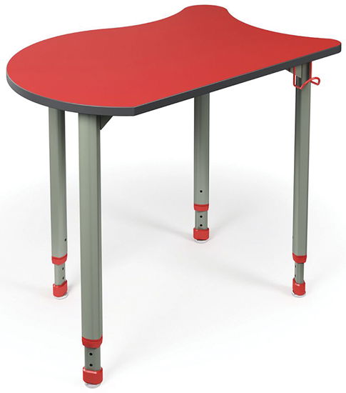
Room to contain 28 student chairs/Computer Comforts KOI tables
KOI Table - Color sample:
Sunray Texture
Laptop cart
Presentation desk
Front of room (projection screen)

Slide 15
Four Southern Housing Complex Classrooms
Open – Fall 2018

Slide 16
March 2016 – Standard Classroom Technology package
Existing Room Upgrade - $16K / New Classroom Construction - $30K
Qty. | Make | Model | Description | Unit Price | Total
1 | Qomo | QIT600F | 22" Monitor with Anotation | $ 1,295.00 | $ 1,295.00
1 | Qomo | QPC70 | Document Camera | $ 609.00 | $ 609.00
1 | Crestron | DM-TX-401-C | Laptop Switcher | $ 1,119.00 | $ 1,119.00
1 | Epson | V11H703020 | Epson G6070 Video Projector | $ 2,129.00 | $ 2,129.00
1 | Crestron | DMPS3-200-C | Switcher Amplifier | $ 4,625.00 | $ 4,625.00
1 | Shure | QLXD124/85 | Wireless Mic System | $ 1,151.00 | $ 1,151.00
4 | Extron | FF220 | 2' x 2' drop in ceiling speaker | $ 250.00 | $ 1,000.00
4 | Listen Tech | LA-164 | Ear Speakers | $ 10.50 | $ 42.00
4 | Listen Tech | LR-500-072 | ALS Receiver | $ 148.00 | $ 592.00
2 | Listen Tech | LA-166 | Neck Loop | $ 41.00 | $ 82.00
1 | Listen Tech | LA-125 | Antenna Kit | $ 36.00 | $ 36.00
1 | Listen Tech | LA-326 | Rack Mount | $ 44.00 | $ 44.00
1 | Listen Tech | LT-800-072 | ALS Transmitter | $ 496.00 | $ 496.00
1 | Crestron | TSW-1052-B-S | 10" Touch Screen | $ 1,136.00 | $ 1,136.00
1 | Crestron | TSW-1050-TTK-B-S | 10" Table Top base | $ 119.00 | $ 119.00
1 | Spectrum | 5517TK | 36" Lectern | $ 1,474.00 | $ 1,474.00
1 | Spectrum | 95522B | Monitor Arm | $ 292.00 | $ 292.00
1 | Spectrum | 55356B | Keyboard Tray | $ 143.00 | $ 143.00
1 | Spectrum | 68204IB | Flip Up Shelf | $ 233.00 | $ 233.00
1 | Spectrium | 95534B | USB Hub | $ 138.00 | $ 138.00
1 | Extron | AAP 102 | Custom Interface Box | $ 575.00 | $ 575.00
1 | Da-Lite | Varies by size and ambient light | Tensioned Advantage Electrol Recessed Electric Screen | $ 6,000.00 | $ 6,000.00
1 | Crestron | DM-RMC-4K-100-C | 4k Receiver | $ 900.00 | $ 900.00
1 | BMS | LCD Loc II | Projector Mount | $ 224.00 | $ 224.00
1 | FSR | WB-X3-GNG | Wall Box | $ 350.00 | $ 350.00
1 | FSR | FSR | Wall Box Cover | $ 325.00 | $ 325.00
1 | FSR | CB-22P | Ceiling Plate for projector with electric and pole | $ 640.00 | $ 640.00
 |  |  | Total of Parts |  | $ 25,769.00
 |  |  | 10% Contingency |  | $ 2,576.90
 |  |  | In Room Cabling |  | $ 2,000.00
 |  |  | TOTAL |  | $ 30,345.90

Slide 17
