Slide 1

Faculty Feedback
CETL Workshop
September 17, 2015
Notes:
Judy

Slide 2
Think-Pair-Share
Communicating with Students
Do you communicate with students early in the semester to let them know how they are doing, especially if there is a concern?
How do you communicate with them?
Are the MSE’s effective?
Notes:
Judy

Slide 3
Learning Outcomes
Participants will be able to:
Describe what Faculty Feedback is.
Explain why Faculty Feedback is helpful to increase student success and retention.
Compare Faculty Feedback to previous systems of Early Alert and MSEs.
Develop class activities that can easily be implemented in the first few weeks of class in order to collect some data on student engagement and student success.
List which level courses require Faculty Feedback to be submitted.
Describe the procedures in completing the Faculty Feedback in SAIL.
Be prepared to implement the Faculty Feedback system early in this fall semester.
Notes:
Judy

Slide 4
Agenda
Welcome and Introductions
Think-Pair- Share
Learning Outcomes and Agenda
What is Faculty Feedback
Why is Faculty Feedback important
How is Faculty Feedback different than Early Alert and MSE
Video
Sample Activities to collect data on early student engagement and student success- low stakes/low hanging fruit
Procedure for using Faculty Feedback
Using the Quick Notes to help remind you
Videos- Champions
Q & A
Notes:
Judy

Slide 5
Faculty Feedback
What was….
  MSEs
  Early Alert
What’s now…
Notes:
Krista
Over the past year and a half, the Early Alert Committee developed and piloted a next step to MSEs and what was formerly known as the Early Alert System
What was…
Mid-Semester Evaluations
Only offer a “U” to signify to a student that they are underperforming
The MSE date is too early for some faculty to adequately identify “at risk” students
Some faculty would prefer that the MSE date is earlier
Early Alert…
Committee:
Susan Awbrey
Judy Ableser Wallis Andersen Eddie Cheng
Beth DeVerna Darrin Hanna Bill Johnson
Krista Malley Nancy Schmitz Steve Shablin
Reuben Ternes Sara Webb
What’s happening now...

Slide 6
Faculty Feedback
Effective Fall 2015
  Replaces current MSE process
  Early Alert Committee continues to meet to refine process
  Continue to measure usage and success
  Will also compare the Faculty Feedback 2015 feature to the MSE system prior to Fall 2015.
Notes:
Krista

Slide 7
Improvements for Fall
Faculty teaching 000-, 100-, and 200-level classes
  Use a SAIL program called Faculty Feedback to notify students who seem to be struggling in a class.
  Replaces MSEs (midterm grades).
  No grades (U/S, or numerical grades) are entered.
NOTE: faculty teaching upper-level courses can use this tool as well.
Notes:
Krista
Faculty teaching 000-, 100-, and 200-level classes will now use a SAIL program called Faculty Feedback instead of “Midterm Grades” to notify students who seem to be struggling in a class.

Slide 8
Improvements for Fall
Plan to submit Faculty Feedback during weeks 2-5 of the term.
Faculty Feedback permits faculty to identify issues and suggest solutions.
Faculty Feedback generates an automatic e-mail directing the student to relevant university resources.
Notes:
Krista

Slide 9
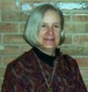
Faculty Feedback in WRT 160
Walli Anderson
Learn about her experience with Faculty Feedback.
Click here for video.
Notes:
https://www.youtube.com/watch?v=30nIOfuInvw

Slide 10
Creating Early Semester Activities
What activities/assignments could you use in the first month of class to determine if:
  Your students are attending?
  Your students are participating?
  Your students are comprehending and understanding what they need to know and do?
  Focus on creating:
  Low Hanging and Low Stakes Assignments
  DISCUSS IN GROUPS- Share back
Notes:
Judy

Slide 11
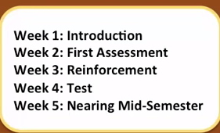

Slide 12
Examples of Early Semester Activities
Syllabus Quiz or Scavenger Hunt – to determine if they have read and understand syllabus
On-line Forums – discussions
1 Minute Papers – at end of session, pose a question and have students reflect/respond, sign and turn in
Take-aways – similar to 1 minute papers – but focus is on what main concepts or points the student will take away from the class time
Muddiest point – what concerns/sill not clear about after class
Early quizzes – on-line or face to face – short, quick
Notes:
Judy

Slide 13
How Faculty Feedback Works
Available September 3-October 30 in SAIL
Feedback can be entered once or throughout the semester. Feedback can be updated for an individual student, as necessary.
Each time feedback is submitted, an email is sent to the student
Student Support Services have access to the feedback and can direct resources
Notes:
Sara

Slide 14

How Faculty Feedback Works
Click here for video on YouTube.
Notes:
https://www.youtube.com/watch?v=R3_CGnzdWgU

Slide 15
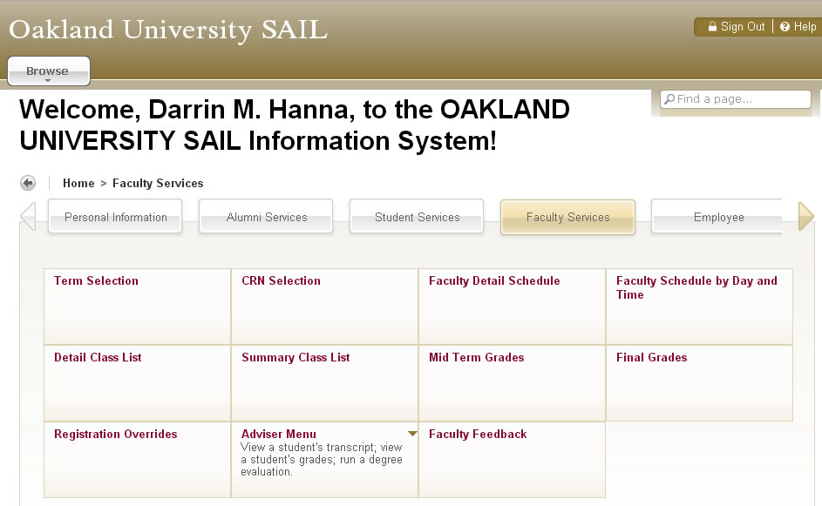
Faculty Feedback on SAIL
Notes:
Sara

Slide 16
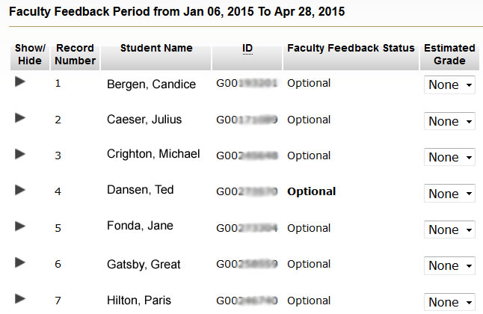
Faculty Feedback on SAIL
Select your course
Select the student
Notes:
Sara
FF Status column will always say “optional”
Estimated Grade does not need to be completed; this information will not be sent to the student

Slide 17
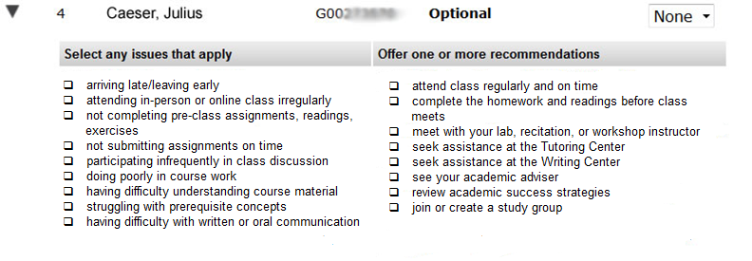
Faculty Feedback on SAIL
Select the “issue” Select the “recommendation”
on left on right
Notes:
Sara
FF program is designed to be a call to action for the student. It’s best to identify 1-2 issues and 1-2 recommendations when entering feedback.
Think --- what is the most prevalent issue preventing the student from being successful?
Think --- what is the one resource/recommendation that could help the student with this issue?
It’s important to provide useful recommendations that direct the student to proper support from the beginning.
For instance, if a student is having difficulty understanding course material, you may suggest … complete homework/readings before class meets OR meet with your lab/recitation/workshop instructor OR seek assistance in the tutoring center. It would not be as useful to send the student to his/her academic adviser.

Slide 18
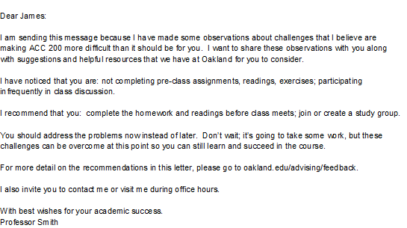
Faculty Feedback on SAIL
Email sent from OU Faculty Feedback (feedback@oakland.edu)
Notes:
Sara

Slide 19
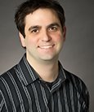
Faculty Feedback in EGR 150
Darrin Hanna
Learn about his experience with Faculty Feedback.
Click here for video.
Notes:
https://www.youtube.com/watch?v=PQPygmJlg-4

Slide 20
Questions?
oakland.edu/uge
CETL Coffee Conversation on 11/5/15
Notes:
all

